Slide 1





Open Science Orienteering
A/Prof Matthew Todd, School of Chemistry, University of Sydney
Open Science, Open Issues, Rio, August 22nd 2014
mattoddchem
Matthew Todd
http://intermolecular.wordpress.com/

Slide 2

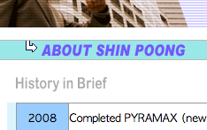
2/30
Open Project #1: Bilharzia
http://www3.imperial.ac.uk/schisto; http://bit.ly/9azFHv

Slide 3





3/30
It was a speed issue

Slide 4
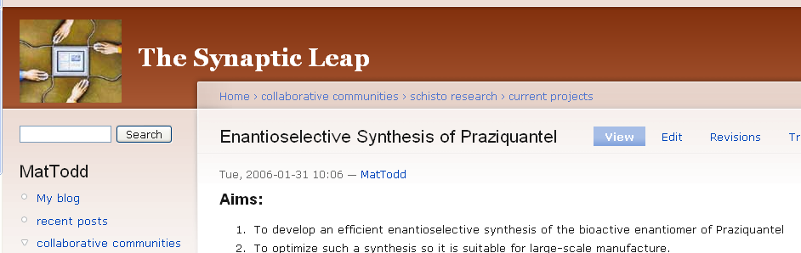
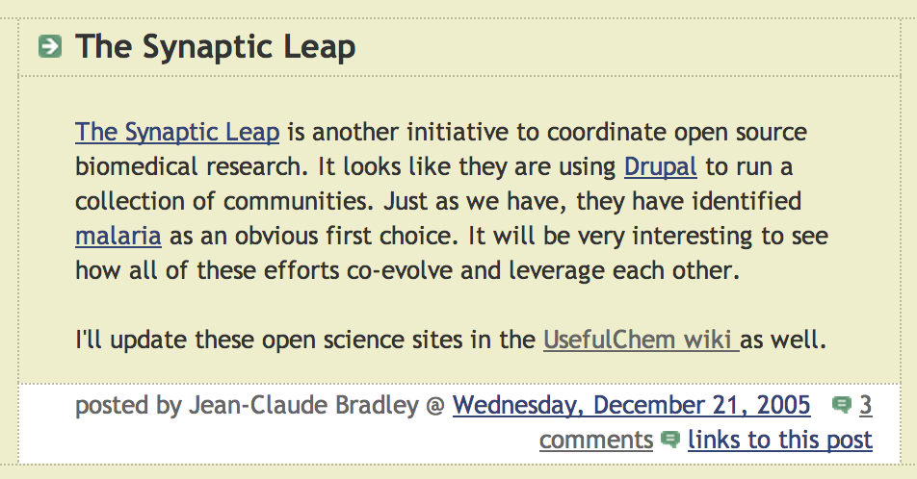
4/30
2005: Synaptic Leap and Usefulchem
α

Slide 5


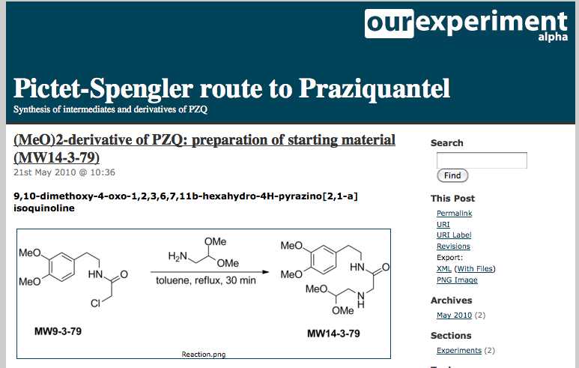
5/30
Funding and Lab Books
β

Slide 6
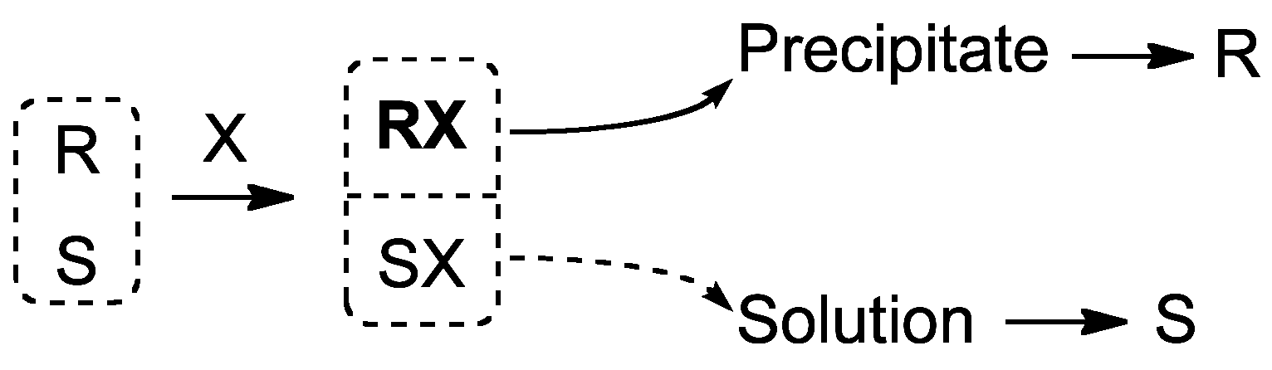
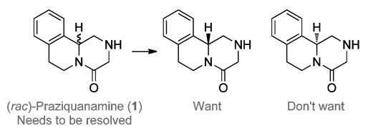




6/30
Openness and the Commercial Sector
γ

Slide 7
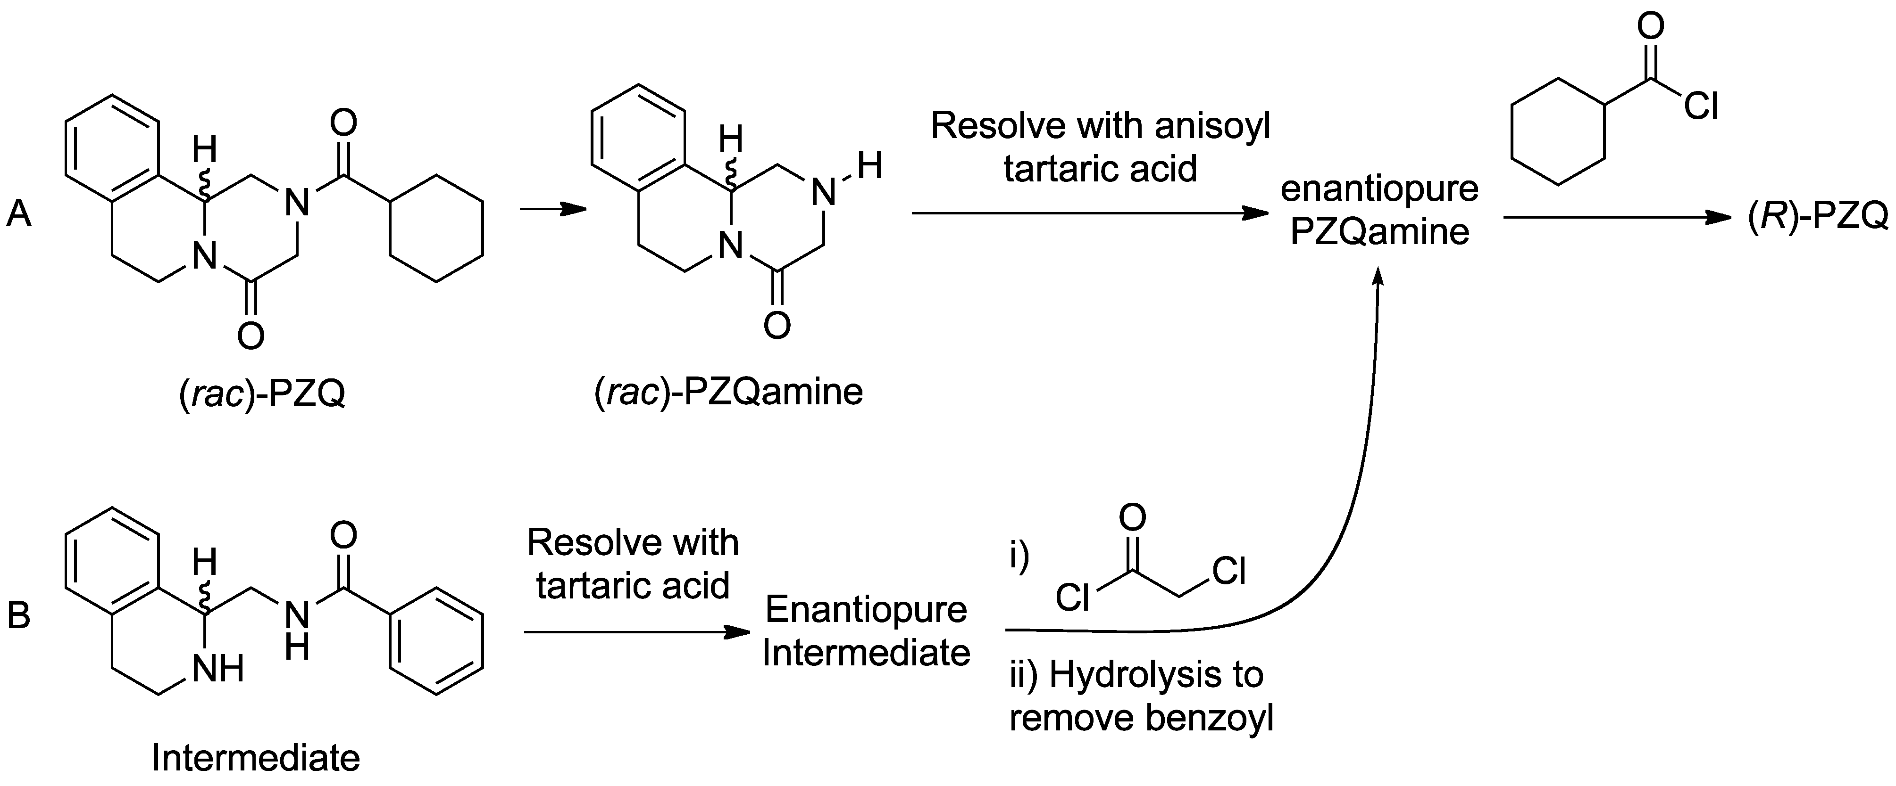
7/30
Publishing the Solution
Details of Route: PLoS NTD 2011, 5(9): e1260
Full Description of Project: Nature Chemistry 2011, 3, 745-748
δ

Slide 8
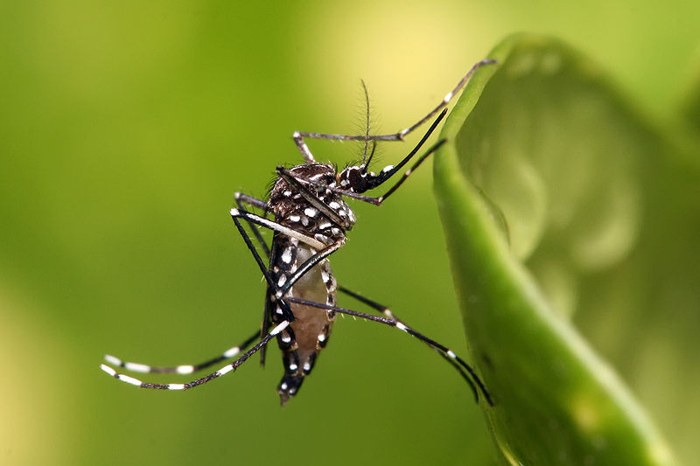

8/30
HIT
LEAD?
CONVENTIONAL DRUG DISCOVERY

Slide 9
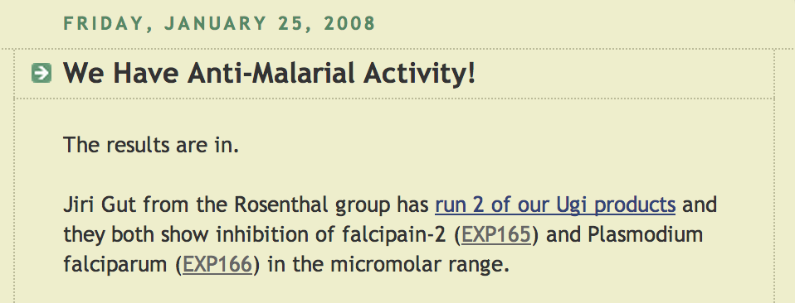
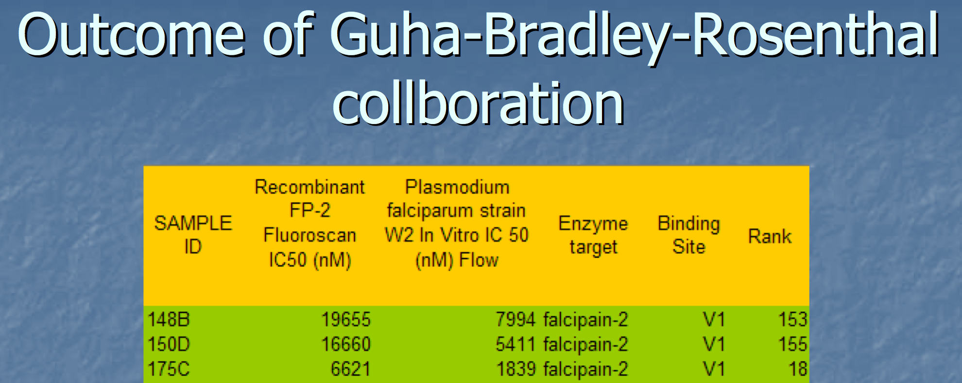
Usefulchem Malaria Project
9/30
Bradley, Jean-Claude, Rosenthal, Philip, Guha, Rajarshi, Mirza, Khalid, and Gut, Jiri. Open Notebook Science – Falcipain-2 Preliminary Results. Available from Nature Precedings <http://dx.doi.org/10.1038/npre.2008.2216.1> (2008)

Slide 10
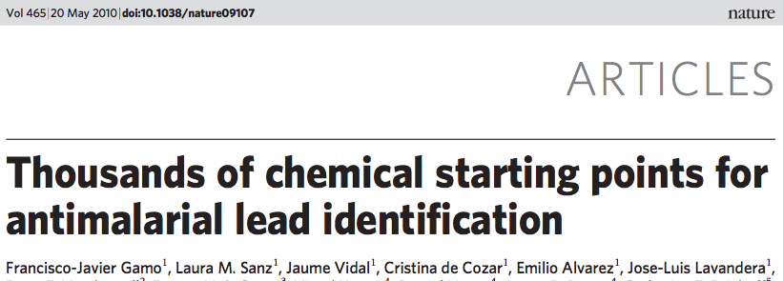
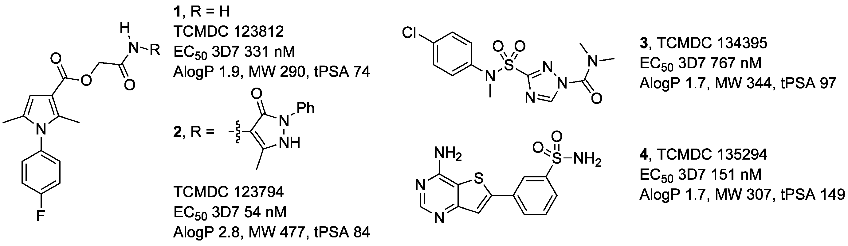
Great Starting Points
10/30

Slide 11
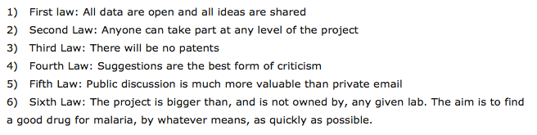

Open Source Malaria
11/30
ε
http://www.thesynapticleap.org/node/343
Landing page:
http://opensourcemalaria.org

Slide 12
OSM Series Summary
12/30
Series typically not exhausted - Decision points made to move to another.
Anyone free to employ OSM infrastructure to explore these series
http://openwetware.org/wiki/OpenSourceMalaria:Compound_Series

Slide 13
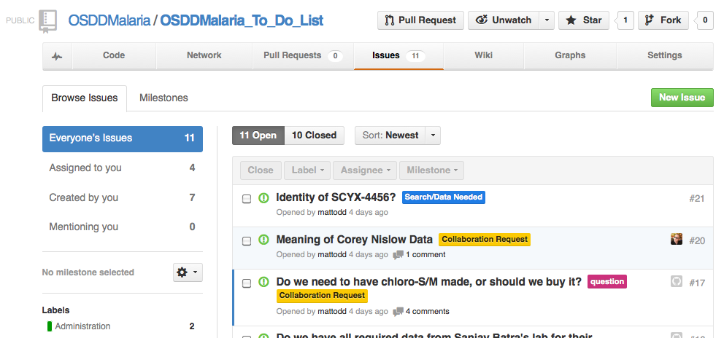
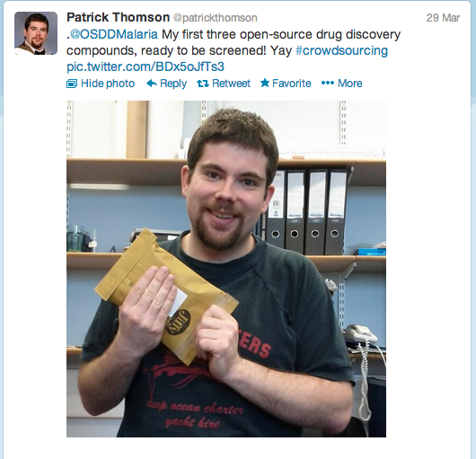

13/30
Openness Activates the Community
ONLINE LAB BOOKS
DATA MANAGEMENT
OPEN PROJECT MANAGEMENT
α,β
γ
ALERT MECHANISMS @O_S_M
ONLINE MEETINGS
γ
δ
Open Source Drug Discovery – A Limited Tutorial, Parasitology, 2014, 141, 148–157

Slide 14
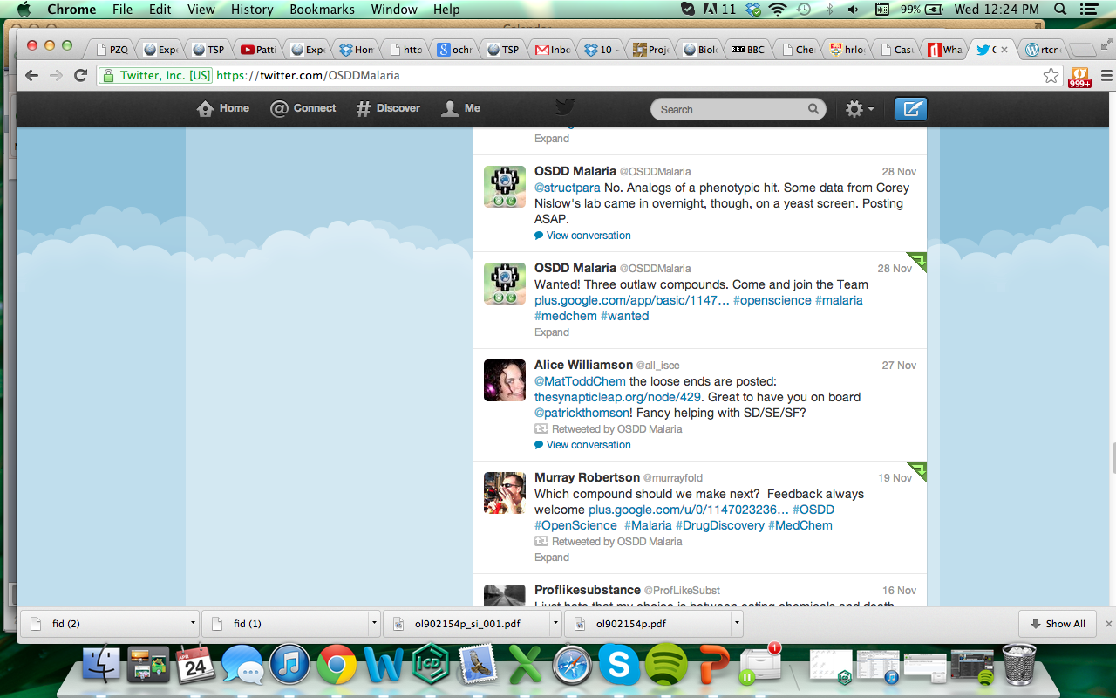
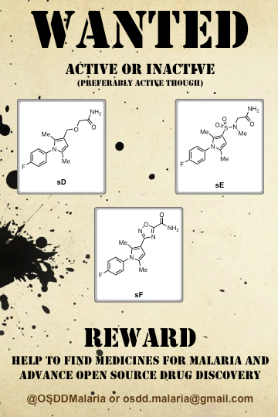
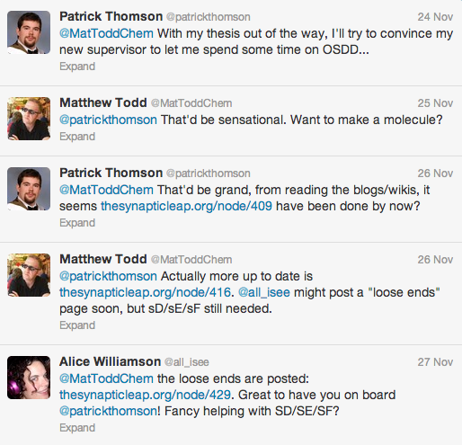
14/30

Slide 15
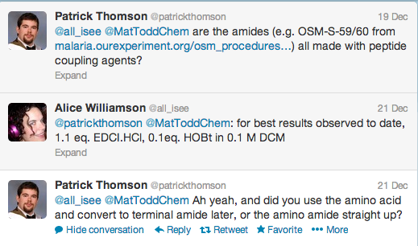
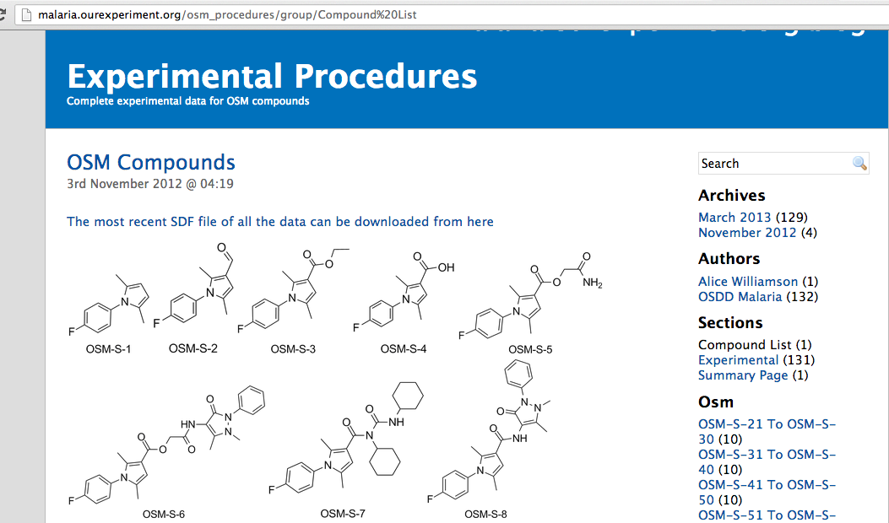
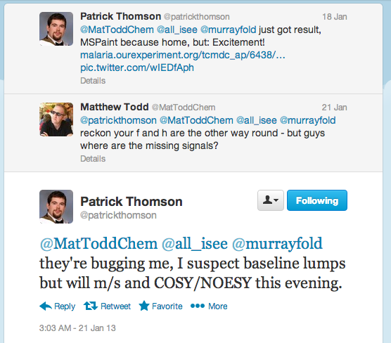
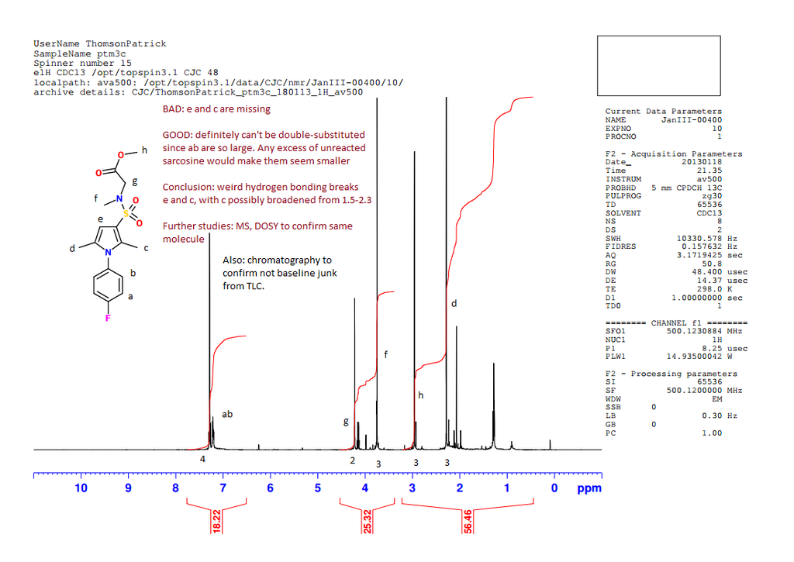
15/30

Slide 16
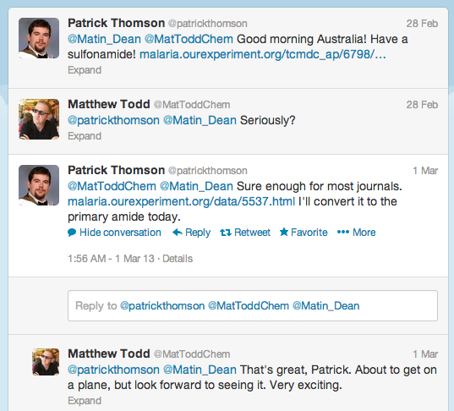
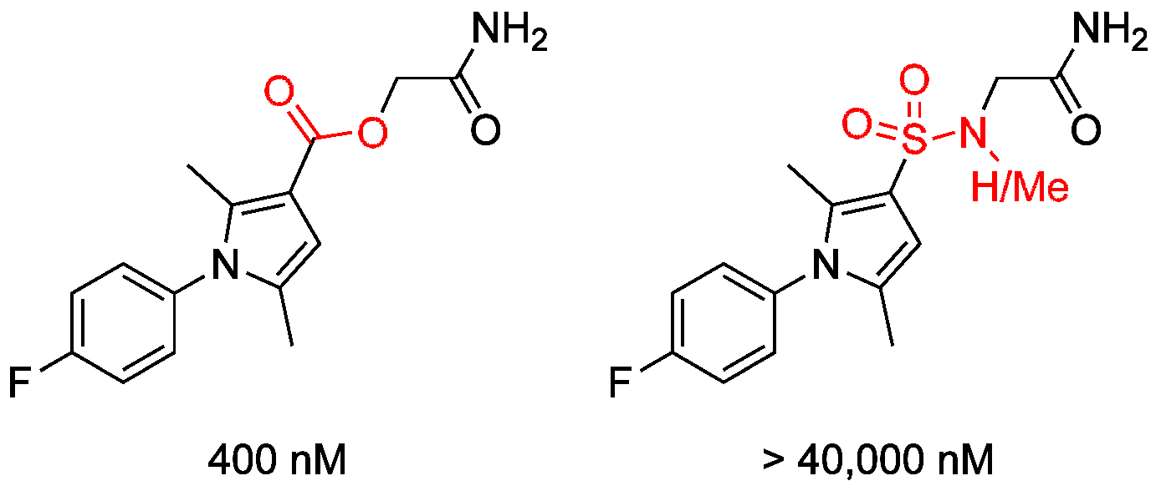
16/30

Slide 17
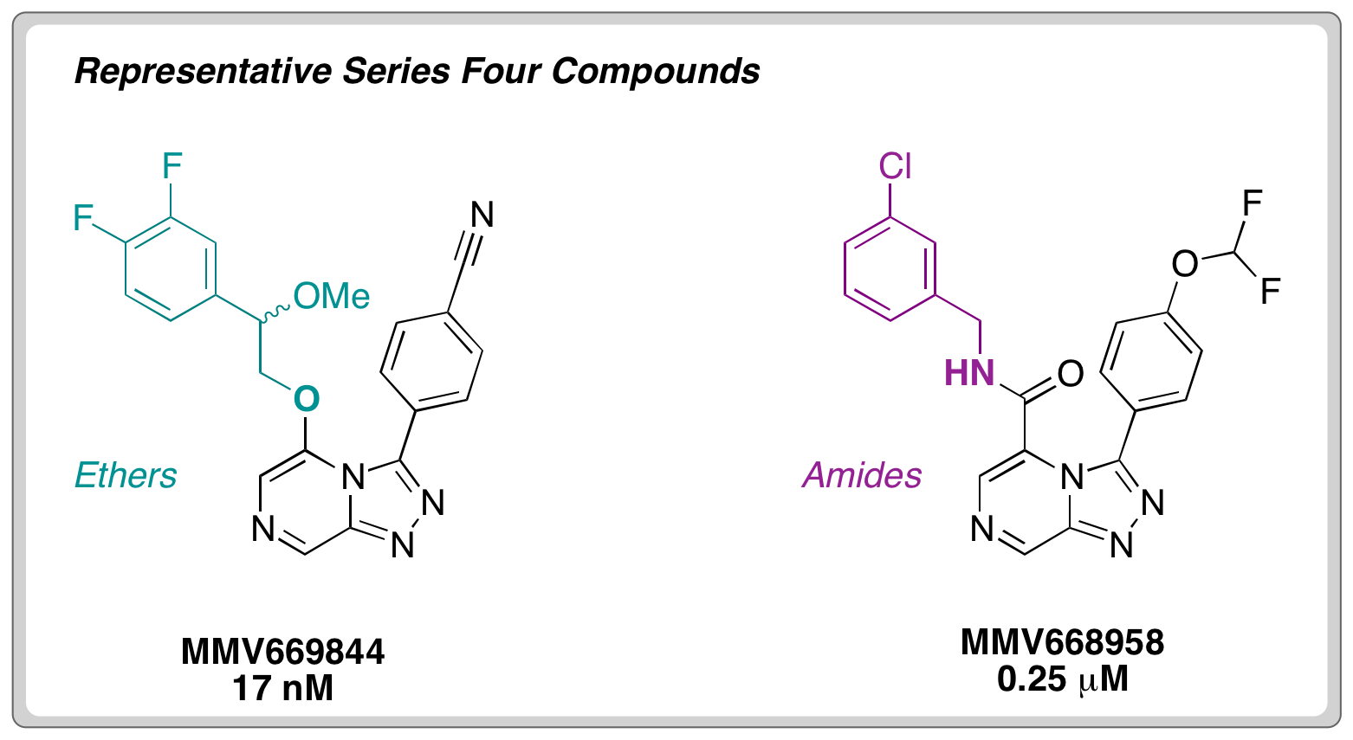
Current Focus – Series 4
17/30
Current
Rapid Parasite Clearance in Mice
What OSM Needs Now
Analog design
Organic synthesis
Prediction of pharmacophore
On-call hERG assay
Data curation/automation
Contacts at CROs
Law/Economics of Downstream

Slide 18
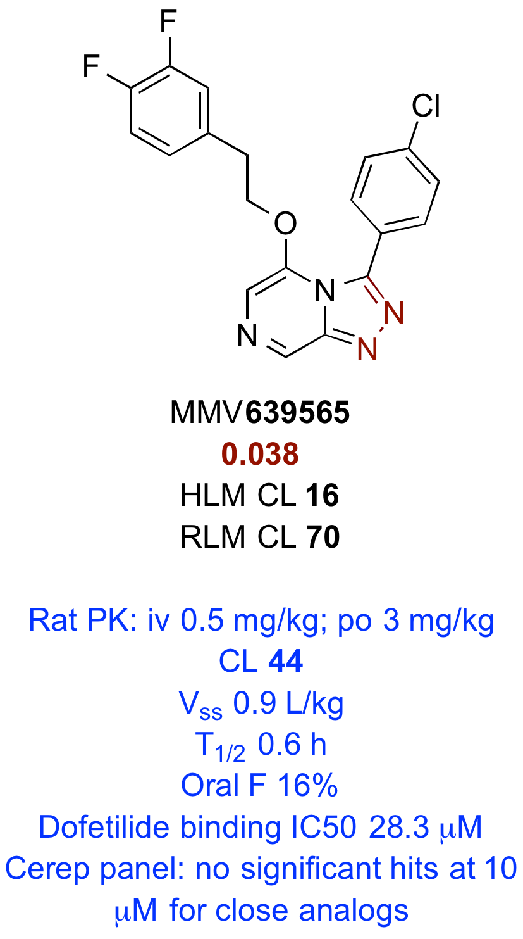
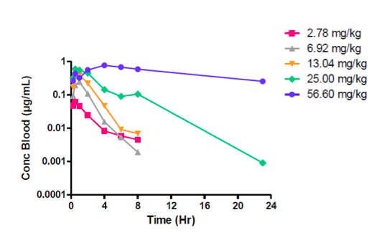
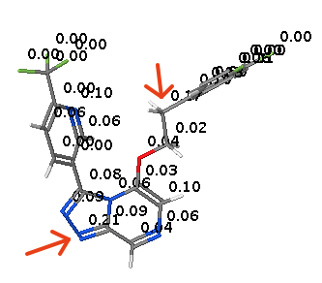
Metabolic Stability → Pfizer
18/30
Current
Chris Swain

Slide 19
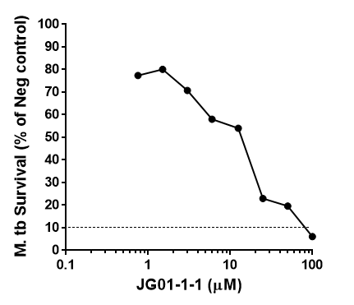
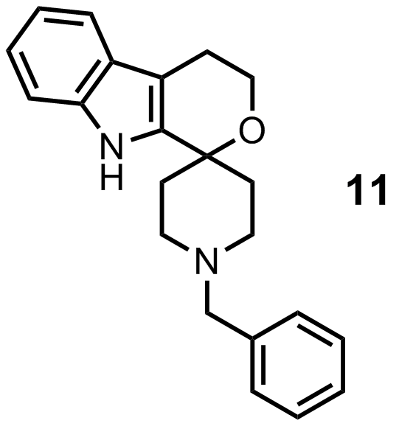
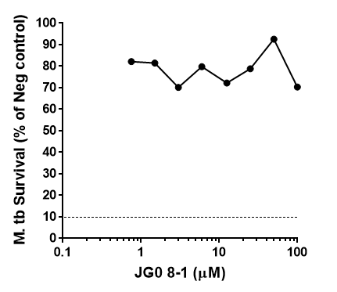
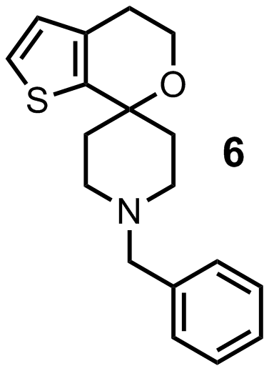
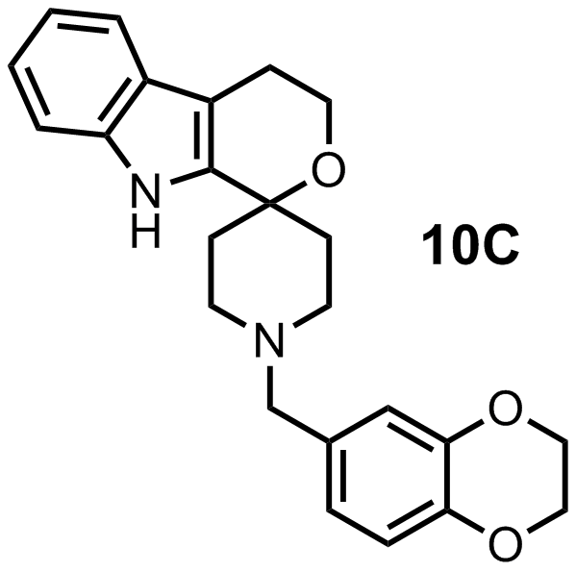
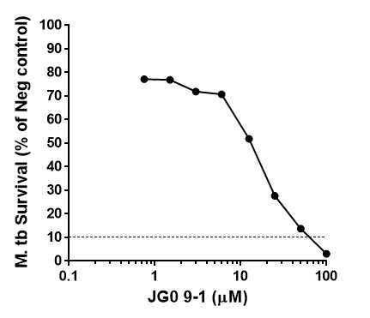
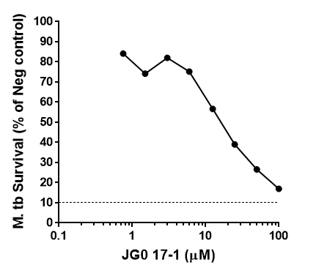
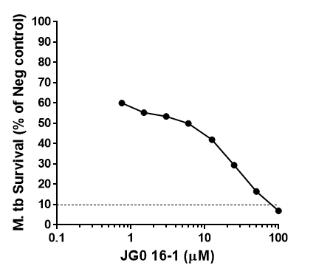
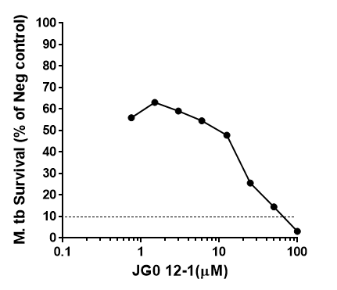
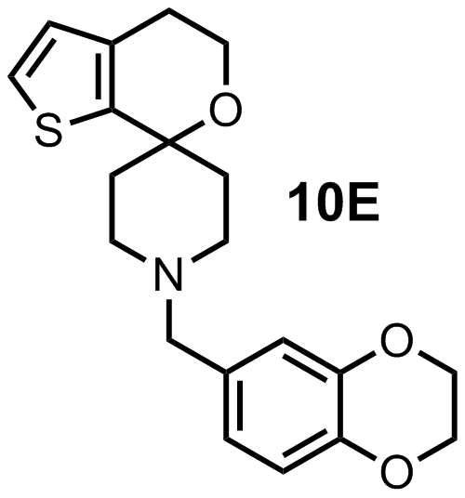
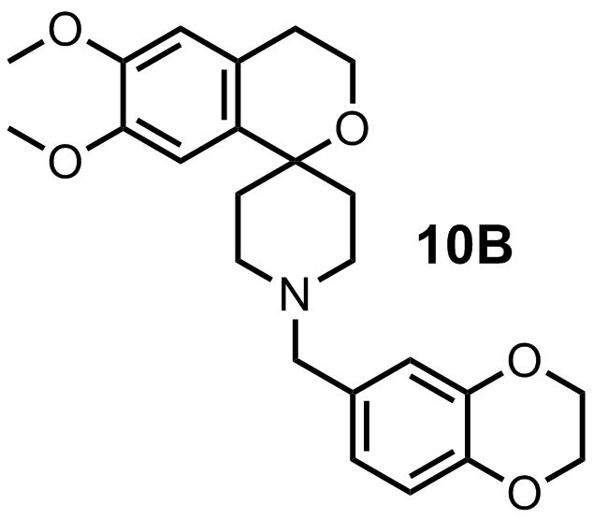
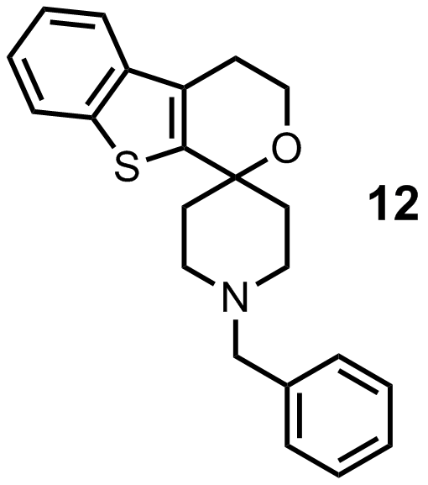
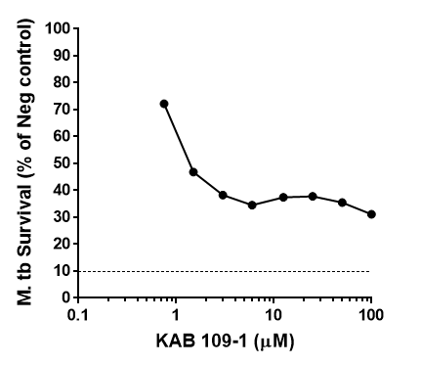
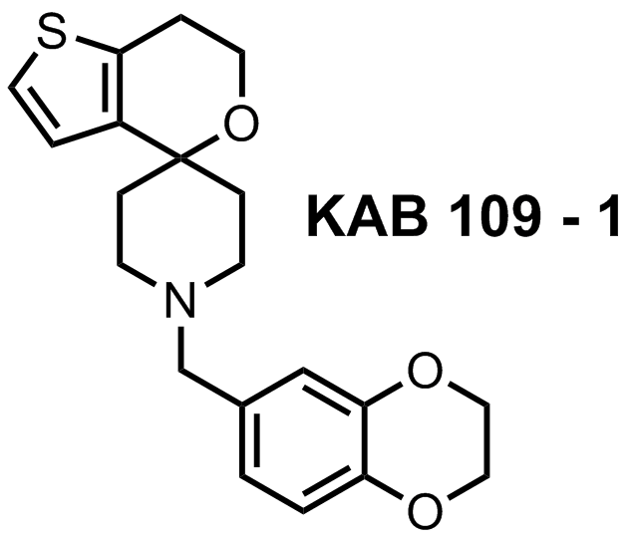
Start of Open Source TB Project
19/30
Current
With Jamie Triccas, Usyd Medicine, and GSK Tres Cantos

Slide 20
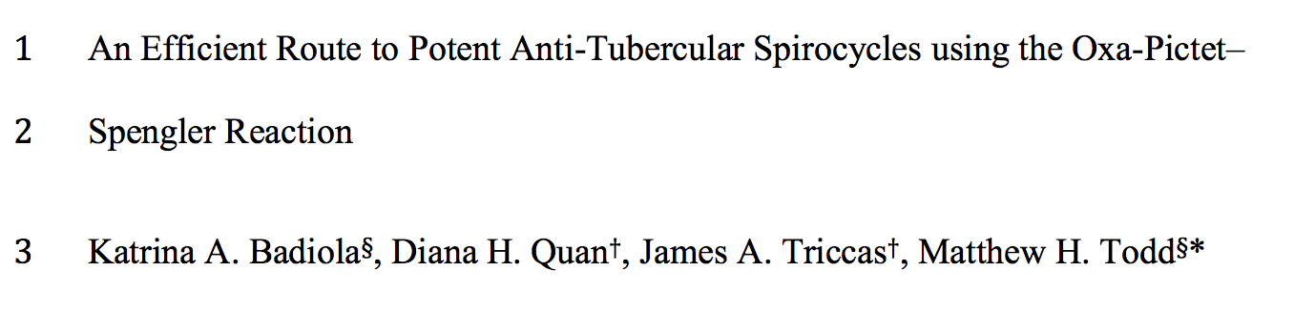
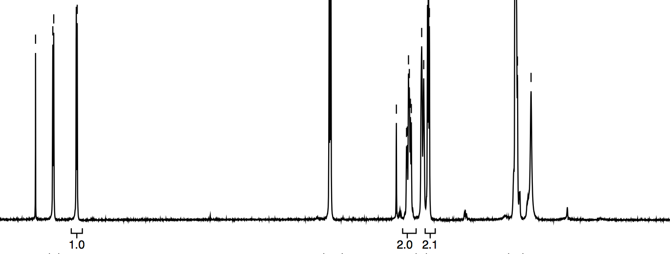

Anatomy of an Open Paper
20/30
Current
Paper
Human Proof
Data Treat
Icing on the cake?

Slide 21
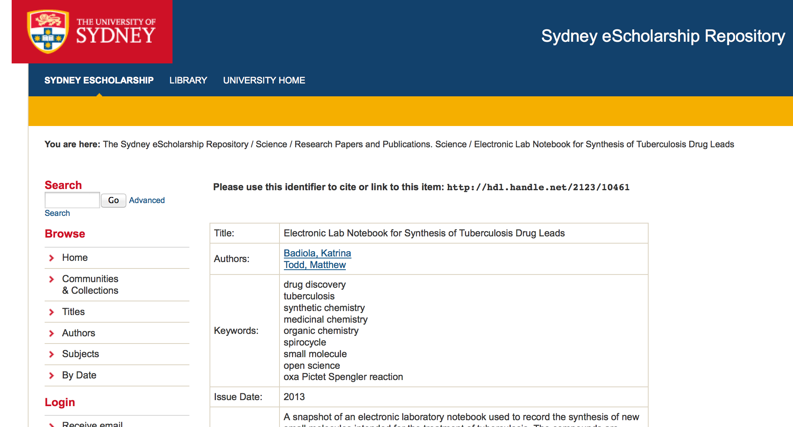
Lab Notebook Archive as SI
21/30
Current
http://ses.library.usyd.edu.au/handle/2123/10461

Slide 22
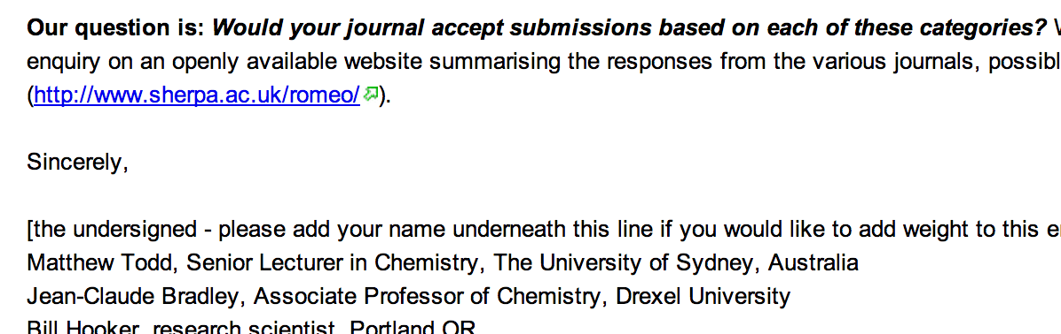
Working with JC on Many Issues
22/30
Current
http://canwepublishopenprojects.wikispaces.com/
March 19th, 2009

Slide 23
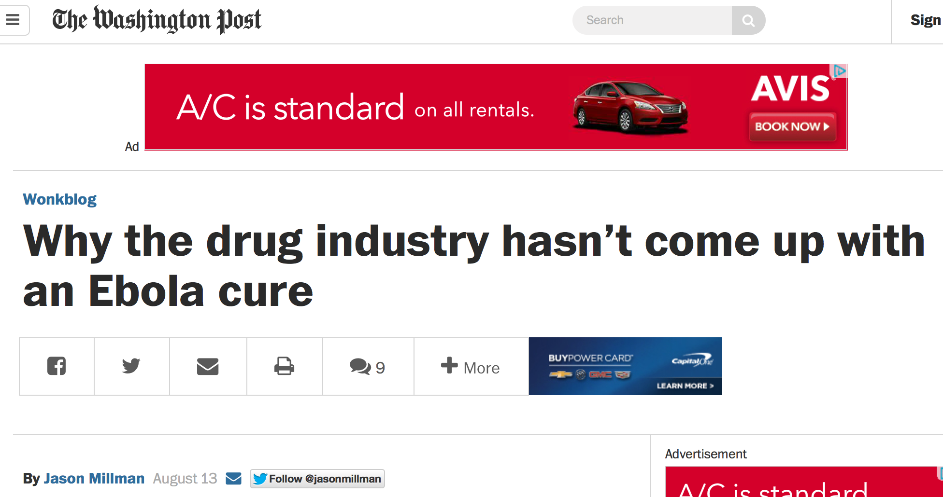
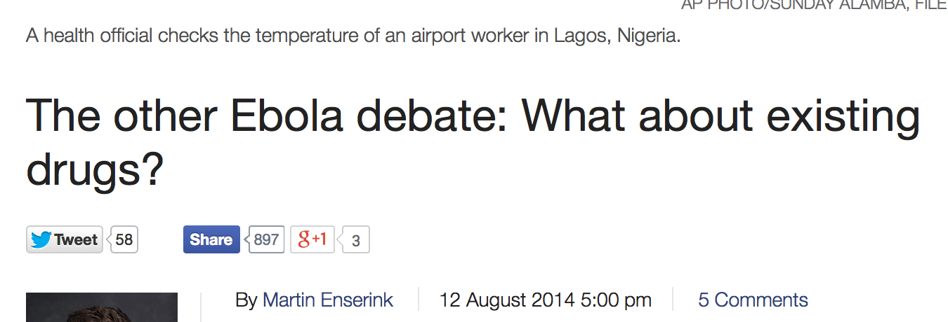
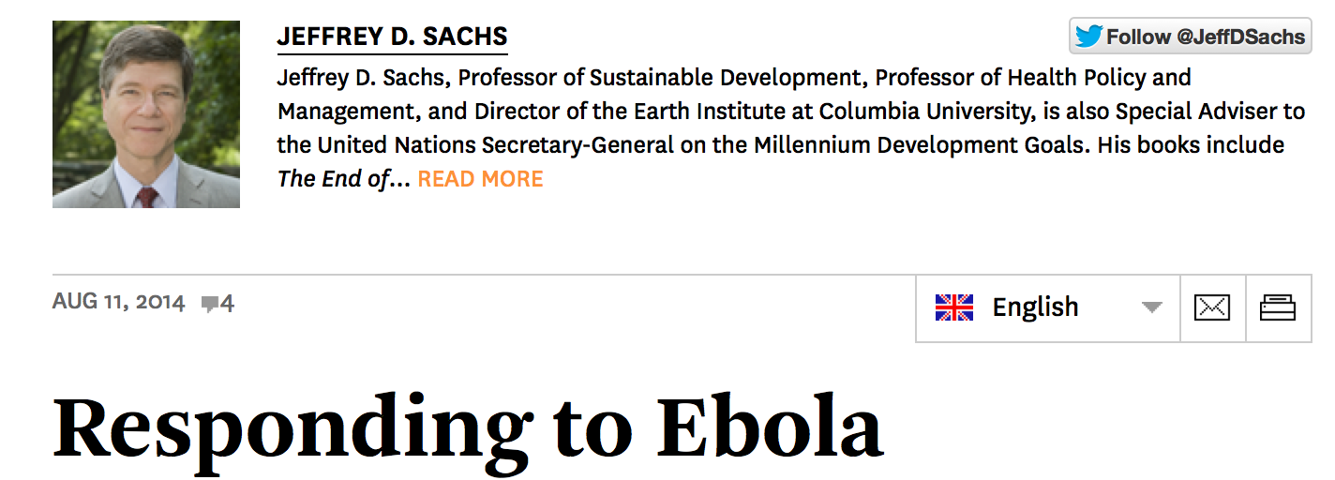
23/30

Slide 24
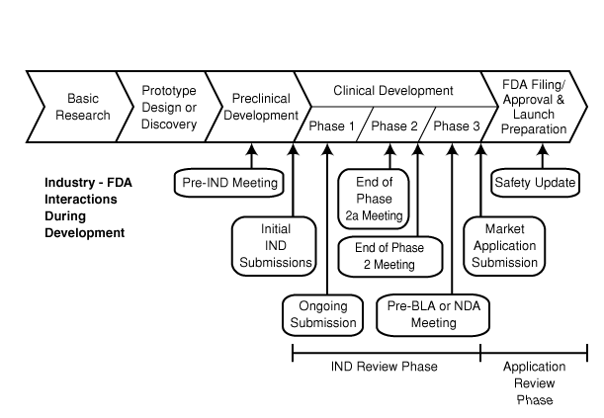
24/30
Is Open Source Drug Discovery Realistic?
100% Obvious
29% Obvious
89% Obvious
http://www.fda.gov/scienceresearch/specialtopics/criticalpathinitiative/criticalpathopportunitiesreports/ucm077262.htm

Slide 25


25/30
Is Open Source Drug Discovery Realistic?
WHO/TDR meeting, Geneva, Sept 2013
Rockefeller Bellagio Center, July 2014, #opensourcepharma
http://www.opensourcepharma.net/, @OSPInfo

Slide 26

26/30
Break a Monolithic Structure

Slide 27

27/30
Reconstruct
Nimble, self-assembly encouraged through openness

Slide 28

The Analogy
28/30
http://bit.ly/13zFJ6s

Slide 29
The Analogy
29/30

Slide 30






30/30
Sydney: Michael Woelfe, Paul Ylioja, Murray Robertson, Alice Williamson, Mike Robins, Kat Badiola, Jimmy Cronshaw, Zoe Hungerford, Laura White, Clara Chen, Angela Butera, Matin Dean, Althea Tsang, Jo Ubels, Tom MacDonald, Ingo Topolnicki, Carmen Tran WHO/TDR: Piero Olliaro Syncom B.V.: Jean-Paul Seerden MMV: Tim Wells, Paul Willis and Jeremy Burrows GSK: Javier Gamo and Felix Calderon Southampton: Jeremy Frey and team ChEMBL: John Overington, Iain Wallace, George Papadatos ANU: Kiaran Kirk Adelaide Dennis and Adele Lehane OSDD India: Sanjay Batra, Soumya Bhattacharyya Eskitis: Vicky Avery, Sabine Fletcher, Sandra Duffy Monash: Sue Charman, Karen White. Melbourne: Stuart Ralph, James Pham Basel: Sergio Wittlin Edinburgh: Patrick Thompson, Devon Scott, Eduvie Omene Stockholm: Sabin Llona Minguez UCSD: Stephan Meister Lawrence Uni: Stefan Debbert Other Online: Chris Southan, Jonathan Baell, Chris Swain and many others

