Slide 1
Open Science & Hardware: patent zombies, chimeras and future monsters
Denisa Kera
National University of Singapore
facebook.com/DenisaKera
nus.academia.edu/DenisaKera

Slide 2
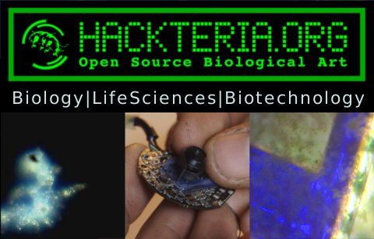
Designer & Philosopher
MA Philosophy
PhD Information Science

Slide 3
“Life Cycle” of OSHW lab equipment
Workshop
Prototype
Education, Art, Design Uses
Research Infrastructure
Bio-entrepreneurship
Indonesia: from DIY microscopes for education to hemocytometers for research & bioenterpreneurship

Slide 4
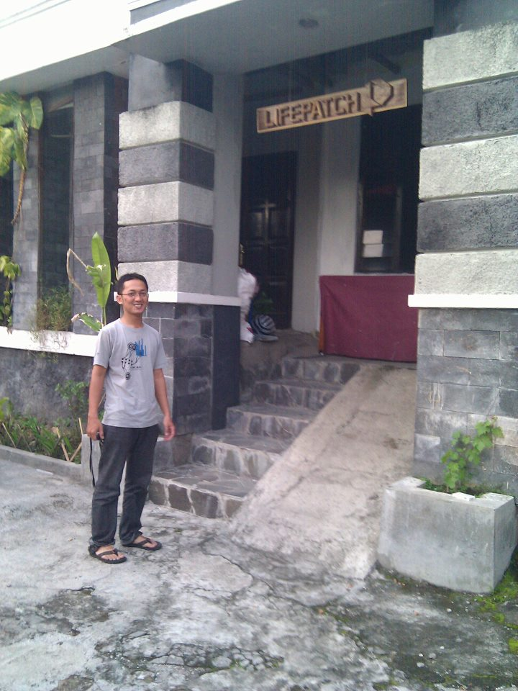
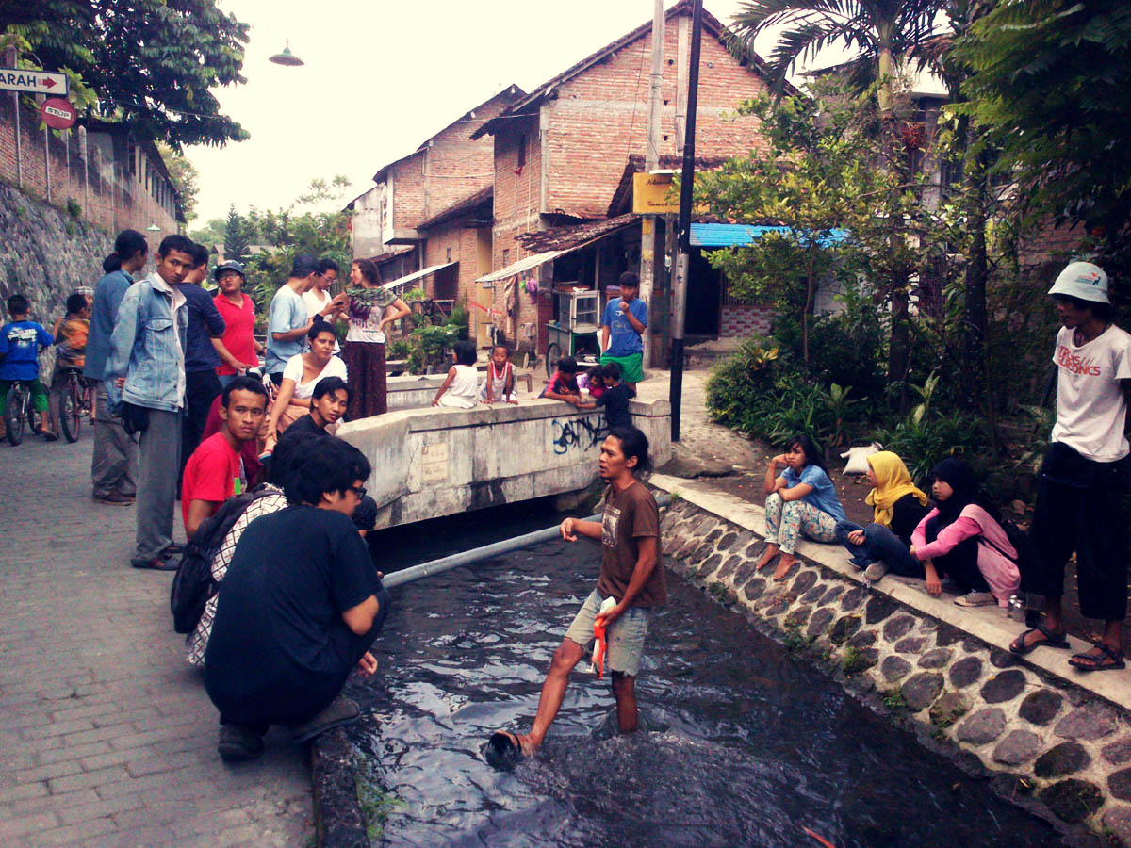
Lifepatch.org - citizen initiative in art, science and technology
Akbar - Researcher at Microbiology Lab and Consultant at Bangun Indonesia
Bugisan
Notes:
Researcher at Microbiology Lab and Consultant at Bangun Indonesia

Slide 5
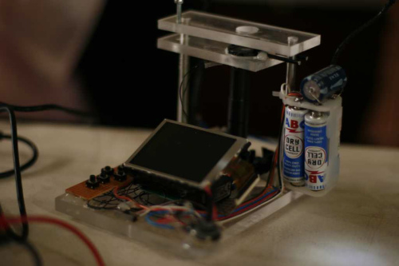
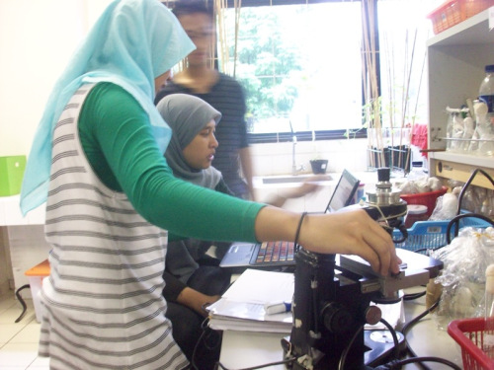
From DIY microscope to Vjing tool and professional hemocytometer
UGM university workshops
Hacked webcam - 2009
PS3 eye game console - 2010
Notes:
http://hackteria.org/?p=1637

Slide 6
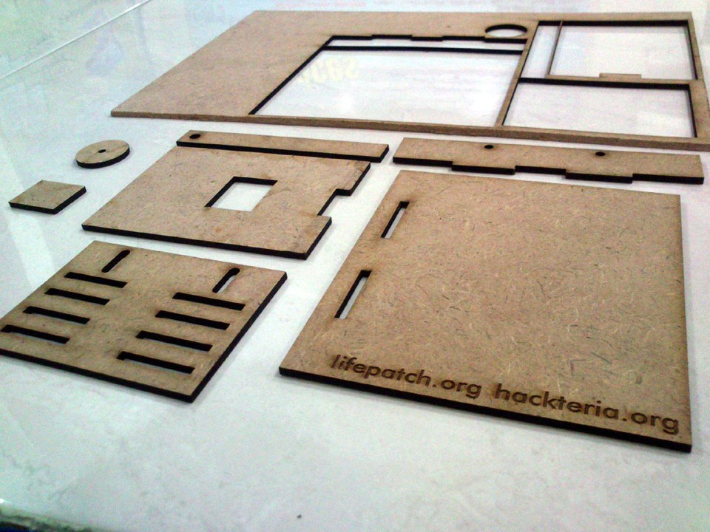
2012 – 2013 DIY Webcam Microscope Stage Kit – Urs Gaudenz/Gaudi Labs

Slide 7
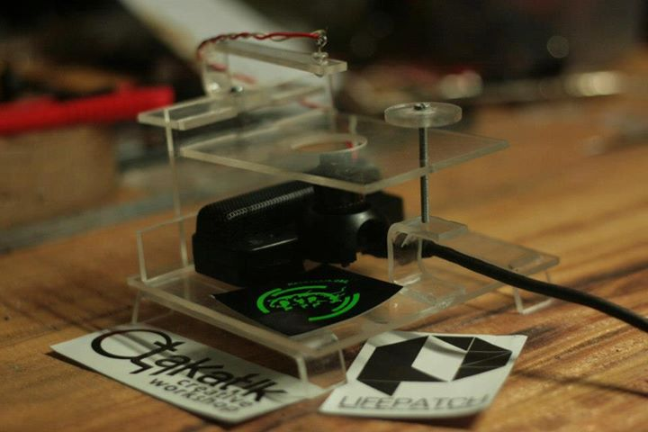
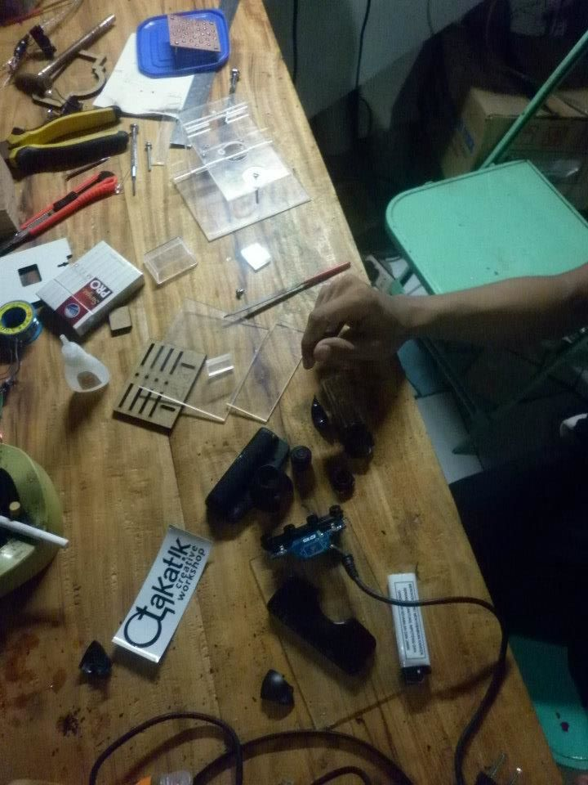
Stage kit – Indonesian clone made with local artisans
Notes:
https://www.facebook.com/media/set/?set=a.549545511747116.131034.284578538243816&type=1
http://www.flickr.com/photos/92698778@N04/8447886916/in/photostream/

Slide 8
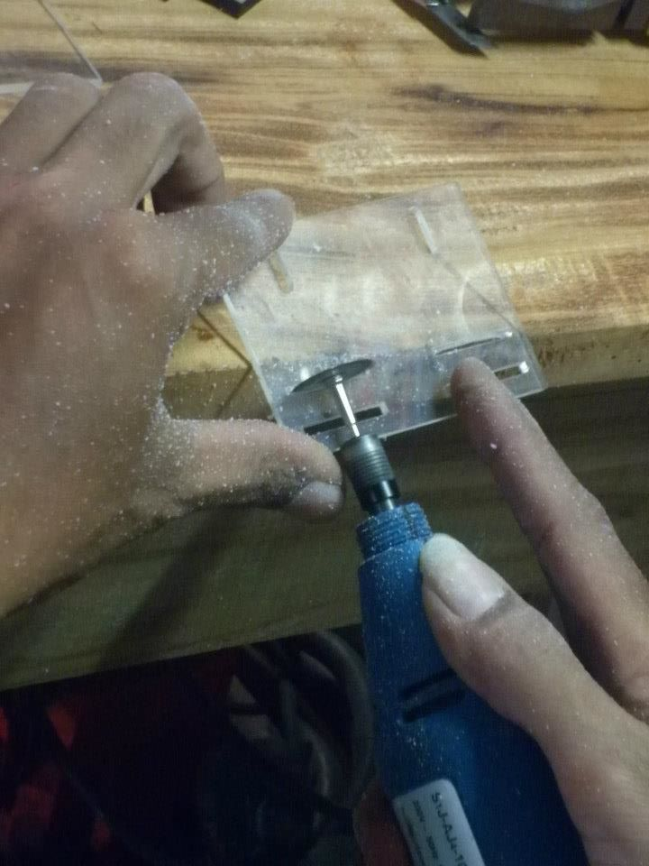
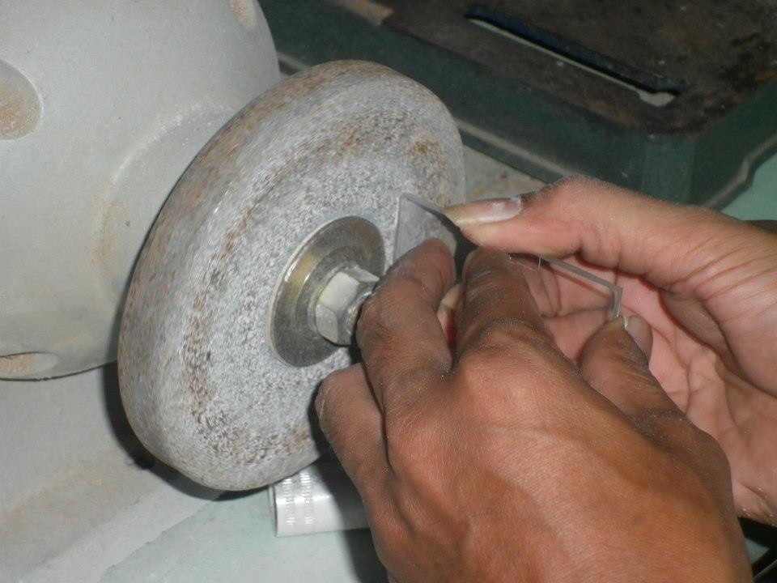
Radix Nugroho
Otakatik Creative Workshop

Slide 9
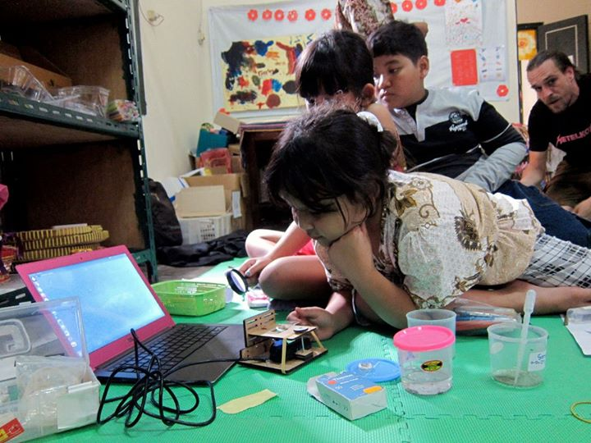
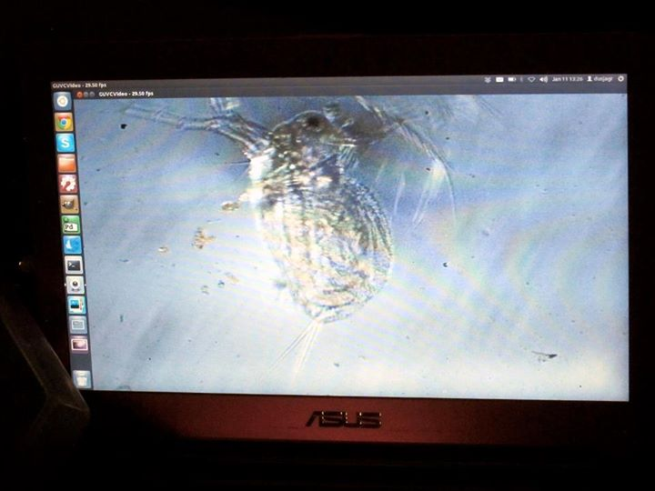
DIY Microscopy workshops with kids

Slide 10
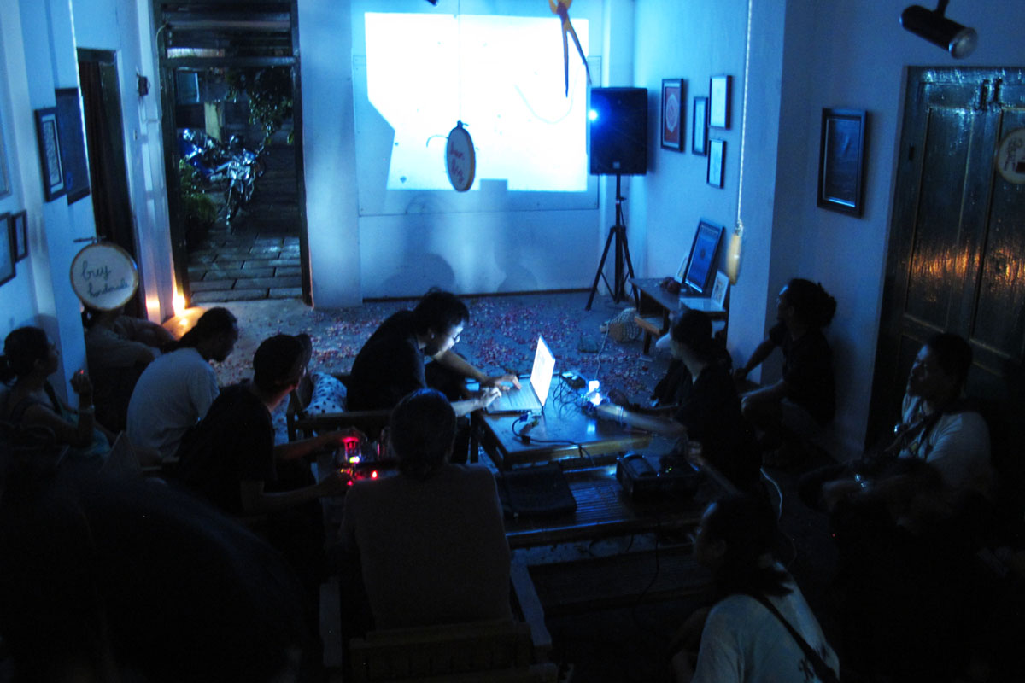
VJ-ing with microscopes

Slide 11
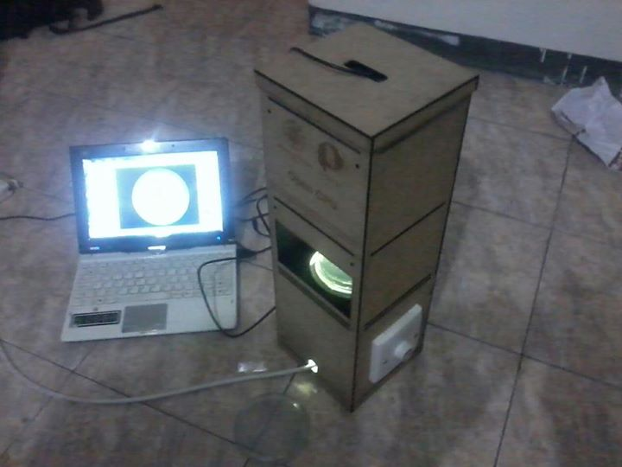
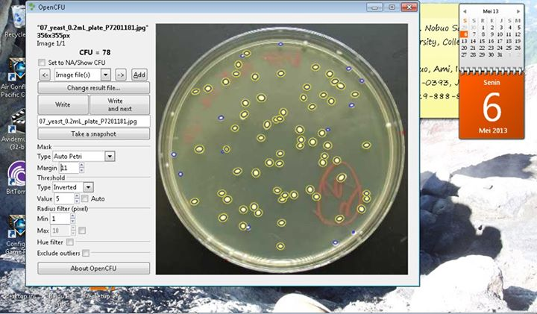
Open CFU, realtime colony counter that uses low magnification microscope webcam.

Slide 12
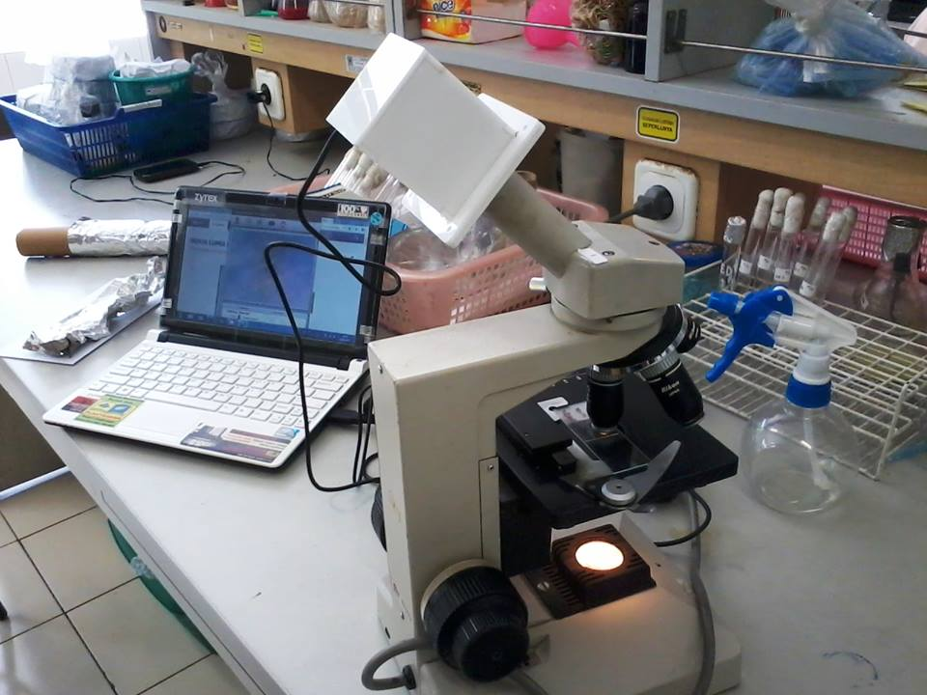
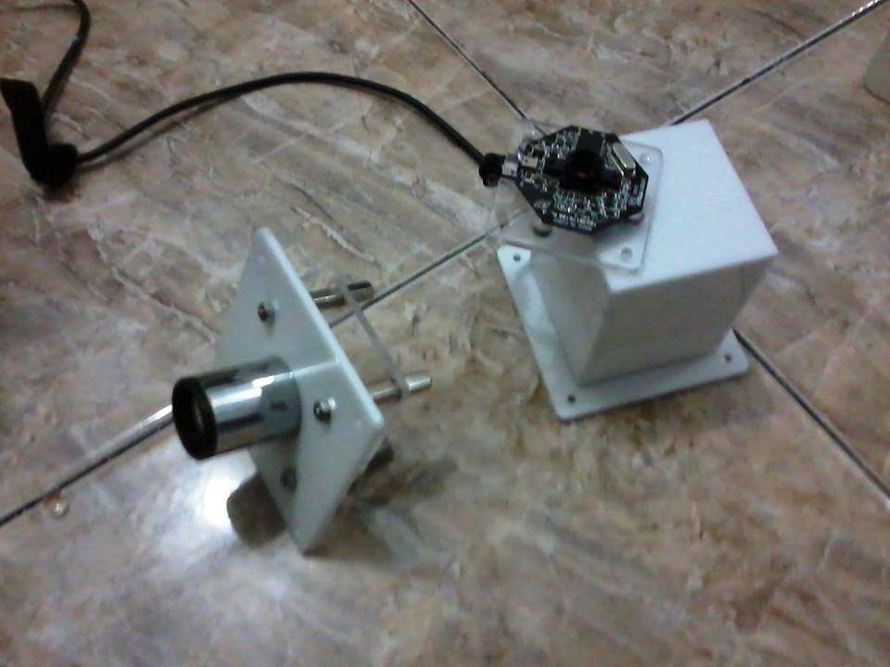
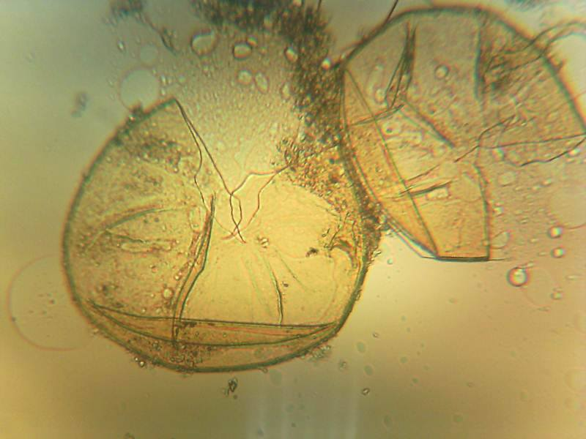
Agro-Hacking: Mycorrhizal Spores
Hacked webcams as Plug and Play microscope attachments
2MP webcam image sensor and 10x okular/eyepiece lens.

Slide 13
Open Source Hardware (OSHW)
Open Science and Citizen Science advocacy
Research infrastructure in the Global South
Open Hardware & Traditional Crafts
DIYbio prototypes collection & archive

Slide 14
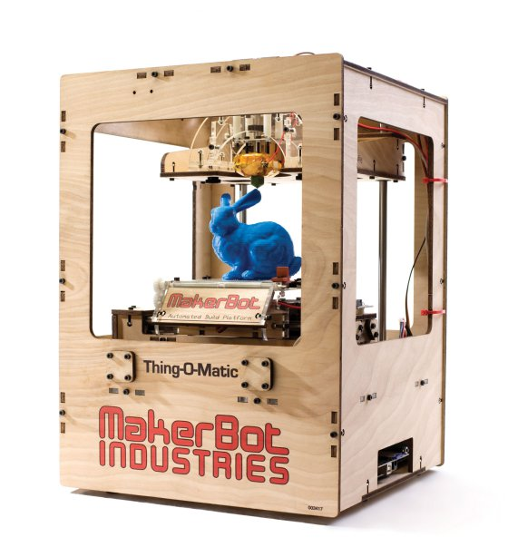
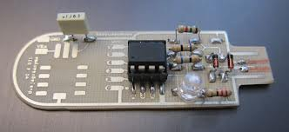

Slide 15
OSHW & Open Science education
OSHW is not really open nor it is a technology….
It is a patent zombie (expiring patents) and
chimera (semi-open)…
we need new monsters (experiment and test):
legal challenges & opportunities
stakeholders relations
empowerment (tools of production)

Slide 16
Hypotheses
Hybrids of OSHW & patents (monsters, chimeras and zombies) support technology transfer of emergent technologies & unique research infrastructure enabling North-South, but also South-South research cooperation.
Method:
Ethnography & Hackathons
Goal:
Experimental Model for Governance of Emergent Technologies & Science Diplomacy & “Science Justice” for the Global South.

Slide 17
Emergent themes
Technology transfer
hybrids of OSHW & patents, expiring patents
(biosensors)
Agro-hacking & rural hackerspaces
(spectrometers for quantifying crops & nutrient values)
Soil bioprostecting
aka Biostrike, Lifepatch.org/UGM hacks

Slide 18
Ethnography/Case studies
Open Beehives OSHW project supported by patented pesticide biosensor (SG, US)
Quantum Biosystems’ patented nanopore sequencing via OSHW (JP, US)
Biostrike (ID, CH, SG, EU, IL, NP)

Slide 19
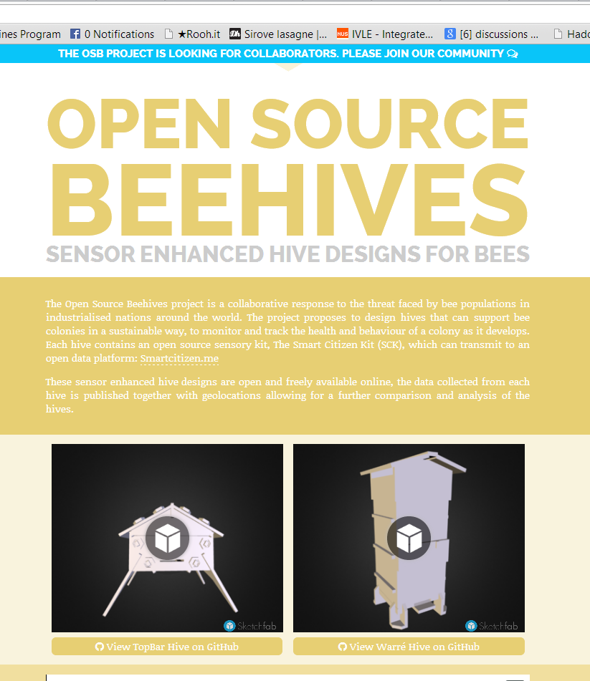
Open Beehives OSHW Project & patented pesticide biosensor

Slide 20
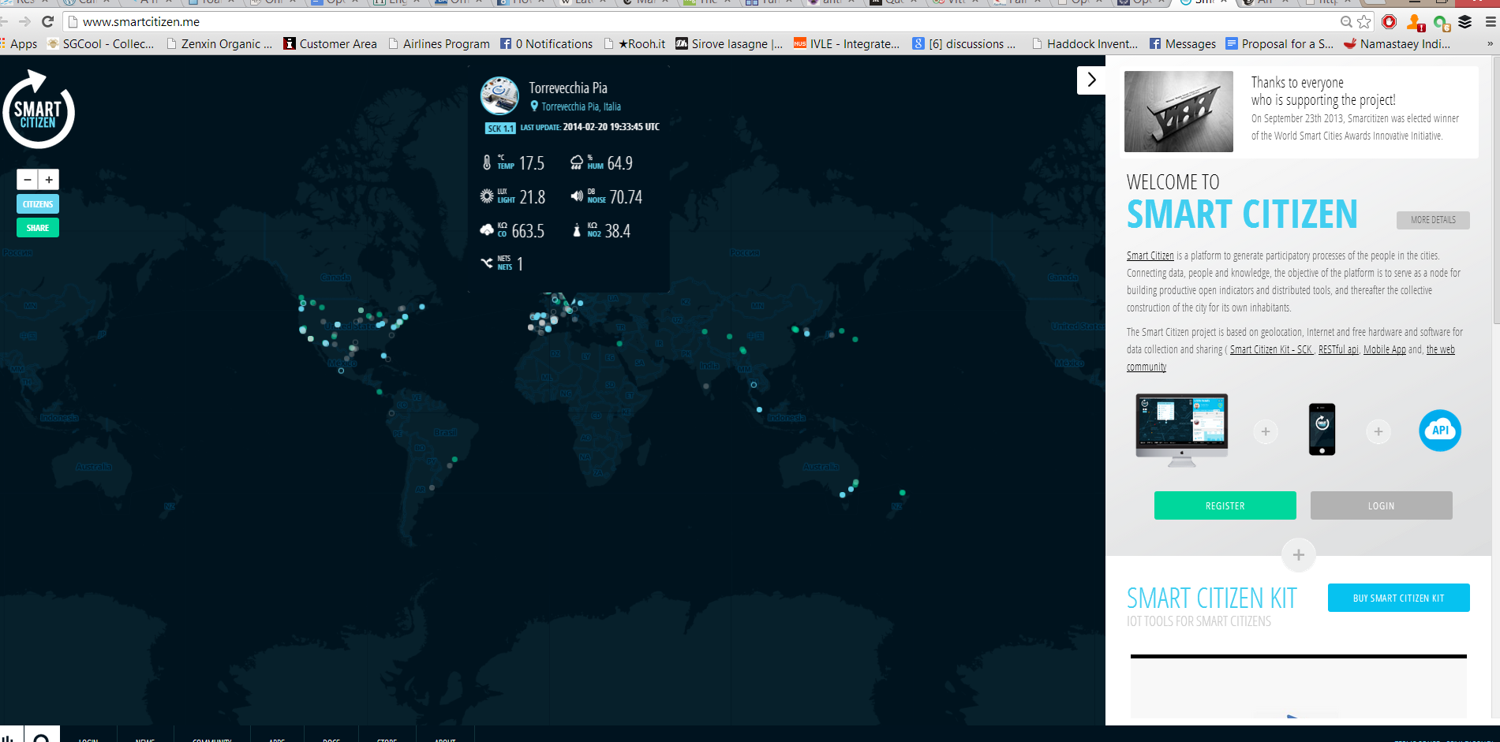
Open Data & Crowdsourcing

Slide 21
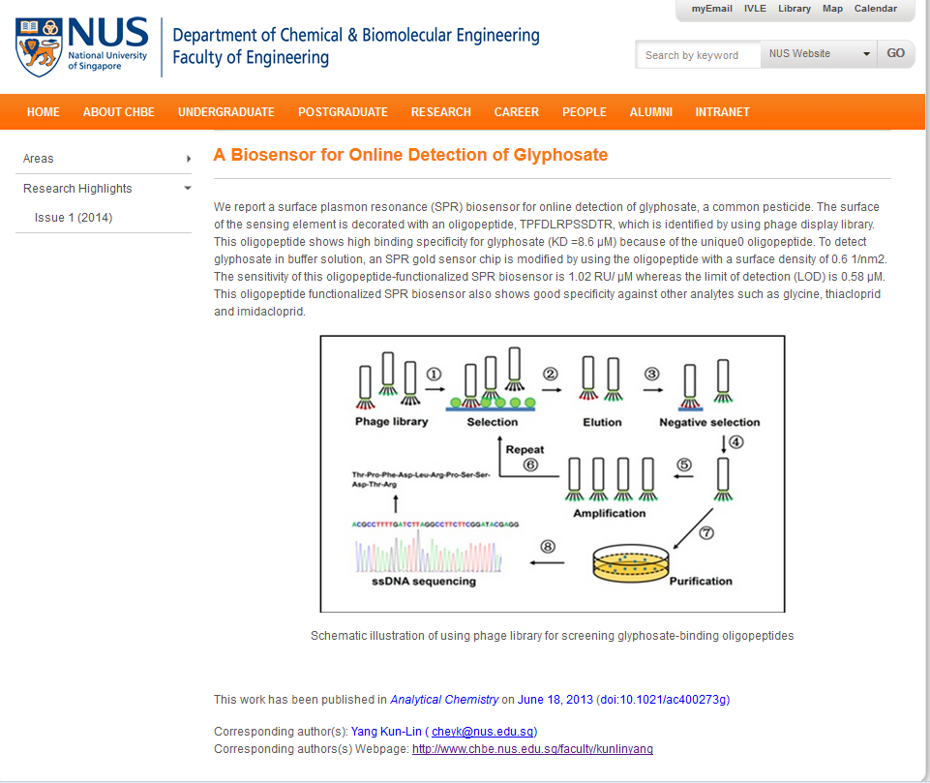
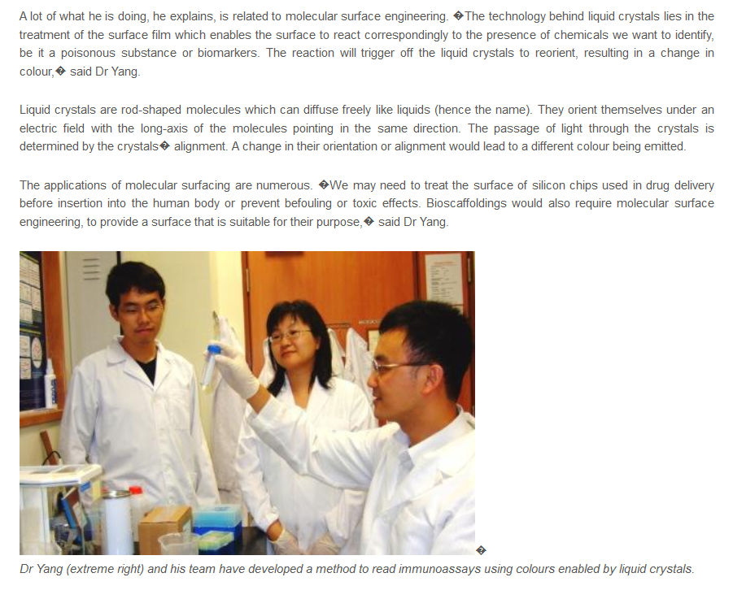
Patents on nicotinoids & pesticide biosensors

Slide 22
Quantum Biosystems (Japan, US): nanopore sequencing with OSHW
Disruptive, fourth generation sequencer measuring single DNA molecules
No need for reagents, PCR etc., measures the electric current on a nanolevel directly.
“measuring tunnel current through nano-electrodes as DNA/RNA passes through nanogaps, and by calculating the current difference. Each chip has a nanogap through which only a single strand of DNA or RNA passes, and the device uses nanoelectrodes (one molecule-wide gap between electrodes) to measure tunnel current.”
Quantum Biosystems

Slide 24
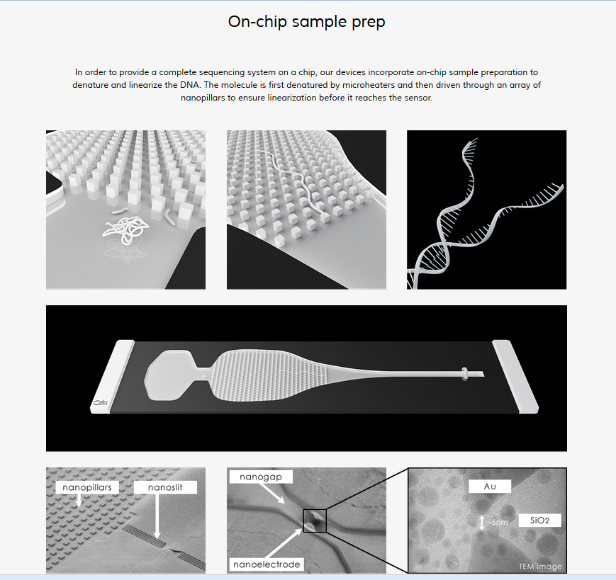

Slide 25
OSHW developers

Slide 26
Chris Wang aka Akiba Tokyo Hackerspace & FreakLabs
But as for how I work with them, it’s a standard contractual engagement and I’m essentially a paid engineer. The money coming from the QB work is paying for a lot of tooling and renovation at the hackerfarm as well as going into the projects that are starting up. Basically it’s a pretty sweet setup since I get to work with a bunch of badasses and it helps build out my hackerfarm experiment.
Akiba
FreakLabs Open Source Wireless
http://www.freaklabs.org

Slide 27
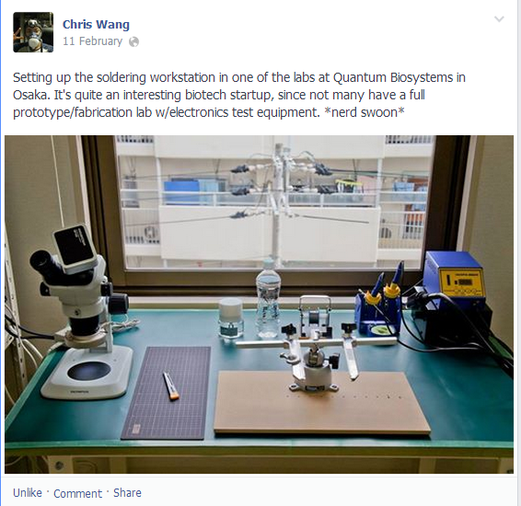
Badass disruptive biotech supports hackerfarm and vice versa

Slide 28
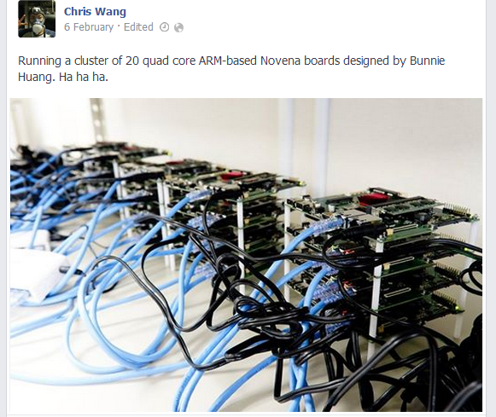

Slide 29
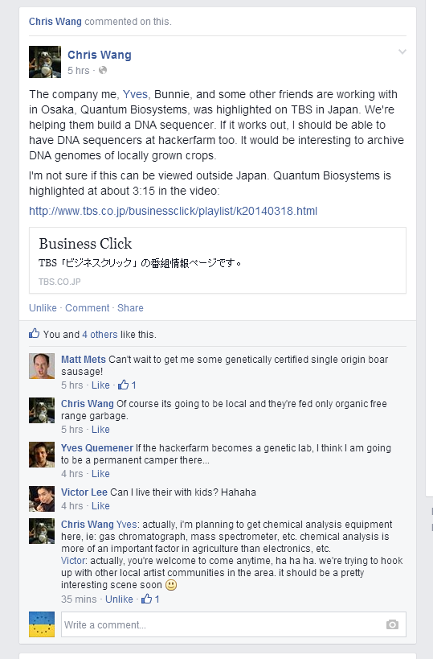
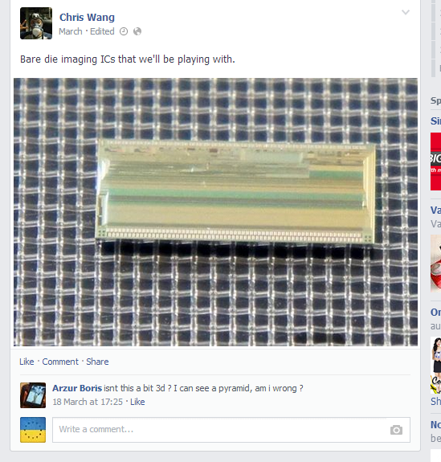

Slide 30
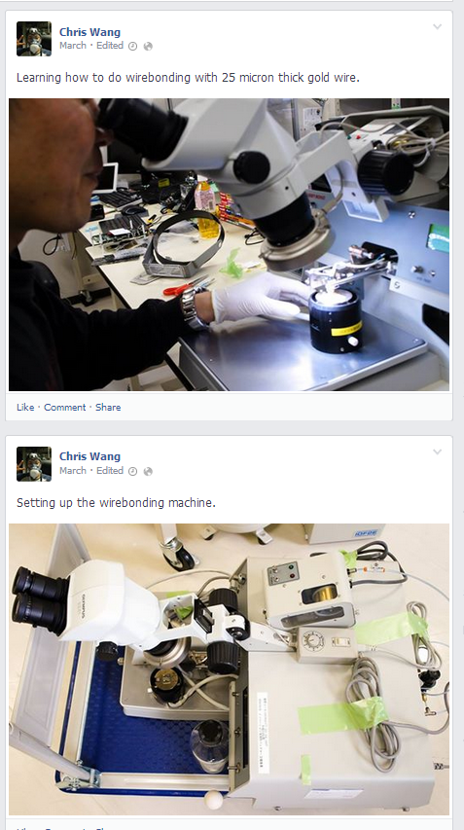

Slide 33
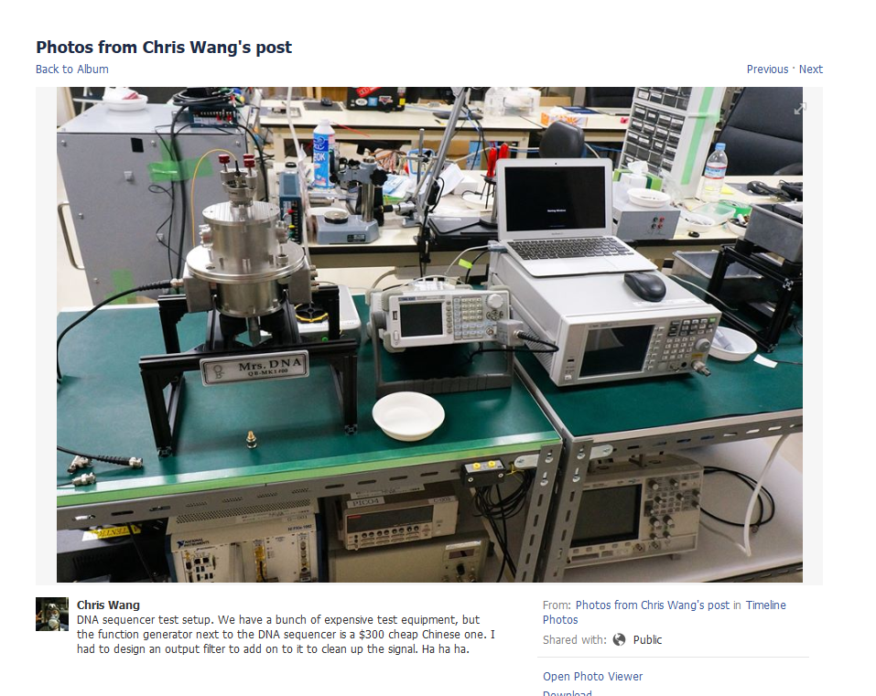

Slide 34
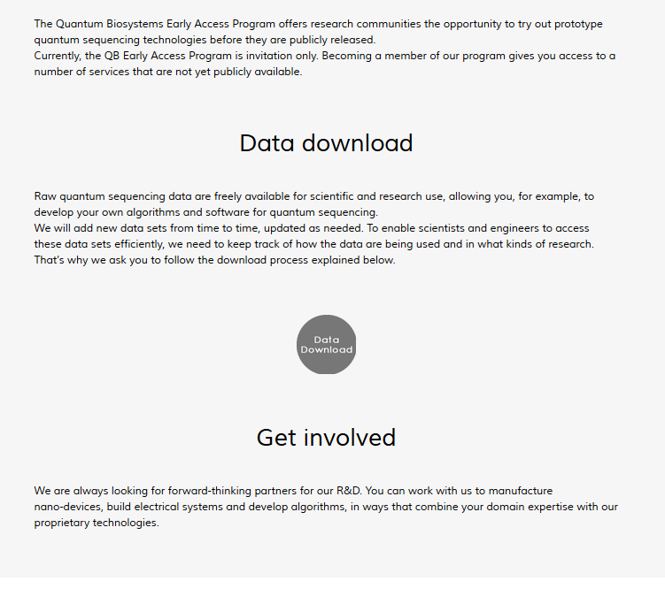

Slide 35
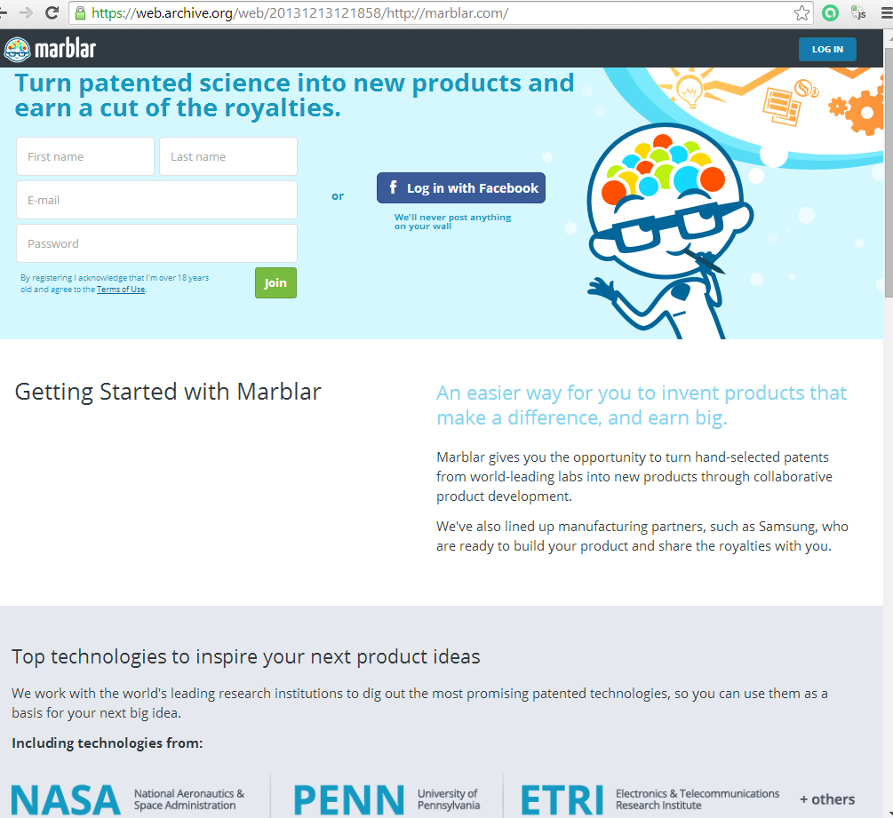
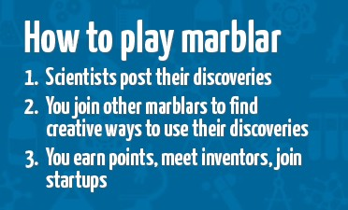
OSHW hybrids, chimeras, monsters

Slide 36
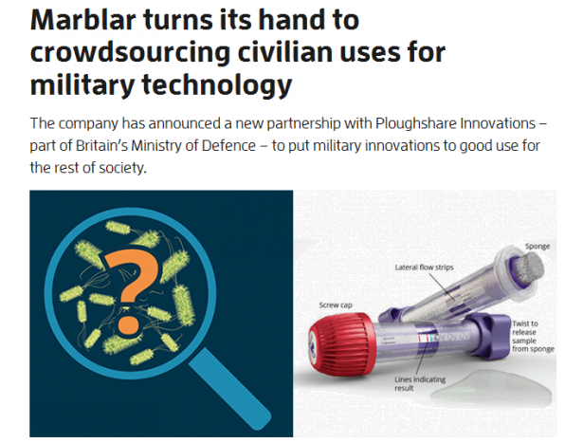

Slide 37
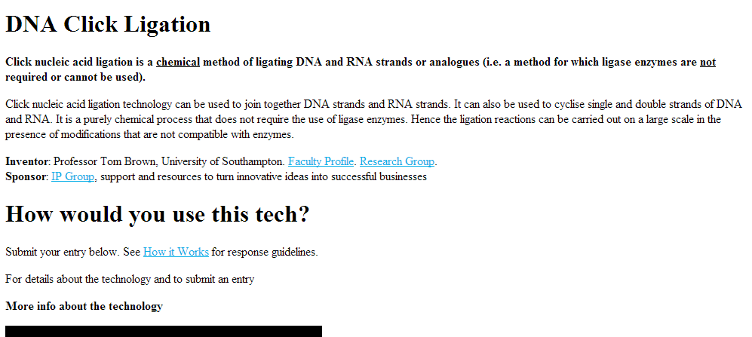

Slide 38
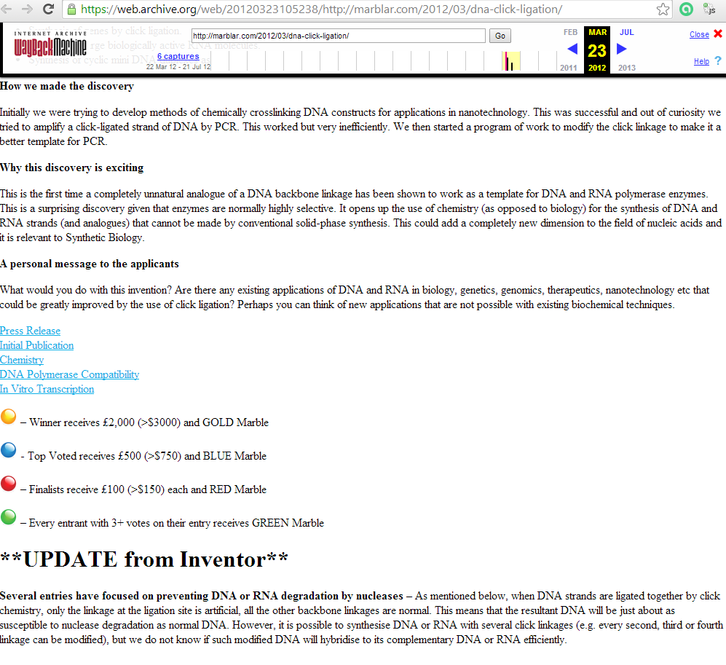

Slide 39
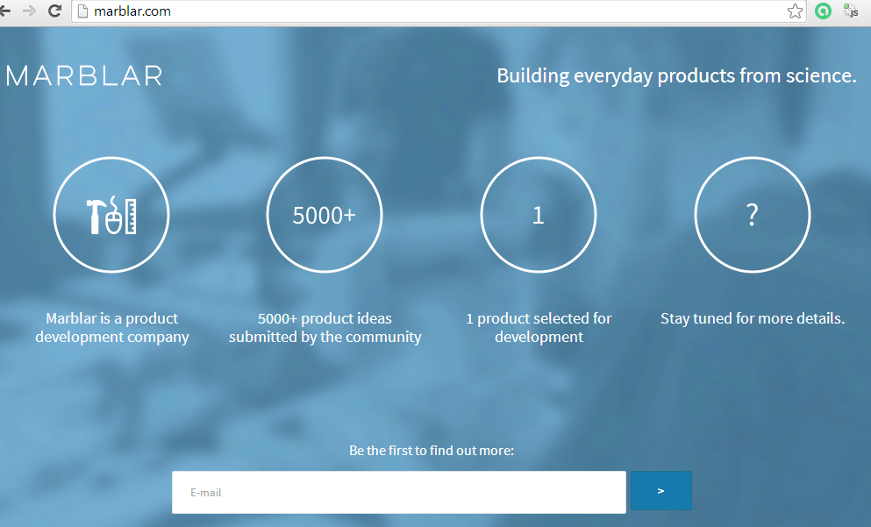
Marblar 2014
http://marblar.com/

Slide 40
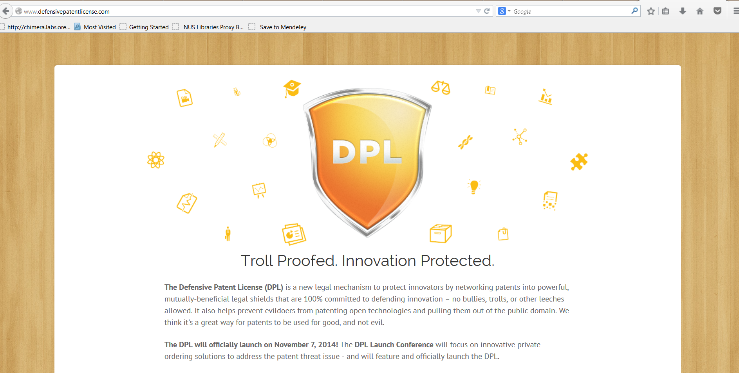
http://www.defensivepatentlicense.com/

Slide 41
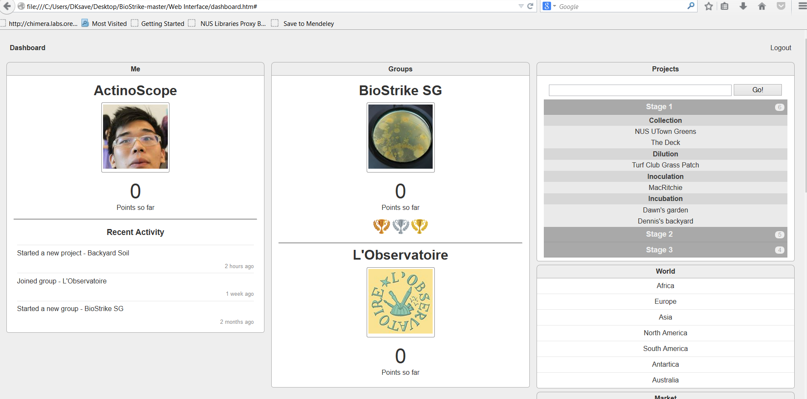
Biostrike: Open Antibiotics Discovery

Slide 42
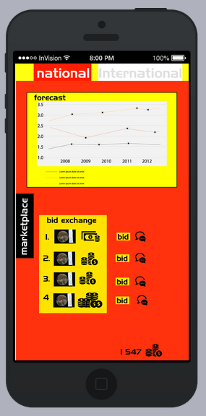

Slide 43
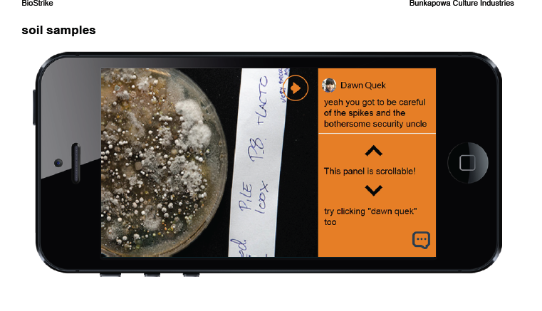

Slide 44
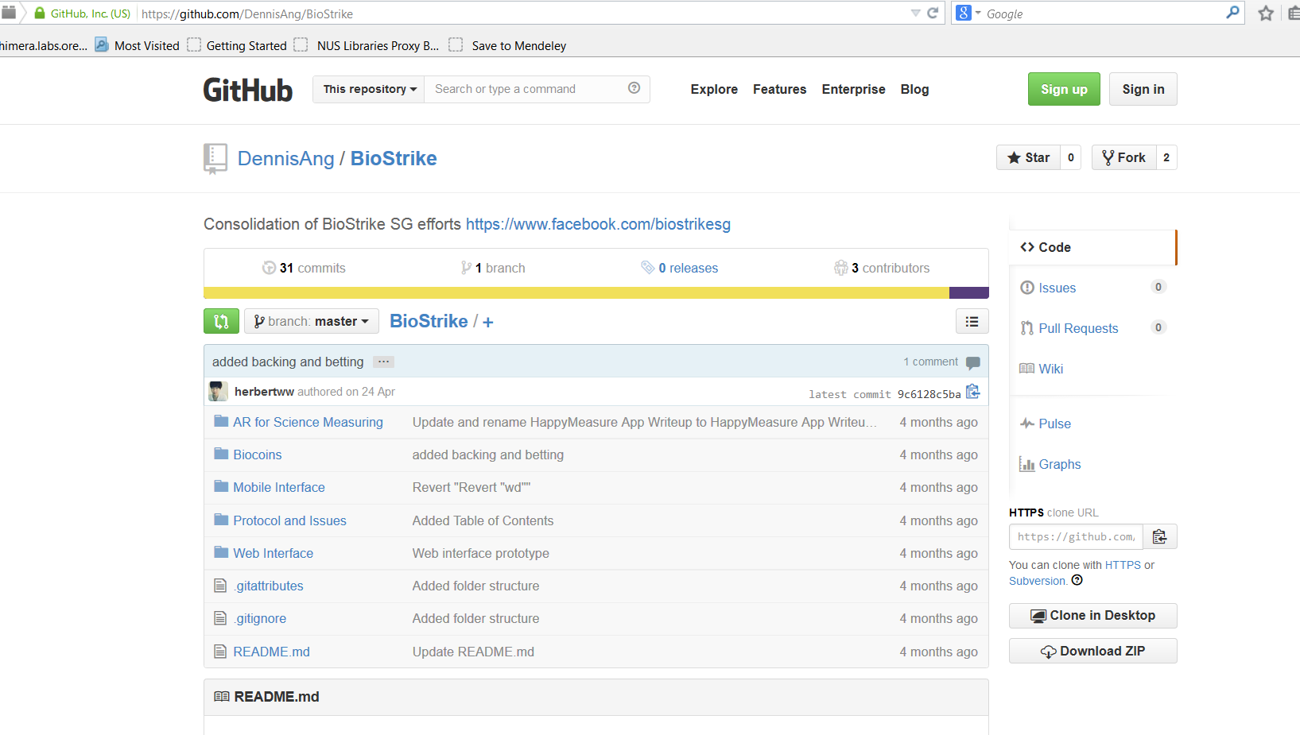
https://github.com/DennisAng/BioStrike

Slide 45
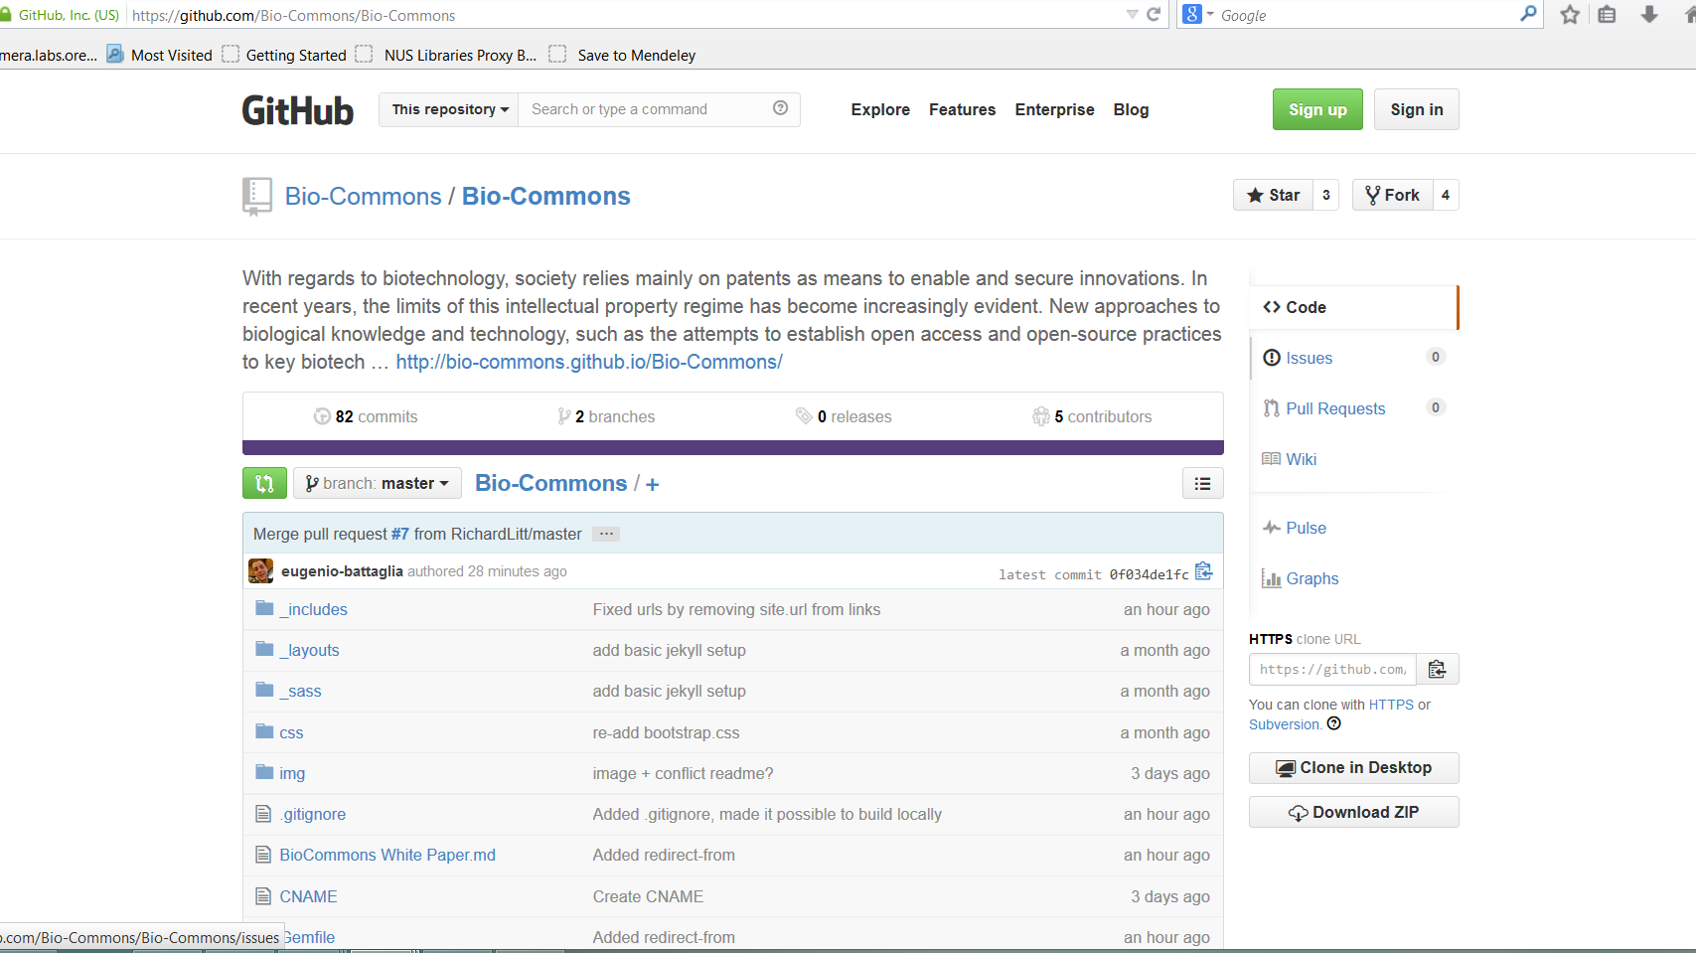
https://github.com/Bio-Commons/Bio-Commons

Slide 48
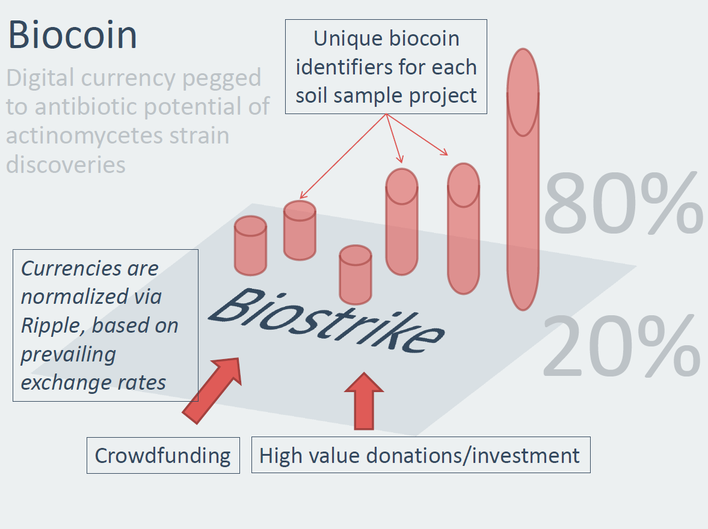
https://github.com/DennisAng/BioStrike/blob/master/Biocoins/Biocoin%20Concept.md

Slide 49
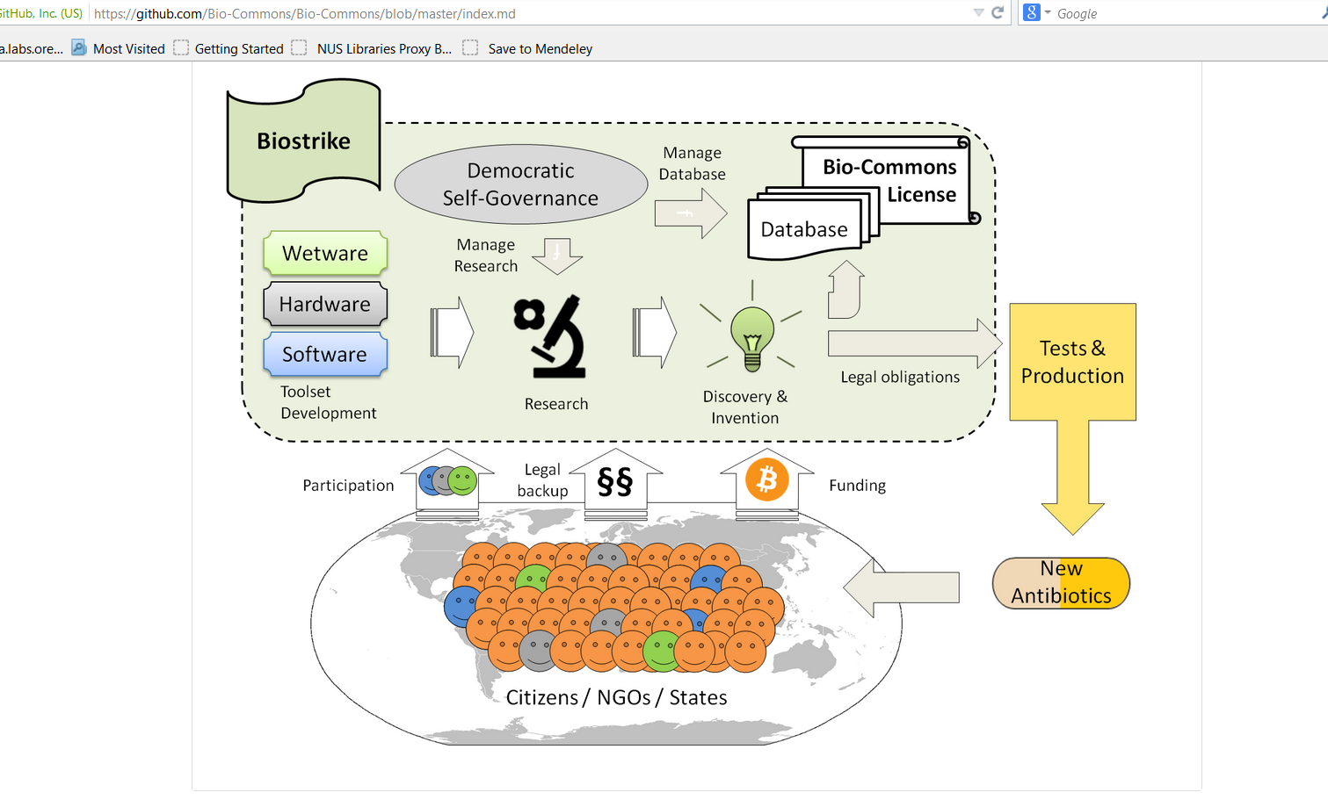

Slide 50
Science, State, Society (Community): divide & conquer?
Science & Tech = Instrument of Governance (Biopolitics)
Improving human lives?
Improving democracy with science.
Public Understanding of Science
Utopian, technocratic projects
= Object of Governance (STS & policy)
Democratizing science?
Improving science with politics
Cultural etc. embededness of science
Civic epistemology (Jasanoff, 2007)
= Object & Instrument of Governance
Hackerspaces
Alternative R&D engagements around DIY, maker communities

Slide 51
Participatory Turn
Enables better quality decisions provides a higher degree of legitimacy... normatively right thing to do (Fiorino 1990)
Consensus conferences, citizens juries and panels, lay membership of ‘expert’ advisory groups, deliberative polling, participatory mapping or planning, and focus groups (Rowe and Frewer 2005)
Calls for “citizens with active role in the production & use of science” (Jasanoff, 2007)
Communication → Participation → Crowdsourcing
→ Making, Hacking
Language → Data → Material practices & Hardware

Slide 52
DIY microgovernance: Fablabs, Hackerspaces, DIYbio
Amalgams of Prototypes and Communities
Culturally specific but also Global networks
Integrating various personal & group projects and goals
Experimental & tentative collectives around tinkering with data, hardware tools, human & non-human actors (molecules, technologies, ideas)
Policy =
conduct rather than policing
less about preventing more about experimenting
searching for models how to share responsibility & integrate various legal, social and even aesthetic aspects of emergent tech

