Slide 1
What are research metrics and do we need them?
Leslie Chan
University of Toronto Scarborough

Slide 2
"Not everything that can be counted counts and not everything that counts can be counted.”
Albert Einstein
Notes:
understand what we can or can't measure. This way we will know which decisions should be based on data and which not.

Slide 3
Questions
Is the diversity of research practices and outputs, particularly those enabled by digital tools and network, recognized in the current academic reward system?
If current metrics are so poor, why are they so hard to replace?
Is “altmetrics” the answer to this “accounting” problem?
Is altmetrics truly alternative?
How to capture “deep” or meaning data of research activities?
Notes:
The field of altmetrics is about looking at a wider variety of indicators - social media, mainstream media, patents, policy documents, download stats - that relate to a wider variety of outputs - datasets and software as well as papers - to supplement peer review and citations.

Slide 4
Metrics as
Complex socio-technical system
Driver of behaviour (reactivity)
Mirror of specific value system
Notes:
Reactivity : the idea that people change their behavior in reaction to being evaluated, observed, or measured.

Slide 5
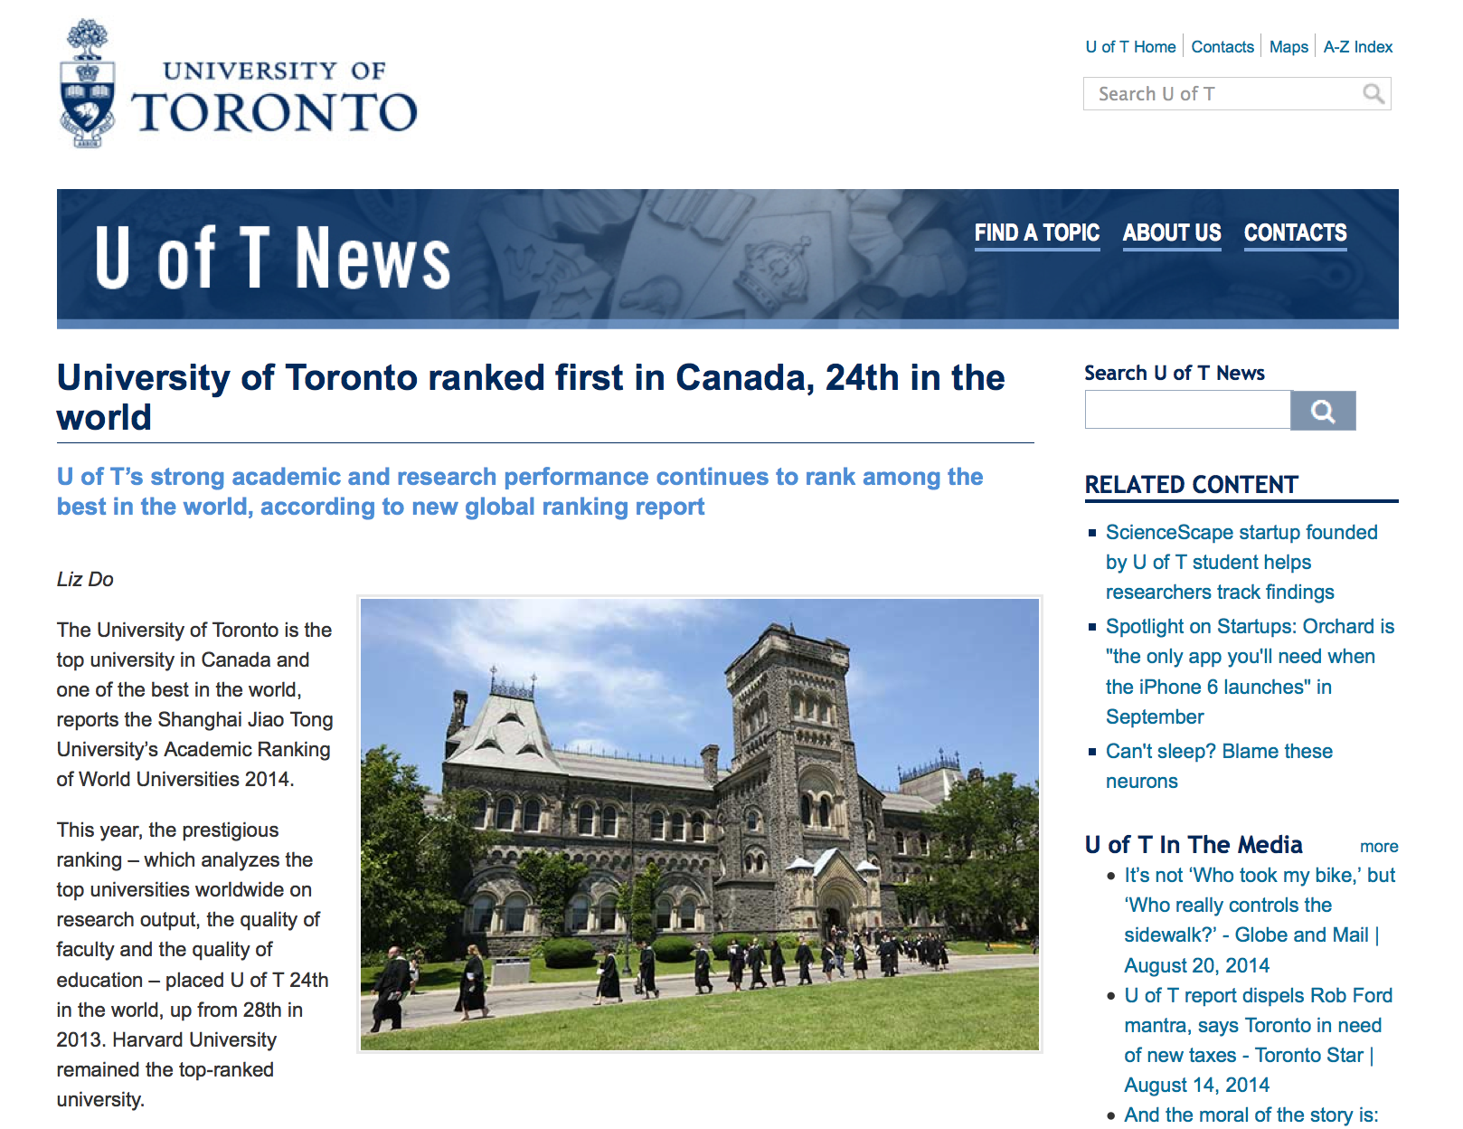
Shanghai Jiao Tong ranks universities by measuring objective indicators of academic or research performance. These include: alumni and faculty winning prestigious prizes and medals; highly cited researchers; articles published in Nature and Science; articles indexed in major citation indices, and the per capita academic performance of an institution.
http://news.utoronto.ca/university-toronto-ranked-first-canada-24th-world?utm_source=Bulletin&utm_medium=Email&utm_content=Lead
Notes:
Public mission
Stakeholder relations?
Shanghai Jiao Tong ranks universities by measuring objective indicators of academic or research performance. These include: alumni and faculty winning prestigious prizes and medals; highly cited researchers; articles published in Nature and Science; articles indexed in major citation indices, and the per capita academic performance of an institution.

Slide 6
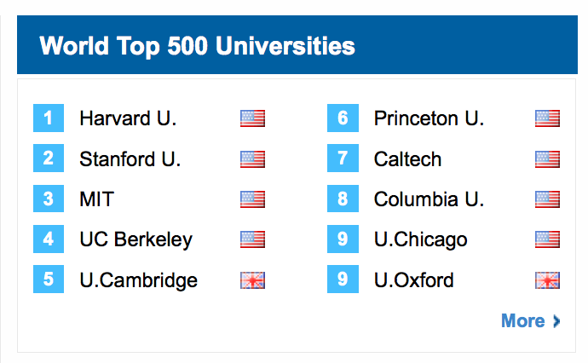
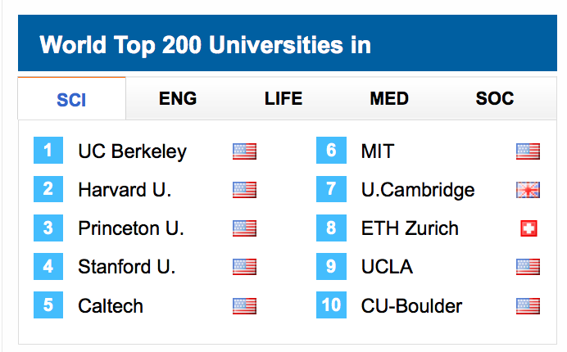
http://www.shanghairanking.com/index.html

Slide 7
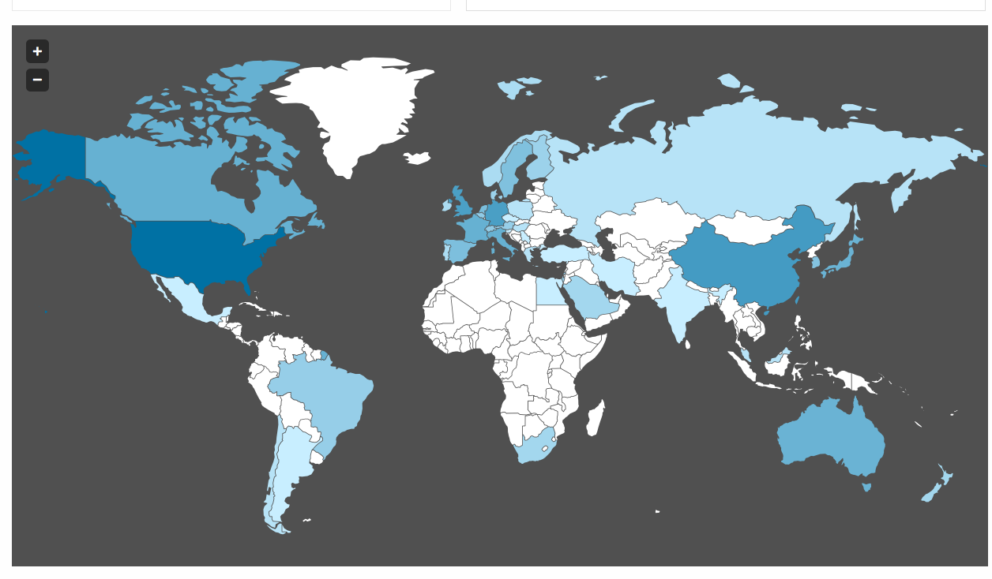

Slide 8

http://www.timeshighereducation.co.uk/world-university-rankings/

Slide 9
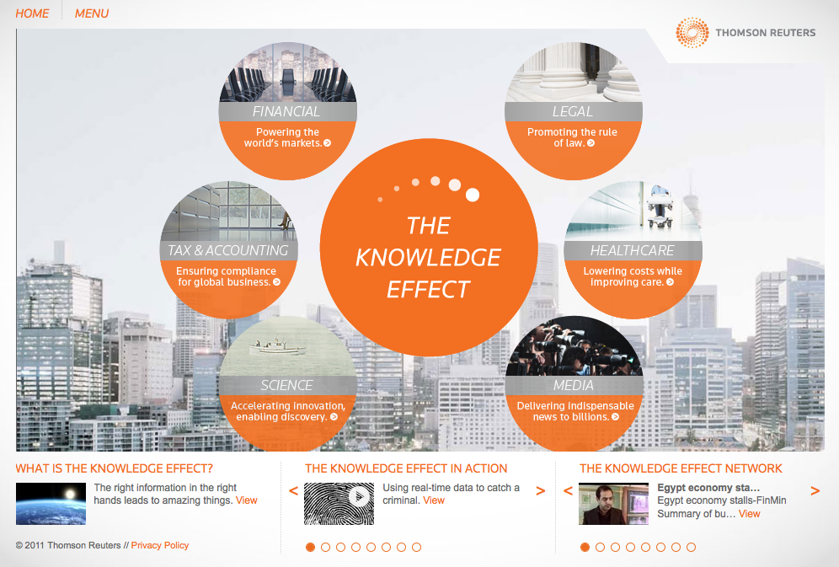
http://ke.thomsonreuters.com/#/index.html

Slide 10

http://thomsonreuters.com/
Notes:
Consequences of publishing in “internatioanlly” indexed journals

Slide 12
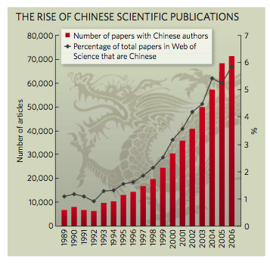
http://www.nature.com.myaccess.library.utoronto.ca/nature/journal/v454/n7203/full/454398a.html

Slide 13
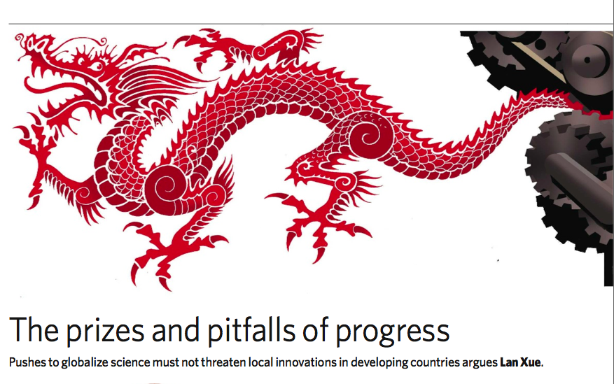
Nature Vol 454|24 July 2008
http://www.nature.com.myaccess.library.utoronto.ca/nature/journal/v454/n7203/full/454398a.html

Slide 14

Research Priority, Policy and National Interests

Slide 15
Rethink the framework and language of “accounting”

Slide 16
Critical Accounting
The very act of “counting” certain things and excluding others shapes a particular interpretation of social reality, which in turn has policy implications
  For example, what should "assets”, “impact” and "liabilities" include/exclude?
The answers to questions such as these define the "health," ”values" and "performance" of an institution
Notes:
Knowing that measuring drives behaviour, it is important to keep in mind that “management by quantified objectives” may run the risk of undermining the qualitative goals they were put into place to measure (Daly 1996:41). Daly gives this example:
Consider, for example, the case of management by quantified objectives applied to a tuberculosis hospital, as related to me by a physician. It is well known that TB patients cough less as they get better. So the number of coughs per day was taken as a quantitative measure of the patient’s improvement. Small microphones were attached to the patients’ beds and their coughs were duly recorded and tabulated. The staff quickly perceived that they were being evaluated in inverse proportion to the number of times their patients coughed. Coughing steadily declined as doses of codeine were more frequently prescribed. Relaxed patients cough less. Unfortunately the patients got worse, precisely because they were not coughing up and spitting out the congestion. The cough index was abandoned.

Slide 17
Social Accounting?
“A systematic analysis of the effects of an organization on its communities of interest or stakeholders, with stakeholder input as part of the data that is analyzed for the accounting statement”
Broadens the domain of items that are included in “accounting statements” (i.e. outputs) so that social organizations and institution can better tell their story
Quarter, Mook & Richmond (2003)

Slide 18
… Social Accounting
Knowledge as “public good” and implications for “open” scholarship and research
Notes:
An accounting framework influences how an organization defines success and values.
Traditional accounting focuses on maximizing shareholder value and on the financial bottom line. But the success of OS projects can not be measured in economic terms (since we do not generate any revenue). We must measure instead the social impact across multiple dimensions: impacts on the authors, readers, publishers, and the broader scholarly communication environment, as well as the broader public and the policy environment

Slide 19
Broadening the definition of “success” and “value”
  Traditional value: economic return
  Scholarly value - reputation and citation
  Institutional value - public mission, community outreach
  Social value - equity, participation, diversity
  Political value - evidence based policy, transparency, accountability

Slide 20
… Accounting for social impact
  What counts as “input”, cost or investment
  What counts as “output” or benefits and impact
  What are the positive and negative externalities
Notes:
How do we account for non-monetary inputs? E.g. Volunteer time (various people including the director, many advisors, students), unpaid but critical technical infrastructure, space and facilities, professional development of volunteers and student training, community networking and collaboration - these all results in significant impact, but are not yet well captured.

Slide 21
Boyer’s Scholarship of Engagement
Discovery
Integration
Application
Teaching

Slide 22
"The scholarship of engagement means connecting the rich resources of the university to our most pressing social, civic and ethical problems, to our children, to our schools, to our teachers and to our cities..."
Ernest Boyer in The Scholarship of Engagement (1996)

Slide 23
Boyer’s Scholarship of Engagement
Discovery
Integration
Application
Teaching
Engagement

Slide 24

Opportunities for Open Scholarship
Public outreach and engagement
New forms of “impact”
Data sharing
New scholarly practices
Experimentations
Interdisciplinary and Collaborative research
Professional development
Student training
Personalization
Curation
Service
Notes:
Open access models are proliferating, not only for sharing traditional forms of scholarly production (peer-reviewed papers), but also among new forms of content, especially databases and media archives.
Data are increasingly born digital

Slide 25
Rethink
Knowledge as Public Good
Scholarship as Service
Quality and Prestige
Social Metrics
Education as Emancipation

Slide 26
The beauty of the current moment is that new media has thrown all of us as educators into just this kind of question-asking, bias-busting, assumption-exposing environment. There are no easy answers, but we can at least be thankful for the questions that drive us on.
Michael Wesch (2009)
http://mediatedcultures.net/publications/from-knowledgeable-to-knowledge-able-learning-in-new-media-environments/

Slide 27
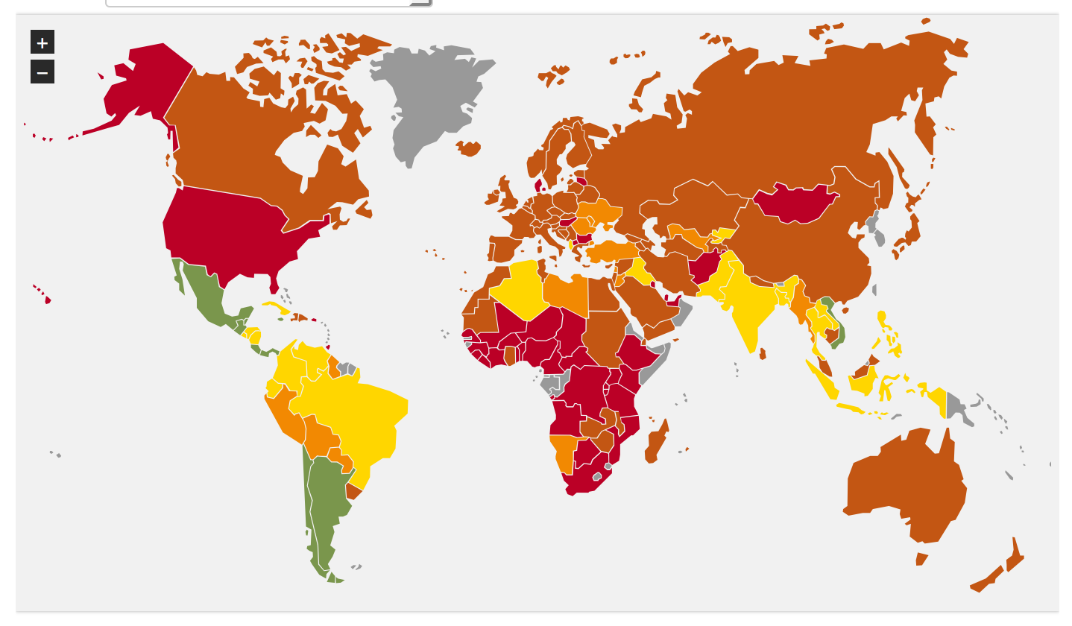
http://www.happyplanetindex.org/data/

Slide 28
Problems with metrics
Treat knowledge as a product or output that we can count
Too much emphasis on counting and not enough reflection on why
Doesn’t measure really “what counts”?
Metrics drive behaviour but do not capture behaviour change resulting from application of new knowledge
Promotion competition and exclusivness, not collaboration and inclusion
Ranking reinforced an entrenched system
Discourage interdisciplinary and multi-disciplinary research
Increasing burden on auditing
Metrics and tools are designed by institutions from the North, impose a new kind of compliance that may be detrimental to local research
Who get to set the “standards”?
Is Altermetrics really an Alternative, and Alternative to what?
We need independence metrics (similar to the independent media)

