Slide 2
* open science: revolution or continuity?

Slide 3
* overall crisis of the modern social contract of science

Slide 4
* not just a new communication technology

Slide 5
* openness re-moralizes science

Slide 6
* a genealogy of open science

Slide 7
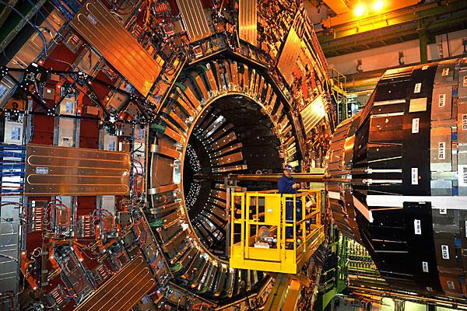

Slide 8
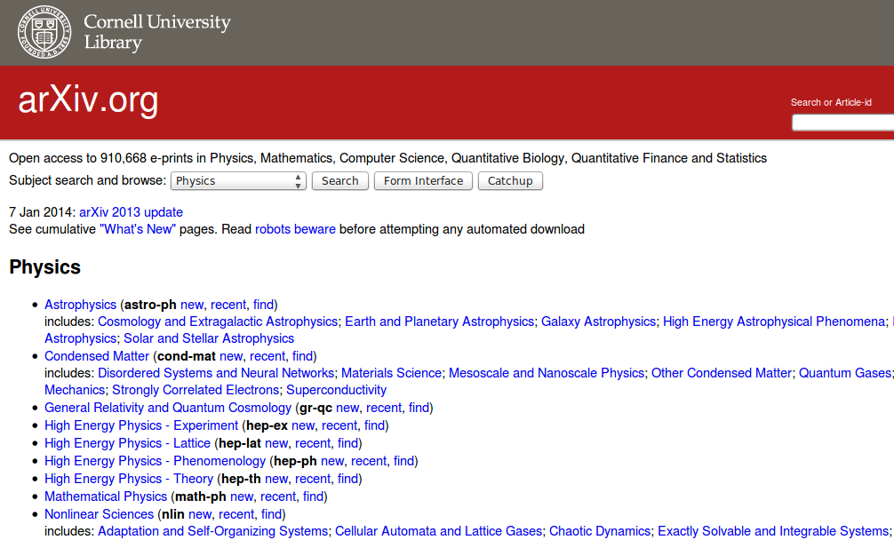

Slide 9
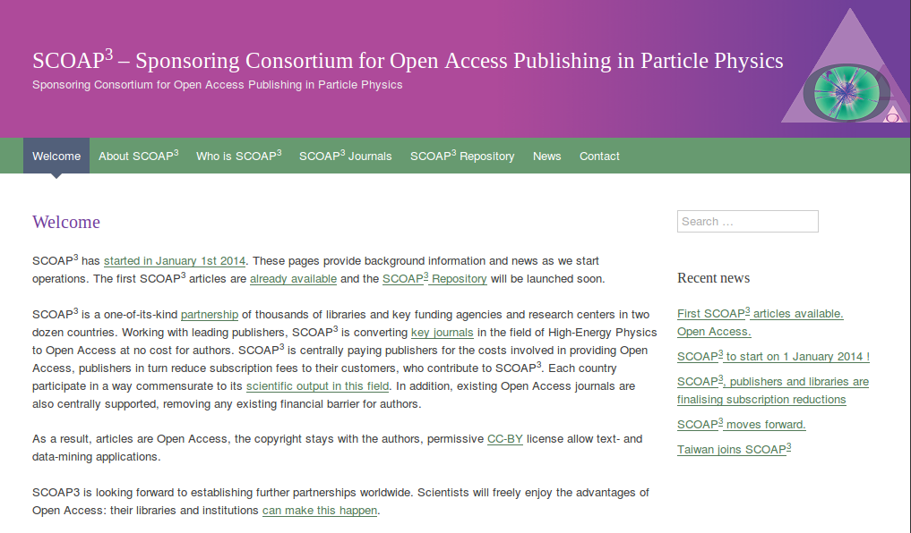

Slide 10
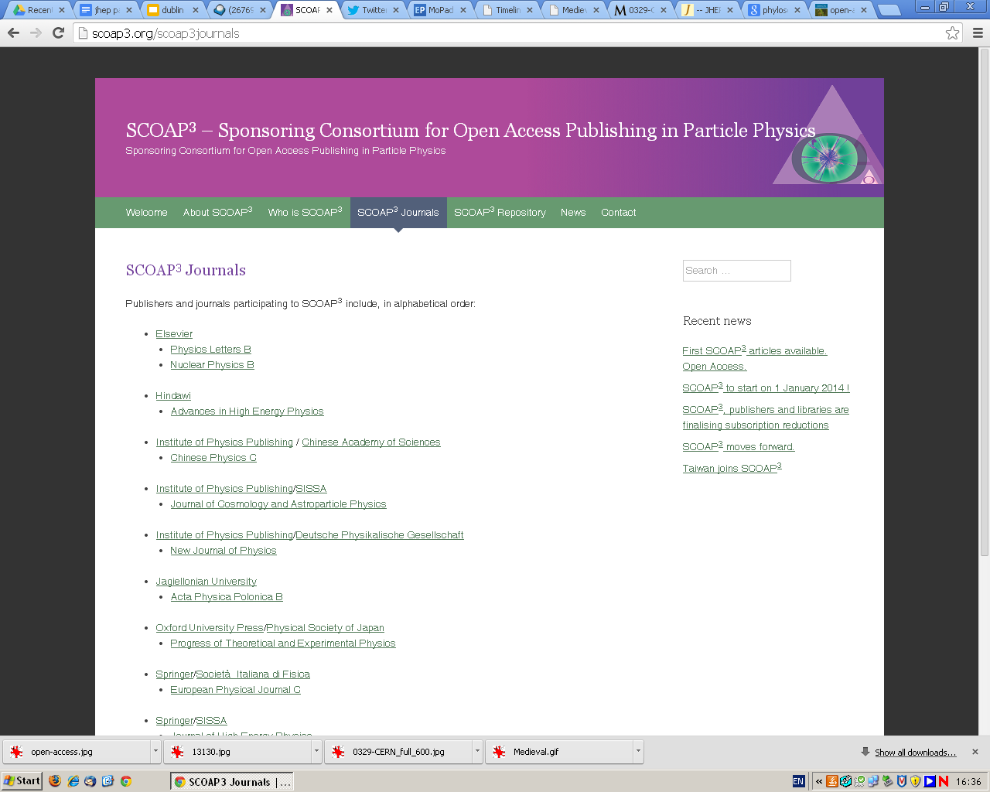

Slide 11
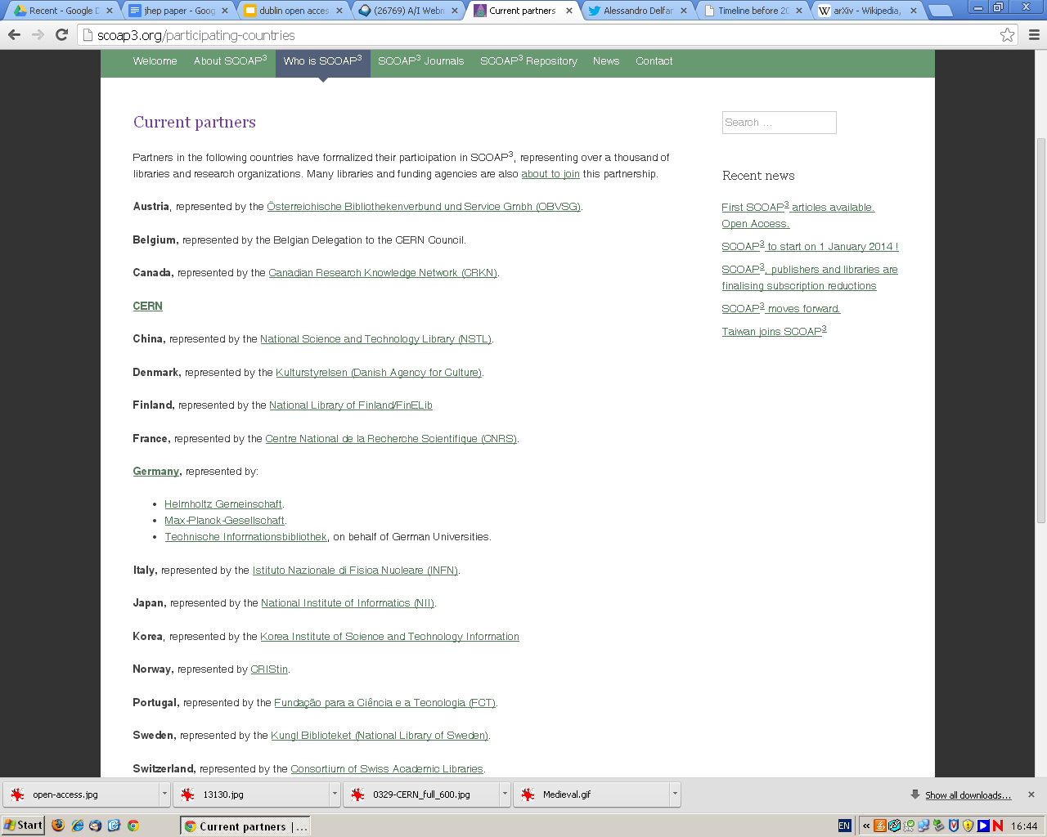

Slide 12
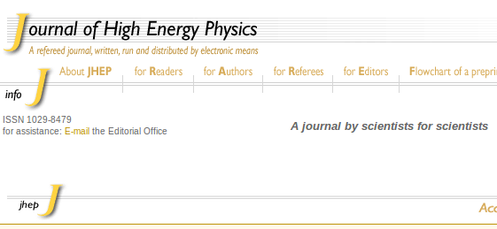

Slide 13
* forking

Slide 14
* migration

Slide 15
* rebooting

Slide 16
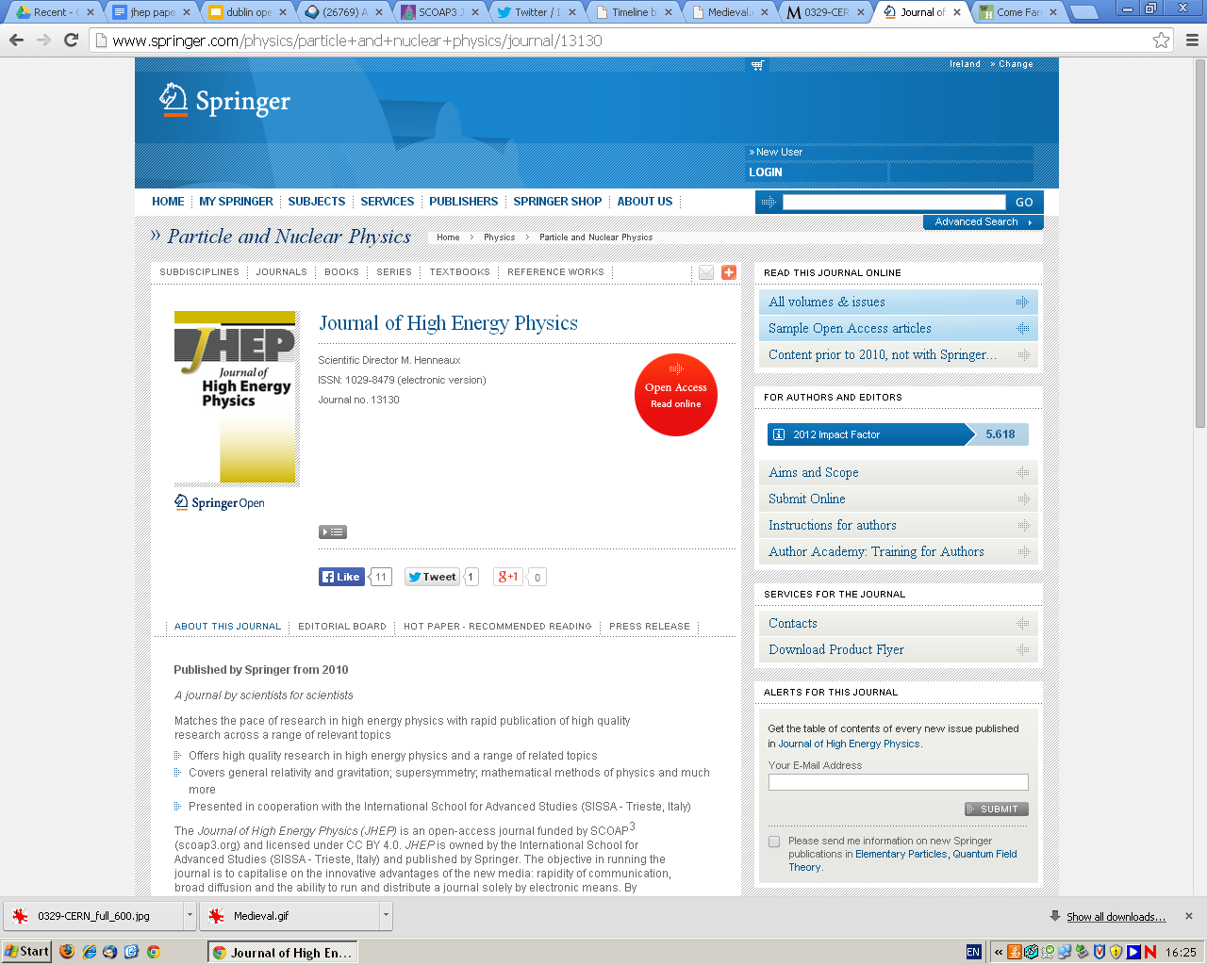

Slide 17
* stability of science’s communication systems

Slide 19
* more radical transformation

Slide 20
* open science as a threat

Slide 21
* what future for open science?

Slide 22
delfanti.org
@adelfanti

Slide 23
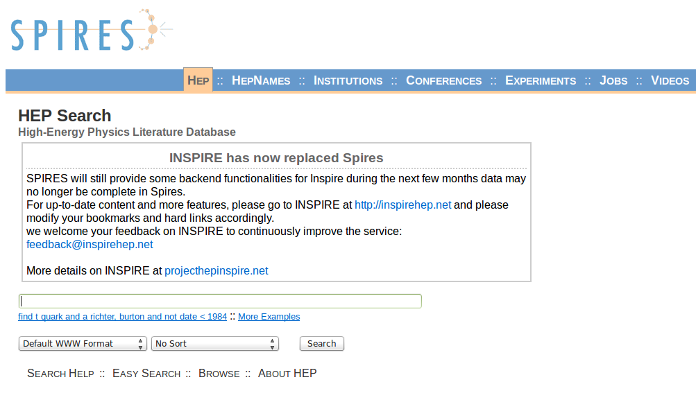

Slide 25
“it was the migration of a pre-existing system onto a new technology”

Slide 26
“we don’t read journals!”

Slide 27
“a journal by scientists
for scientists”

Slide 28
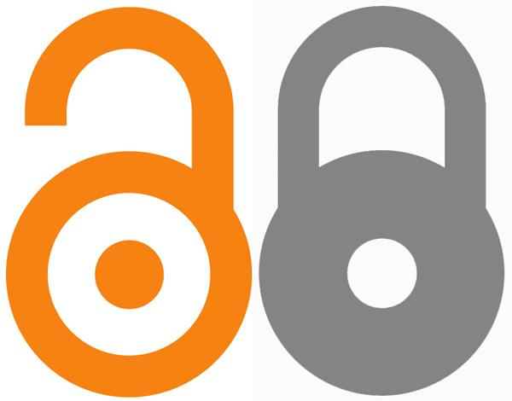

Slide 30
CONTACT INFORMATION
Alessandro Delfanti
Media@McGill
McGill University
alessandro.delfanti@mail.mcgill.ca
twitter: @adelfanti
www.delfanti.org

Slide 31
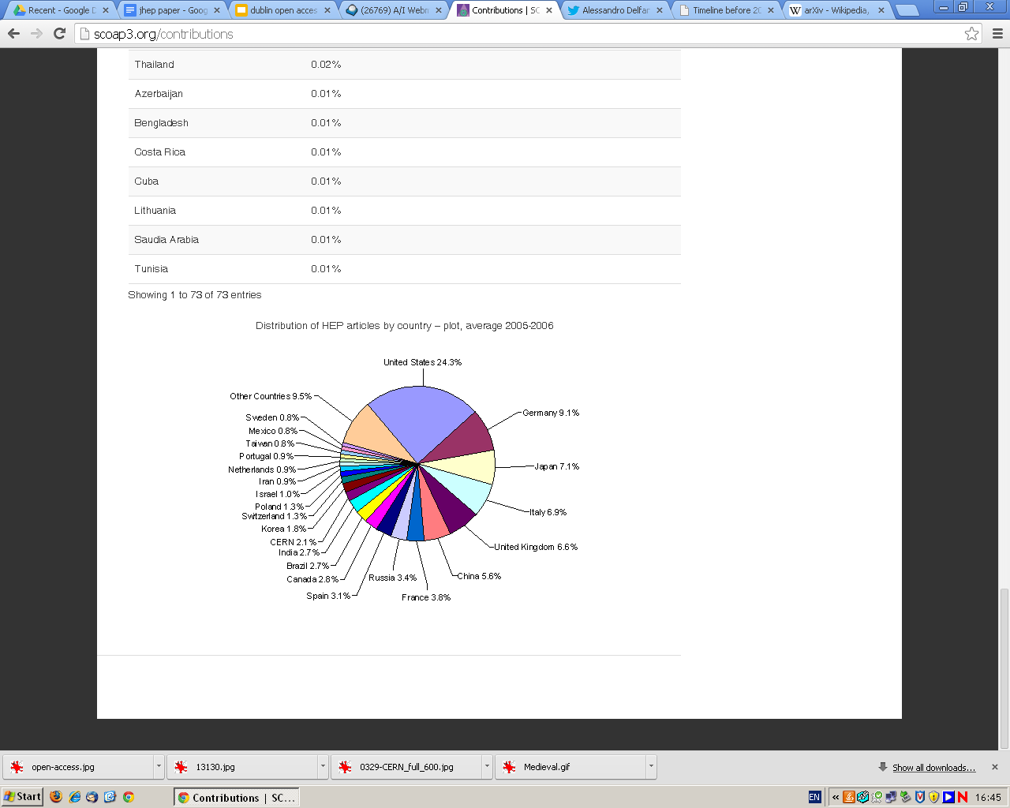

Slide 32
