Slide 1
The Republic of Open Science
The institution’s historical origins and prospects for icontinued vitality
By
Paul A. David
Stanford University & All Souls College Oxford & UNU-Merit (Maastricht, NL)
A Keynote Presentation for the
International Seminar « OPEN SCIENCE, OPEN ISSUES » in Rio de Janeiro, Brazil on 20-22nd August, 2014
Organized by Lincoe Interdisciplinary Lab with the joint sponsorship of BRIST, UFRJ and OKF-Brazil
P
This work is licensed under a <a rel="license" href = "http://creativecommons.org/licenses/by-nc-d/2.5/"> Creative Commons Attribution- NonCommercial-NoDerivs 2.5 License</a>.

Slide 2
The Menu
PROLOGUE : Motivation and Principal Messages
PART I : Some economics of research activities
PART II : Open science’s ethos and institutions
PART III: The historical circumstances in which Open Science first emerged
PART IV: Modern challenges to the survival of Op Sci and their legacy – the New Open Science
PART V: A Cautiously Optimistic Conclusion

Slide 3
Prologue
Motivation and MessagesI

Slide 4
Background and Motivation
critical importance of exploratory research for major advances in scientific knowledge
comparative efficiency in exploratory research of the fragile complex of informal norms and institutionalized practices associated with ‘open science’ (Op Sci)
self-organized collective creativity has been as important in the responses to modern external threats as in Op Sci’s origins
universalist and collective pursuit of scientific knowledge, self-organized by the respective research communities resonates more with ethos of the early Renaissance’s Republic of Letters than with metaphorical notion of “the market for ideas” – leading economists’ analysis of the institution to lag that by sociologists

Slide 5
Principal messages from the ‘new economics of science about the the formal and informal institutions of the Republic of ‘Open Science’ - 1
OpSci belongs to a larger class of decentralized, non-market systems of knowledge and information production and distribution that are important, intricate interesting, and only recently studied systematically by economists.
OpSci is a comparatively efficient (but not perfect) system of resource allocation for producing reliable new knowledge, but it performs comparatively poorly in capturing ‘social surpluses’ from the exploitation of existing knowledge.

Slide 6
Principal messages about the Rep-OpSci - 2
OpSci therefore can interacts positively in many ways with the proprietary R&D regime at the macro-system level, sustaining rapid rates of technological progress – when (and if) the two complementary sub-systems are kept properly “balanced.” To achieve and maintain that balance is the central science and technology policy challenge for modern economies.
OpSci, like other cooperative institutional arrangements, is fragile and its performance (and hence the overall research system’s performance) can be seriously degraded if it is not protected from market competition for resources.

Slide 7
Part I
Some modern economics of the organization of research activities
● The peculiarity of information as an economic good
● Three macro-institutional questions about the existence of distinctive modes of organizing research activities

Slide 8
Why do we have different institutions for organizing research activity? The economist’s (‘ahistorical’) answer for publicly funded open science goes as follows:
:
Information is the key input as well as the output of research, and it has public good properties:
a) infinite expansibilty, i.e., negligible marginal transfer costs and non-rival use
b) indivisibility (i.e., information is integral and heterogenous) and it has substantial fixed costs of creation
c) significant costs of effectively excluding access to and assuring exclusive possession of such goods

Slide 9
Thomas Jefferson recognized the “public goods” properties of ideas and information…in 1813:
"If nature has made any one thing less susceptible than all others of exclusive property, it is the action of the thinking power called an idea, which an individual may exclusively possess as long as he keeps it to himself; but the moment it is divulged, it forces itself into the possession of every one, and the receiver cannot dispossess himself of it. Its peculiar character, too, is that no one possesses the less, because every other possesses the whole of it. He who receives an idea from me, receives instruction himself without lessening mine; as he who lights his taper at mine, receives light without darkening me.
“That ideas should freely spread from one to another over the globe, for the moral and mutual instruction of man, and improvement of his condition, seems to have been peculiarly and benevolently designed by nature, when she made them, like fire, expansible over all space, without lessening their density in any point, and like the air in which we breathe, move, and have our physical being, incapable of confinement or exclusive appropriation."

Slide 10
Economic implications of public goods for the organization of scientific research activities:
  Competitive markets fail to allocate ‘public goods’ efficiently, due to
    ‘transactions externalities’ – try to sell a secret for its full information value
    possibilities for ‘free-riding’ – full demand isn’t revealed
  Competitive pricing (at incremental cost) leaves most (fixed) costs uncovered, even at large scale
  external use benefits (from ‘spillovers’) not properly valued by private willingness-to-pay

Slide 11
Classic economic analysis in “public finance” identifies three solutions for the problem of providing “public goods” (e.g., water and lighting utilities)
    tax-financed subsidies
    monopoly
    direct public provision.
Correspondingly, we identify:
“The 3 P’s” -- co-existing institutionalized solutions for the problems posed by information-goods:
    Patronage – and the ‘open science’ reward system
    Property — IPR monopoly rights
    Procurement -- public production and/or “sourcing”

Slide 13
Q 1: What is special about the open science mode of organizing research that justifies it being supported by (State or Private) patronage? b7
The cooperative (open) mode is especially functional – it promotes the rapid cumulative process of advancing reliable knowledge :
A “collegiate reputational reward structure” (CRRS) provides incentives and signals for agents’ effort allocation decisions
A researcher’s reputational standing is based on the peer community’s acknowledgement of the validity of claims to “priority of discovery”
There is incentive compatibility between the priority rule and the norm of open-ness (full disclosure) :
asymmetric information → problems of input monitoring →
monitoring of output, with rewards for priority → rapid disclosure

Slide 14
Q 2: How do the “3 P’s” co-exist productively in modern economies?
  Open Science, being non-proprietary and requiring the support of Patronage is suited for maximizing the growth of the stock of reliable knowledge
  Proprietary R&D is suited for maximizing the volume of economic ‘rents’ extracted from the existing stock of knowledge
  It is most efficient that some government mission agencies conduct the research on which their action must be based (e.g, public health actions; space research).

Slide 15
Q 3: Why can’t we combine the best of each regime in just one set of institutions?
  This is what has been promoted by policy-makers seeking to emulate the Bayh-Dole experiment and induce EU universities to embark on producing and exploiting intellectual property;
  But there is a conflict between that purpose and the university’s performance of it main social role as host for independent scientific inquiry and scholarly critique, and as disseminator of reliable knowledge: organizations with conflicting purposes are likely to serve both badly.
  University administrations could probably learn how to exploit the IP produced by their faculty, but what would they not being attending to whilst learning that skill.?

Slide 16
Part II
Open science’s ethos and institutions

Slide 17
“Open science”– understanding a remarkable social innovation
What are the ethos, norms and institutions that distinguish the “Republic of (Open) Science”?
Why do we have a number of quite different “organizational regimes” for conducting scientific research? Particularly, why have both ‘open science and ‘propriety R&D’?
How could “open” science arise in a world of secret knowledge, and the secretive hunt for “Nature’s Secretes”?

Slide 18
Institutional features structure resource allocation in ‘the Republic of Science’
The key institutionalized social ‘norms’ that R. K. Merton (1973) identified are readily remembered using J. Ziman’s (1994) mnemonic :
    C ooperation
    U niversalism
    D isinterestedness
    O pen-ness
    S cepticism

Slide 19
Idealized social norms and institutionalized procedures of modern “open science” (the Republic of Science)
Idealized social norms
  cooperation and trust among scientists
  autonomy in determination of research agendas
  personal disinterestedness in research outcomes
  full disclosure of findings and methods
  expectation of verification by replication

Slide 20
Idealized social norms and institutionalized procedures of modern “open science” (the Republic of Science)
Stylized procedural arrangements
  rewards based upon collegiate reputational status
  reputation based on peer-appraisal of ‘scientific contributions’
  eligibility for evaluation based upon non-ascriptive characteristics
  substantial autonom of individual in design and research conduct is expected (and with this goes responsibliity for the research)
  ‘a scientific contribution’ requires validation of the researcher’s claim to priority in discovery or invention

Slide 21
institutional features and resource allocation in the Republic of Science
Functionality of the cooperative system that promotes rapid cumulative growth in reliable knowledge:
  “collegiate reputational reward structure” (CRRS) provides incentives and signals for agents’ effort allocation decisions
  scientific reputational standing is based on community acknowledgement of claims to “priority of discovery”
  incentive compatibility of priority with the norm of open-ness (full disclosure) :
asymmetric information → problems of input monitoring →
monitoring of output, with rewards for priority → rapid disclosure
  disclosure, skepticism and disinterestedness → validation of results →promotes rapid “closure” (effective consensus)
  universalism prevents “homogenization” of social communications network structure → protecting deviant opinion from premature formation of consensus (dogmatic belief)

Slide 22
The “Logical Origins” of Open-Science Institutions: Functionalist Rationale
GOAL: Rapid Accumulation of Knowledge
Public Knowledge
Publication Procedures
Reward System
Validation
Disclosure Norms
Priority Races

Slide 23
OS is not a perfect institution: its key features cause inefficiencies in research resource allocation
Priority-based rewards creates conflicts between incentives to compete and the norms of cooperation and openness (typically resolved by dynamic “switching”.
Although “peer-interest” affects expected size of “rewards” priority, this also induced “herding”: excess concentration of effort on particular topics and problems.
Tournament-like payoff structure induces inefficient (wasteful, excessively duplicative) “racing” behavior.
Positive feedback from reputation effects on access to research inputs leads to path dependence in career dynamics (the “Matthew Effect”), degrading reliability of signals of ability in competition for new funding.
Public patronage means that societal needs must be translated into government science policy by a political process, which creates more scope for private political interests extraneous to both scientific or technological merit to affect the allocation of funding for research.

Slide 24
Part III
The European circumstances in which the ideas and practices of open science arose
● The medieval world of “hidden knowledge”
● The “Scientific Revolution” of the 17th century
● Noble patrons and mathematicians

Slide 25
The historical origins of the Open science Revolution… are not its ‘logical origins’:
‘Open science’ emerged in Europe during the latter 16th and early 17th centuries, accompanying but distinct from the epistemological transformation of the Scientific Revolution.
The development of this mode of engaging in research --as a collective cooperative undertaking --constituted a break from the older tradition of secretively pursuing “Nature’s Secrets”….
….a socio-institutional development that owed more to renaissance mathematics than to any imperatives of the new mechanical philosophy and observational methods of the Scientific Revolution.

Slide 26
The medieval world of arcana - 1
The moral obligation was to be circumspect about revealing the “Secrets of Nature’ – an old idea
Belief in the original wisdom or knowledge of the ancients’ (prisca sapientia), imparted by God to Adam, and lost to man, was common among the learned in the middle ages
The pseudo-Aristotelian Kitab Sirr al Asrar, translated as the Secretum secretorum (“The Book of the Secret of Secrets”) was the most popular, widely copied book of the middle ages [Thorndike (1950: ii)]

Slide 27
The medieval world of arcana - 2
The historical continuity of the imperative of secrecy among an elect few, for altruistic motives
  Si haec scientia hominibus esset discoperta, confunderent universum : “ If this knowledge was revealed to all men, it would confound the universe”
  Cornelius Agrippa [1486-1532], German-born philosopher-alchemist, emphasized the venerable tradition of secret knowledge: Plato had forbade disclosure of ‘the mysteries’, Pythagoras, and Porphyry [232-305 c.e.] bound their disciples to silence about their teachings
  Or, as Newton wrote in the 18th century, to uncover the secrets sought by the old Alchemists risked bringing “immense dammage to ye world.”

Slide 28
The medieval world of arcana: ‘hidden knowledge’
Al khataab…secret secretorum: the most popular medieval book
Craft-guild restrictions preserving the “mysterie of the trade”—discouraged working fine crafts in the open
Guild cartel practices’ indirect effects:
-- increased value of technical secrets reinforced balkanization of information circulation
17th c. Maps showing trade routes were kept secret
The Alchemical tradition: the hunt for health, wealth and power – is highly instrumental, valuable and dangerous; the hunt it was to be pursued in closed “clubs” or “circles”.

Slide 29
SCHEMA OF THE 17TH C. EPISTEMOLOGICAL REVOLUTION:
“The Fusion of Mathematics and Experimentalism”
Astronomical
and
Astrological
‘Observational
Programs’
‘Experimentalist
Program’
Roger Bacon
c.1220-c.1292
Arabic
Mathematics
Introduced
In West
‘Classical
Mathematics’
Aristotelian
‘Natural Philosophy’
Medieval
‘Occult
Science’
Nicholas Copernicus
1472-1543
Renaissance Mathematics
(15th and 16th centuries)
Regiomontanus 1432-76
Tartaglia c. 1500-65
Cardano 1501-76
Tycho
Brahe
1546-
1601
Francis Bacon
1561-1672
‘The Scientific Revolution’
Galileo 1564-1642
Kepler 1571-1630
Descartes 1596-1650
Galileo’s
Scholastic Opponents
Second Generation of Experimental and Mechanical
Natural Philosophers: Boyle, Newton, Hooke,
Huygens, Gilbert, Harvey, Torricelli, Pascal
‘Chemical Alchemy’
And Occult Sciences

Slide 30
The medieval world of arcana--‘hidden knowledge’, 2
The medieval alchemical tradition had dual aspects
  Alchemy was regarded as a form of personal knowledge, a “divine science, …a way of life of life, a great work which absorbed all mental and material resources.” [B.Y.T. Dobbs,1975]
  The ‘hunt’ for health, wealth and power was also an instrumental search for knowledge by experimental methods, its ‘quarry’ being viewed as valuable to possess as they were dangerous to disclose to the multitudes
  The practice developed into the sophisticated mid-17th c. form of “chemical alchemy”, carried by Boyle, Issac Newton and other ‘rational scientist’--who participated in closed “circles”, within circulated special materials and manuscripts phrased in ambiguous terms and obscure notations
Craft-guild restrictions preserved the ‘mysteries of the trade’, inhibiting generation and spread of new technology
-- e.g., by discouraging the working of ‘fine crafts in public view [Long, 1991]
-- urban guilds’ cartel practices had direct and indirect effects [Ogilvie, 2004]:
output restrictions increased the value of technical secrets
employer cartels reinforced balkanization of information circulation

Slide 31
If new practices of revealing Nature’s Secrets had reflected just the effects of a purely intellectual, or ideological shift, why wouldn’t the new idea of ‘public knowledge’ have triumphed completely?
Yet, the worlds of ‘hidden’ and ‘revealed’ research co-existed during the early Scientific Revolution... and well beyond it…
  The leading scientific figure of the age, Issac Newton continued his researches in chemical alchemy from 1660s through 1690’s – filling notebooks with 1.2 mn. words on the subject, more than all his other writings
  London “projektors” in the mid 17th c. who dreamed up new science-based business schemes kept them secret
  …Puritan social reformers (in Saml. Hartlib’s circle) dabbled in alchemy, especially magical medicinal recipes

Slide 32
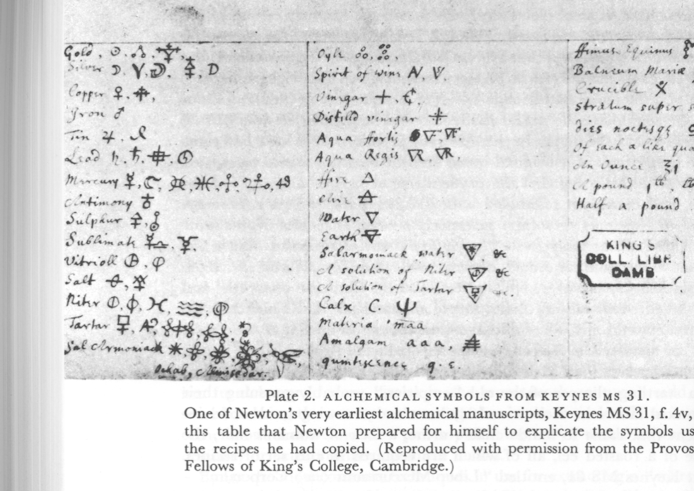
Symbols from Newton’s ‘Liber Mercurioum Corporum’, the “Book of the Mercuries of Bodies” -- one of his earliest alchemical manuscripts (Keynes MS 31), dating from the late 1660’s
This table was prepared by Newton to explicate the symbols used in the recipes he copied for extracting “mercuries”, most probably, according to Dobbs (1975), from manuscripts collected by members of the Hartlib circle in London, who interested themselves in chemical alchemy among other ‘practical projects’ in this period.

Slide 33
‘The Historical Origins’: overview of the thesis
Open Science Institutions
Communications
Technology
and Institutions
Intellectual Authority Conventions
Patronage
System Conventions

Slide 34
‘Historical Origins’: details of the thesis
17th Century
Development of Open Science
Institutions and Norms
Publication as
Means of Disclosure
and Advertising
Reputational
Tournament
Processes
Legitimization
Organizations
for Scientists
Intellectual
Authority
Problems
Copyright
Laws
Printing
Technology
Principal
Agent
Problems
New
Mathematics
Patronage System
‘Ornamental Motives’
New Experi-
mentalism

Slide 35
Noble patrons, mathematicians, and principal-agent problems
Multiple motivations for patronage
-- the utilitarian and the ornamental
Renaissance mathematicians’ successful development of useful applications
-- also brought greater informational asymmetries between client-savants and their patrons, few of whom were mathematicians

Slide 36
The Ornamental Motivation of noble patrons in Renaissance Europe was instrumental -- about POWER AND THE MANIFESTATION OF MAGNIFICENCE:
Mary Hollingsworth (1995: p.1), writing of Renaissance patrons of art and architecture, describes the usage of magnificence in state-craft:
"For them, art was the prime vehicle for the display of status, ambitions, beliefs and achievements; it was not a statement of their aesthetic sensibilities. The magnificent palaces and their lavish decoration commissioned by governments, guilds and individuals were designed to demonstrate the wealth and power of their owners....They understood [architecture's] value as propaganda. Pope Nicholas V insisted that magnificent buildings were essential to convince ordinary people of the supreme power of the Church. The Venetian government began to build a costly clock tower at a time of economic instability to demonstrate that the state was not bankrupt.”

Slide 37
RENAISSANCE MATHEMATICS -- A century after Regiomontanus, the practical “fruits” of mathematics had become a commonplace prescription for humanist educational reform:
The Jesuit mathematician Christoph Clavius,] n 1586, prescribed the identification of mathematical passages in Aristotle as pedagogical exercises and stressed the centrality of mastering the mathematical disciplines for an understanding of the new ‘mechanical philosophy’:
“Physics cannot be understood correctly with [the mathematical disciplines], especially what pertains to that part concerning the number and motion of the celestial orbs, of the multitude of intelligences, of the effects of the stars…, of the divisions of continuous quantities to infinity, of the tides, of the winds, of comets, the rainbow, haloes, and other meterorological matters, or the proportion of motions, qualities, actions, passions, reactions etc., concerning which the calculatores [of fourteenth century-Merton College, Oxford] wrote much. I omit an infiinity of examples in Aristotle, Plato, and their most illustrious interpreters which can in no way be understood without some knowledge of the mathematical sciences.”
Source: English translation by Peter Dear, in Mesenne and the Learning of the Schools, Ithaca and London: Cornell University Press, 1988: p.45, from Christoph Clavius, “Modus quo disciplinae mathematicae in scholis Societatis possent promoveri,” In Monumenta paedogagical Societatis Iesu quae primam Rationem Studiorum 1586 praeccessere (Madrid 1901: p. 472).

Slide 38
The utilitarian involvements of leading scientists from the late 15th through the late 17th century – reflected extensive engagement with the “mathematized” technological fields
% of All Non- % of All
Principal technological field Number Medical Techs Scientists
Medicine & Pharmacology* 267 42
All Non-Medical Techs 245 100 39
Engineering 101 41
Military 51 21
Hydraulic 50 20
Cartography 92 38
Navigation 47 19
Other Technologies 5 2
None 118 19
TOTAL 630 100
Source: Tabulation of the practical involvements in technology of individuals listed in the Dictionary of Scientific Biography as having been born between 1470 and 1680 – from Westfall (1993)

Slide 39
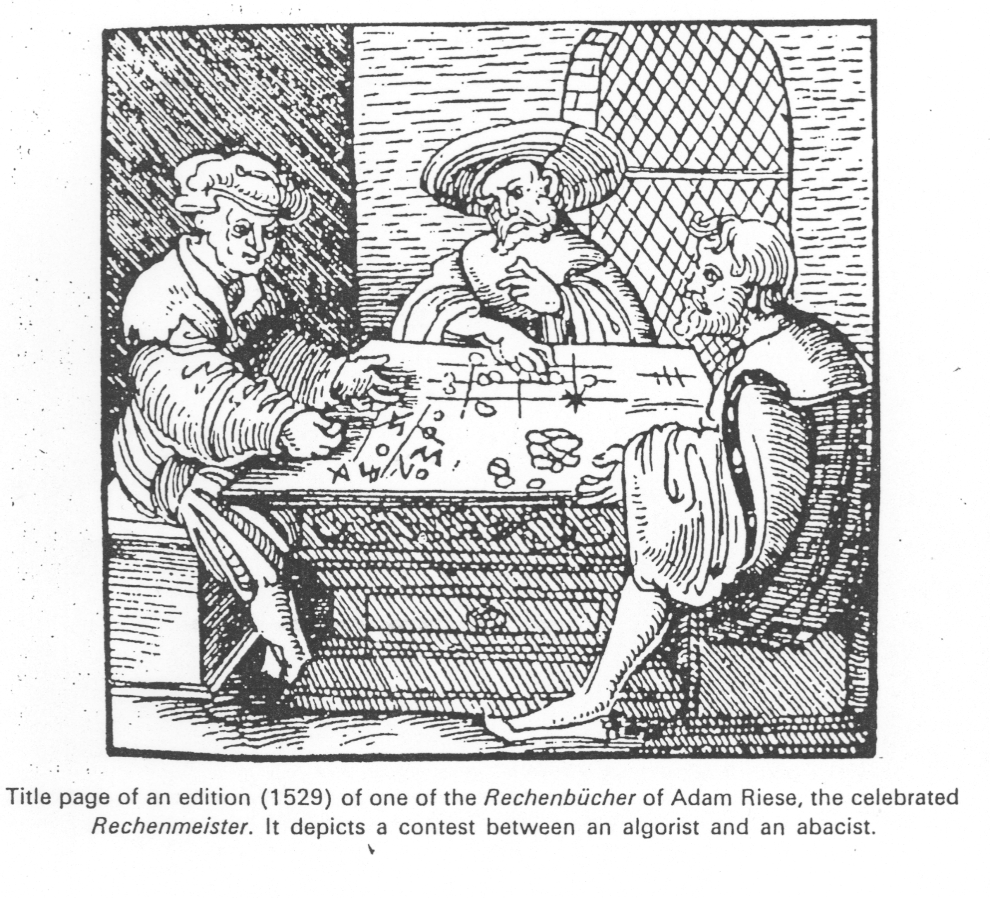
Open challenges, claims of discoveries and methods builds on the tradition of public trials of methods in Renaissance mathematics
An early 1529 book’s depiction of a contest between an algorist and an abacist

Slide 40
Noble patrons, mathematicians and principal-agent issues:
Coping with informational asymmetries in the patronage system
● Challenges and public contests from mid-16th c. onwards, especially among mathematicians
-- reputational competition gives rise to increasingly frequent priority disputes towards the end of 16th century
● A exceptional opportunity for ‘direct confirmation’-- the telescope and Galileo: in the quest for fame and patronage, ‘autoptic proferrence’ was more effective than independent scientific corroboration

Slide 41
Noble patrons, mathematicians asymmetric information and principal-agent issues - 2
The telescope and Galileo
-- c.July, 1609 Gallileo learns of (1608) Dutch low-power telescope
-- late August, 1609 presents 12 x ’scope to Venetian Senate→ big salary at Padua
-- March 1610 : having built c. 20x ‘scope to observe the moon and planets, he publishes Siderius nuncius, presenting his discovery of the moons of Jupiter as the “Medicean Stars”
-- April, 1610, goes to Florence to make sure that Cosimo II will view his “Stars” →
-- June 1610: made Chief Mathematician at Pisa, and Philosopher to the Grand Duke, he begins building ornate telescopes for the Duke to send to princes and cardinal
-- September- December, 1610 first independent corroborations of Jupiter’s moons: from Santini (Venetian merchant); from Kepler (given one of Gallileo’s ‘scopes for his patron Rudolph II by from the Elector of Cologne; and in December from Jesuits in the Collegio Romano

Slide 42
Patronage, competition, and common agency: some economic implications
The nature of “common agency games and the distribution of information rents

Slide 43
Economic analysis and the Court Patronage System:
Common agency contracting, with rivalrous principals
________________________________________________________
Structural conditions:
Nobel patron derives ‘ornamental’ and ‘utilitarian’ benefits from clients’ services
Strong informational asymmetry between patron and matematician-client
Patronage contract typically has two-part structure: a fixed ‘retainer’ and a variable ‘gift-reciprocation’ component based on novelty, uniqueness, and propitious circumstances of client’s performance
Client-savant typically has multiple patrons, i.e., ‘common agency contracting
‘Positional-goods’ nature of benefits received by the patron (owing to importance of ‘ornamental’ value of the client) implied common agency contracting in substitutes is a dominant situation

Slide 44
Economic Analysis and the Court Patronage System:
Common agency contracting --- continued
________________________________________________________
Principal implications:
Nash equilibrium of the game among patrons for client’s attention yields ‘weak incentives’ contract-structures, because each patron is aware of the possibilities that they might be cross-subsidizing rivals (see Avinash Dixit 1996).
‘Weak incentives’ reinforces the client’s acceptance of multiple patronage contracts in the equilbrium.
Common agency contracts in substitutes leave the client/agent with a larger equilibrium share of the informational rents, compared to situations where principal’s benefits are pure complements – e.g., knowledge-services with major ‘spill-overs’ (see Lars Stole 1990).
Fragmented political authority (many courts) and ‘ornamental’ motives of rival patrons created terms of support more favorable to client-savants than conditions of centralized patronage, or primacy of patrons’ interests in non-positional goods – knowledge with utilitarian spillover effects.

Slide 45
Main conclusion from the story of the ‘origins’ of open science practices:
  A pre-capitalistic disposition to award court patronage (to the savants and virtuosi) for the purpose of enhancing the ruler’s political power by displaying of ‘magnificence’ came to confer value on those pursuing mathematics and the mechanical philosophy in the late 16th and 17th centuries.
  Fragmented political authority, and the symbolic competition among many courts within Europe (the legacy of feudalism) meant that common agency contracts tended to be particularly favorable to the scientist-clients—because the services provided were viewed by their multiple patrons largely as substitutes, rather than as complements.

Slide 46
Open science: “European feudalism’s greatest gift
to modern capitalism”
  Renaissance statecraft established the practice of awarding court patronage (to savants and virtuousi) for the purpose of enhancing the ruler’s political power-- by displaying ‘magnificence’-- came to confer value on those pursuing mathematics and the mechanical philosophy in the late 16th and 17th centuries.
  The progress of mathematics and its practical applications, by exacerbating the asymmetric information problems of patrons, and hence of their client-scientists – creating incentives for the latter to build an external, peer-based reputation by public demonstration of their abilities.
  Fragmented political authority, and the symbolic competition among many courts within Europe (the legacy of feudalism) meant that ‘common agency contracts’ tended to be particularly favorable to the scientist-clients —because the services provided were viewed by their multiple patrons largely as substitutes, rather than as complements.

Slide 47
Open science --“European feudalism’s greatest gift to modern capitalism” -- is a fragile legacy
  That process of institutionalization was distinct from, yet was driven by, and reinforced the epistemological transformations that historians associate with the Scientific Revolution.
  Open science has been able to find public patronage and reproduce itself through the enculturation (socialization) of young trainee researchers -- because it turned out to be highly productive when coupled with a market-driven proprietary R&D regime oriented to create new technologies.
  Yet its cooperative institutional arrangements are fragile, and can be undermined when they have to compete for resources with a market system, so open science exists in a state of uneasy tension with the proprietary R&D regime.

Slide 48
Part IV
Modern challenges to the survival Open Science and the legacies -- the New Op Sci Movement

Slide 49
The Present & Future of Open Science
The optimum is not clearly identified, but we can tell when changes are pushing the system out of balance.
Property
Public
Provision
Patronage
Fiscal pressures to “privatization” government informaiton production, reinforced by stronger and more comprehensive IPR protections, and the disruptive effects of ICT innovation, and contributing to a drift toward the “property” pole.

Slide 50
Property – successive expansion of the IPR regime
Reinforcement of international conventions by bilateral agreements
TRIPs Agreeement: ‘harmonized’ national IP treatment at developed country levels; created obstacles to recourse to compulsory licensing
Extensions of the domain of patenting in the U.S.:
    living organisms: Diamond v. Chakrabarty (1980)
    software : Diamond v. Diehr (1981)
    business models: State Street Decision (2000).
Sui generis protections:
    copyrights in semi-conductor mask work (1980)
    EC directive on the legal protection of databases (1996)
ICT advances as drivers of IPR regime changes:
    “self-help” technologies (water-marking, encryption, trusted systems: foreclosure of effective “fair use” exclusions)
    legal restraints on decryption of material that is protected by copyright law: U.S. DMCA (1998); EU InfoSoc Directive (2002)

Slide 51
public domain
Intellectual property rights

Slide 52
Some unintended consequences of stronger IPR protections on public sector research results:
“Anti-commons” effects: patent thickets and royalty-stacking raise barriers to exploratory, high risk research
Database linkage impeded by imposition of “pass-through” licensing conditions, and legal protection of (non-compatible) digital rights management systems
PROs emphasis on obtaining and exploiting IPR weakens norms of trust and cooperation among researchers
IPR distribution conflicts complicates negotiations between developed and developing country research institutions, blocking some projects in extreme cases
(e.g., the U.C. Davis and the abandonment of the Andean strawberry project)

Slide 53
digital technology and modern IP legislation
…may combine to end effective “fair use” limits on monopolization of information-goods
DMCA and EU criminal law sanctions against decryption
sui generis legal protection of databases
digital rights management technologies & trusted systems
Together these have the potential to displace the copyright regime as socially designed to balance private property rights against protection of the public domain in data and information.
The result could be a regime of exploitation based upon indefinite possession, greatly attenuated ‘fair use’, one-way private contracting, and impediments to virtual federation of distributed database contents.
Implying -- unintended ‘collateral damage’ to the ability of e-Research to fully exploit emerging collaboration technologies.

Slide 54
An historical irony: the digital technology boomerang comes back...
…and hits ‘open science’
+
“Open science” research
Fundamental ICT
innovations
+
_
+
Disruption of industry
incumbents’ equilibrium
+
“Privatization”
of scientific data
and information
+
IPR regime
revisions
+
+
+
Other public policy
drivers of privatization
+
+
+
Proprietary R&D and
commercial innovation
Altered university-industry
research relationships and
technology licensing
+

Slide 55
Intellectual Property Rights and the Open Pursuit of Knowledge: critical issues for contemporary science and technology policy
How long can the Republic of Science survive in a digital information technology environment organized under a regime of “Intellectual Capitalism” ?
If open science is seriously curtailed by the erosion of the public information domain that facilitates low transaction cost access to data and research findings, what does that mean for the sustainability of long-run technological change at the pace experienced in the past century?

Slide 56
….critical issues for contemporary science and technology policy -- continued
If patronage support for open science shrinks, relative to private industry support for commercially oriented proprietary research, what answers society’s need for independent, disinterested scientific expertise?
If public research organizations conduct scientific research to further their mission, where is the “check” on the basis for public action?

Slide 57
What could be done?
Two approaches to protecting OpSci
“Top down” responses – requiring political mobilization for external legislative and legal correctives
  Statutory reforms in the IPR regime to restore public domain conditions for publicly funded researchers
“Bottom up” initiatives –
Organizing OA journals, repositories
  Creating research commons by contract, using IPR licensing powers

Slide 58
The response from academic science communities – stimulated by “open source”
“Bottom up” initiatives to contractually construct “research research resource commons” -- by licensing intellectual property on terms that protect common-use rights in information and data:
Working exemplars exist in the copyright domain:
Open access publishing of scientific preprints, and self-archived pdfs of published articles – resisting the on-going scientific publishers’ attack on the NIH’s ‘OA repository rule’ for its funded publications.
The Creative Commons (“some rights reserved” ) approach to licensing of scholarly and creative cultural information products (text, images, sound): offering a menu of standard licenses– http://creativecommongs.org

Slide 59
INITIATIVES TO DEFEND THE ‘OPEN SCIENCE WAY OF WORKING’
The 1990s saw the emergence of “bottom up” movement from within academic research communities undertook to protect and preserve shared and timely access to information and data resources, and to create supportive tools, infrastructures and proceedures facilitating development of sustainably available digital information resources.
These have included institutionally hosted repositories for scientific pre-prints, journal articles and educational materials, “open access” electronic journals published with the support of universities and not-for-profit scientific organizations, public-domain digital data archives and federated open data networks – for example:
U.S. open data centers and archives: GenBank, the Protein Data Bank, Space science data centers;
Federated open data networks: World Data Centers, Global Biodiversity Information Facility,NASA Distributed Active Archive Centers;
Publicly supported non-subscription and non-profit open access (OA) journals: BioMed Central, Public Library of Science (PLOS), +and 65% of the c. 2500 nominally “open access” scholarly journals);
Open institutional repositories for publications in a major subject areas: PubMedCentral, arXiv.org (physics) e-Print Archive.

Slide 60
PROTECTING ACCESS TO DATABASE RESOURCES IN GENETICS AND GENOMICS – USING CONTACTS: The “HapMap” paradigm:
HapMap is an example of an open collaborative research project whose members created a sustainable public domain-like database resource that has been protected against privatizatio by legally enforceable contracts.
The National Human Genome Research Institute (NHGRI) and other national funding agencies launched the International Halotype Mapping Project in 2002 (see http://www.genome.gov/10001688).
HapMap’s Scientific Purpose
The haplotype map, or "HapMap," exemplifies a database tool that has been created to allow researchers to find genes and genetic variations that affect health and disease. The DNA sequence of any two people is 99.9 percent identical, but the variations may greatly affect an individual's disease risk. Sites in the DNA sequence where individuals differ at a single DNA base are called single nucleotide polymorphisms (SNPs). Sets of nearby SNPs on the same chromosome are inherited in blocks, and the pattern of SNPs on a block is called a haplotype. Blocks may contain a large number of SNPs, yet a few SNPs are sufficient to uniquely identify the haplotypes in a block. The HapMap is a map of these haplotype blocks; “tag SNPs” are specific SNPs that identify the haplotypes.
By reducing number of SNPs required to examine the entire genome for association with a phenotype--from the 10 million SNPs that exist to roughly 500,000 tag SNPs–HapMap provides a means of greatly reduce the costs and effectiveness of research in the field of genetic medicine. By dispensing with the need to type more SNPs than the necessary “tag SNPs”, it aims to increase the efficiency and comprehensiveness of genome scan approaches to finding regions with genes that affect diseases.

Slide 61
Protecting future open access to critical data is sometimes possible for a community that is responsible for generating the data and able to act ex ante – i.e., before their data is taken into the regime of legal IPR protection:
A combination of technological “self-help” and contract law can be sufficient to do that, as was shown by the HapMap community….
Contractual construction of a research commons within the sphere of IPR protection is therefore an ex post “corrective” strategy .

Slide 62
The HapMap Project’s novel anti-privatization tool:
The HapMap Project followed the precedents established by the Human Genome Project (HGP), by rejecting protection of the data under copyright or database rights, and establishing a policy requiring participants to release individual geneotype data to all the project members as soon as it was identified.
It was recognized that any of the teams with access to the database might be able to take that data and, by combining it with their own genotype data, generate sufficient information to file a patent on haplotypes whose phenotypic association with disease made them of medical interest.
To prevent this, a temporary “click-wrap license” was created – the IHMP Public Access License – which does not assert copyright on the underlying data, but requires all who accessed the project database to agree not to file patents where they had relied in part on HapMap data. This is a “click-wrap” contract!
The IHMP-PAL is another special form of legal jujitsu, by which “copy-left” is mutually imposed on database users through an enforceable contract, here in the absence of IPR ownership. Technological protection of the database at a level sufficient to compel users to take the “click-wrap” license makes it possible to dispense with the legal protection of asserting copyright in order to use “copyleft” licenses.

Slide 63
The contractually constructed quasi-commons (or “club commons) is the immediately feasible remedy for the anti-commons
-- and also for other less serious barriers to collaborative production of information and data resources:
– It makes use of the legal protection afforded by the IPR regime,and its limitations on total and indefinite monopoly ownership;
-- It utilizes contract law to enforce compliance with voluntarity entered agreements to pool IPR under common use or other cross-licensing and “sharing” arrangments among members of t he commons.)

Slide 64
public domain
research
commons
Intellectual property

Slide 65
Creating a “research commons” --by licensing intellectual property to provide common-use rights has a number of working precedents:
Open access publishing of scientific preprints, and self-archived pdfs of published articles
The Creative Commons (“some rights reserved” ) approach to licensing of scholarly and creative cultural information products (text, images, sound): offering a menu of standard licenses– http://creativecommongs.org
Free/Libre and Open Source Software approach ensures access to software tools by unconventional use of copyright licensing terms: GNU GPL (‘copyleft’ principle) requires distributors of code to do so on the same, open source, royalty free, attribution basis on which they received the code.

Slide 66
Ex Post Organization of Scientific Research Commons … Biomedical Paradigms
Case 1:Creative Commons’ Neurocommons Project
http://sciencecommons.org/projects/data/background-briefing/
The NeuroCommons is a proving ground for the ideas behind Science Commons’ Data Project. It is built on the legal opportunities created by Open Access to the scientific literature and the technical capabilities of the Semantic Web.
Executive Summary
The Neurocommons project, a collaboration between Science Commons and the Teranode Corporation, is building on Open Access scientific knowledge to build a Semantic Web for neuroscience research. The project has three distinct goals:
To demonstrate that scientific impact is directly related to the freedom to legally reuse and technically transform scientific information – that Open Access is an essential foundation for innovation.
To establish a framework that increases the impact of investment in neuroscience research in a public and clearly measurable manner.
To develop an open community of neuroscientists, funders of neuroscience research, technologists, physicians, and patients to extend the Neurocommons work in an open, collaborative, distributed manner.

Slide 67
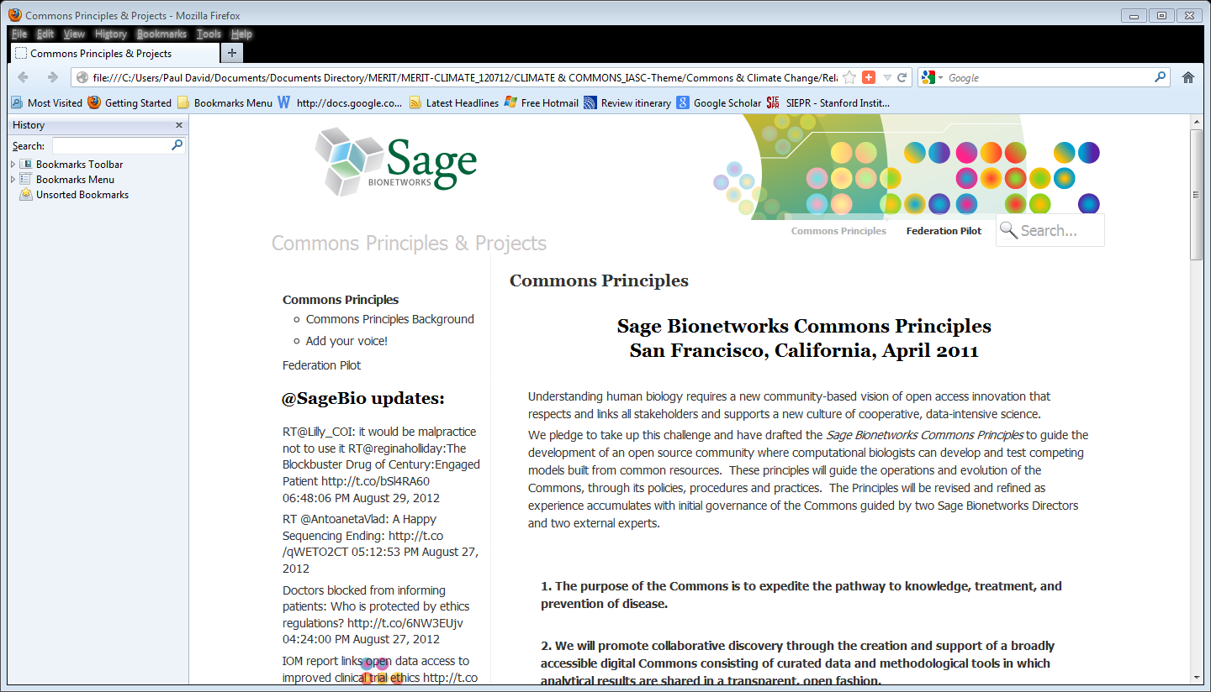
.
Case 2: Sage BIONETWORKS’ Drug Discovery Commons

Slide 68
SELECTIVE IMPLEMENTATION OF CONTRACTUALLY CONSTRUCTED COMMONS IN INTANGIBLE AND NON-EXHAUSTIBLE RESOURCES: EFFICIENT IPR POOLS
The case for efficient patent pools [see Shapiro, 2000;Lerner and Tirole, 2002]; rests on overcoming the obstacles to research and innovation posed by the growth of “ thickets” and designed complementarities in claims that create blocking patents.
Defense against anti-trust objections to pooling would be easier where there an empirical procedure for establishing the likelihood that an inefficient patent cluster, i.e., a “thicket” had formed.
Clarkson (2005) proposes and demonstrates an application of network analysis of patent citations to discover patent “thickets” where complementarities lead to frequent “co-citation”.
Dual pricing policies by foundations running public PRC-i’s, are potentially subject to abuse, and competition among the foundations will be limited if complementaries are to be internalized. So anti-trust supervision will be necessary here .

Slide 69
As the threat to the “open-ness” of open science system posed by the expansion and strengthing of IPR protection passed and the OA movement became established – with all its problems that call for remedies….
There has emerged movement to renew Open Science by transforming the production of scientific research and the distribution of its findings in ways that would both address long-recognized inefficiencies in Op Sci as a resource allocation system, and the respects in which communities of researchers in science remain hierarchically structured.
This welcome development continues to display the mixture of creativity, ingenuity and volunteered dedication in “tool-building,” including organizational innovations --on the part of people within the academically based open science communities, traits that served well its defense.

Slide 70
Beyond “defensive” measures – can the Open Science system be thoroughly re-engineered to make it ”better” and less fragile?
Visions of a future mode of doing science are inspiring and energizing pratical tool-building activities that are visible now on thousands of pages of the Web .
E.g., Daniel Mietchen’s …
Open source software has provided a metaphor for the possible emergence of a radically different and more effective model of producing useful knowledge…in the form of algorithms, and tools that permit fundamental restructuring of such work. But metaphors harbor dangers along with their ability to liberate thinking. There are serious problems in taking a metaphor to be a useful paradigm: the brilliant success of open source was grounded on features of software and the system within which its productions could readily be embedded. Code is self-validating: it compiles and runs, or the doesn’t, it admits of modularizations and semi-decomposability of its architecture – which opens the way for its production to be distributed and to scale…

Slide 71
Beyond “defensive” measures – can the Open Science system be thoroughly re-engineered to make it ”better” and less fragile? contd
Science conducted in the traditional open science mode is not like open source software development because it is not like software: software code is self-validating, but scientific findings relate to particular properties of large and complex natural systems, and their implications and interpretation often remain contextually determined and problematic.
As John Wilbanks (2009) pointed out, open source software’s success stemed because the environment in which it arose facilitated its development (and debugging) being distributed process. EXPAND (see “modern science’ for Wilbanks).
To avoid the dangers of embracing and commitment resources to forcing an inappropriate paradigm upon open science in the effort to “improve it”, it is important not only to understand how Open Source arose, but also to understand the open science system that we were fortunate to have inherited, to grasp the sources of its comparative efficiencies and their connect with the systems imperfections.

Slide 72
Tools for Open Science – an OKFN OP SCI Working Group Selection
http://science.okfn.org/tools-for-open-science/
In this page are listed a series of tools and services scientists can use to open their science. These are organized in different topics covering different facets of Open Science. Some of these tools are only targeted to certain fields of science, some are more general. Early 2013, the open science community is very active. New initiatives emerge every week and it is hard to be up to date. At the end of the page are links to other webpages tracking the creation and evolution of tools with different emphasis.
Share Your Data – share data with other scientists of your field
Site About
Publish all of your research outputs in seconds in an easily citable, sharable and discoverable manner. All file formats can be published, including videos and datasets that are often demoted to the supplemental materials section in current publishing models. figshare uses creative commons licensing to allow frictionless sharing of research data whilst allowing users to maintain their ownership.
Collaborate & Reproduce Previous Studies--Transparently document and archive studies with version control
Site About
Open Science The Open Science Framework (OSF) is part network of research materials, Framework part version control system, and part collaboration software. The purpose of the software is to support the scientist’s workflow and help increase the alignment between scientific values and scientific practices. The Reproducibility Project uses this system.
-
See more at: http://science.okfn.org/tools-for-open-science/#sthash.RbYdzvXe.dpuf
figshare

Slide 73
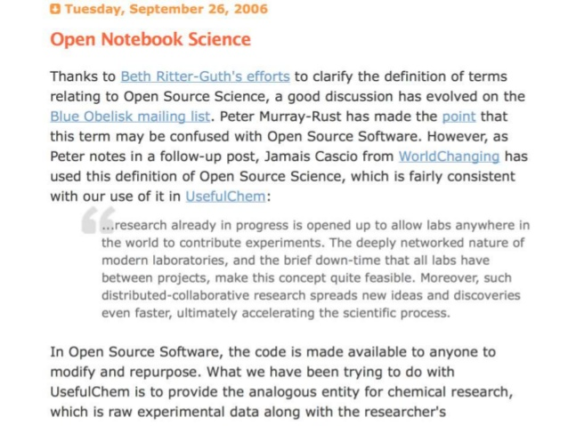
Toward the more radical “opening of Science”: OPEN NOTEBOOK Tools
notebooks.

Slide 74
Part V
A Cautiously Optimistic Conclusion

Slide 75
A cautiously optimistic conclusion 1
The main lessons and implications for the future vitality of open science institutions that can be drawn from an understanding of their origins, and the experiences of the past 15 years, is that research communities of this kind possess not only the technical and organizational ingenuity, but also the organizational capabilities to apply them to sustain key features of their distinctive “way of working.”
Society at large has benefited from this, since it served to protect the comparative efficiency if open science’s collaborative modes of conducting socially valuable exploratory, fundamental research.

Slide 76
A cautiously optimistic conclusion - 2
Moreover, researchers working in the open science mode have demonstrated their ability to generate attractive projects and proposals to radically restructure the way that science will be conducted in the future, so that it can more fully exploit the powers of digital information and computer-mediated telecommunications networks.
For these efforts to succeed will require that they also work to mobilize sustained adequate support from external, public and charitable sources of funding, and “top down” public policy and regulatory actions that will reinforce their informal norms. In the way OpSci communities will be able to reproduce its ethos in successive generations of university-trained researcher. researchers.

