Slide 1
What is Open Science and what role does it play in Development?
Leslie Chan
University of Toronto Scarborough
@lesliekwchan
Open Science, Open Issues
International seminar, workshops and Open Science work group meeting August 18-22, 2014 @ Rio de Janeiro, Brazil
Ciência Aberta, Questões Abertas
Seminário internacional, oficinas e encontro do grupo de trabalho em Ciência Aberta 18 a 22 de agosto de 2014, Rio de Janeiro, Brasil

Slide 2
Unpack the question and its assumptions
Introduce the Open and Collaborative Science in Development Network and its objectives
@ocsdnet
http://www.ocsdnet.org

Slide 3
Personal context
Open Access
Rights based approach to development
Critical reflection on “research” on development
Could these approaches transform the power relations among the various development actors?

Slide 4
Development?
The old model is broken. We need to create a new one…a vision for equitable human development, a healthy planet, an enduring economic dynamism
- Ban Ki Moon, UN Secretary General

Slide 5
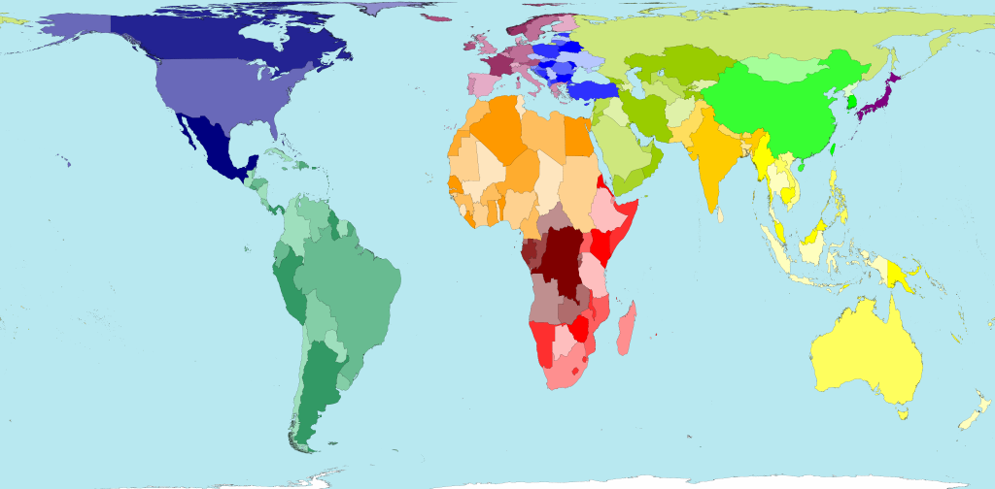

Slide 6
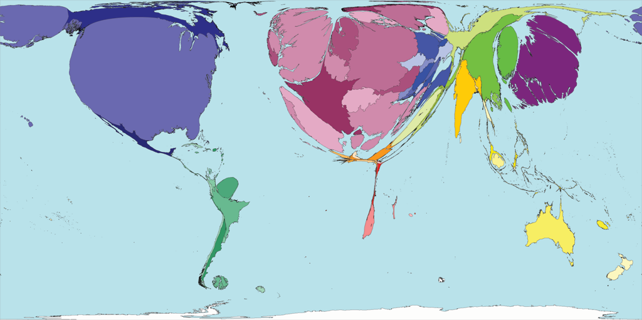
The World of Scientific Output According to Thomson’s ISI Science Citation Index
Data from 2002
http://www.worldmapper.org/display.php?selected=205
Notes:
Metrics of total publications and citations in 2002 according to Thomson’s ISI
Top 15 countries account for 82% of total publications
Author with African institutional affiliation account for less than 1% of global output, and S. Africa has the highest output. The rest are “invisible”
Consequence of trying to publish in “International” journal results in neglect of important local problems and solutions that are appropriate for local conditions.
==
Could Open Access begin to address the inequality in the global scientific system, with its structure of power based in the Global North and established criteria of “excellence” based on a set of narrowly defined metrics, particularly the Journal Impact Factor
More important, could OA improve participation of researchers from around the world, given the democratizing power of network technologies and new forms of social production? And ultimately, could the new form of participation and inclusion of voices and knowledge lead to better understanding of some of the core development challenges that face humanities around the world – namely poverty, inequality, inequitable health, food insecurity, and increasingly problems associated with climate change.
The new forms of social production, which Yochai Benkler called commons based peer production, is characteristic of a broad range of activities, from Open Source software development, to Open Educational Resources, Open Data (big data), Open government, Open business model etc., and more recently a broad approach to address the improvement of human well beings – that of Open Development.

Slide 7
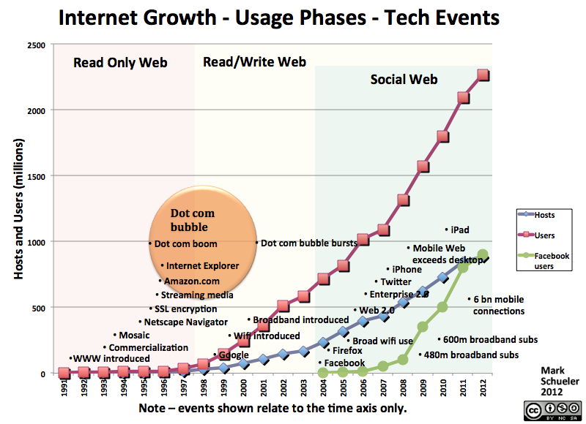
OPENNESS – ““Network Information Economy”
BOAI
Bioline
International

Slide 8
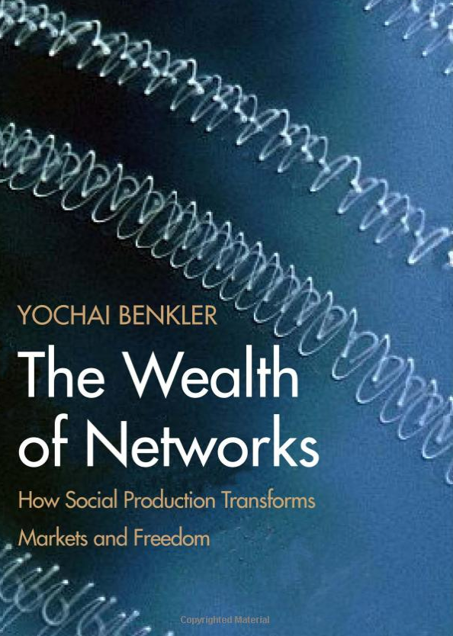
Benkler, 2006
“ What has Wikipedia got to do with the 49 percent of the population of Congo that lacks sustainable access to improve water resources?”
What are the potential impact of burgeoning non-market common-based production on the issue of justice and development?
Notes:
The emergence of the networked information economy has the potential to increase individual autonomy in three ways
Ease of access to tech
Non-proprietary alternatives
Access to individuals and expertise
The impact of burgeoning non-market common-based production on the issue of justice and development. Current dominant market-based production lays its foundation on the economic incentive for production and innovation. It relies on the proprietary protection to create exclusive rights as the core policy for growth and development. However, the system has many negative effects on the issue of distribution.
Can common-based production economy provide an alternative to the market-based economy by generating innovations and productions that can satisfy the needs of the poor?

Slide 9
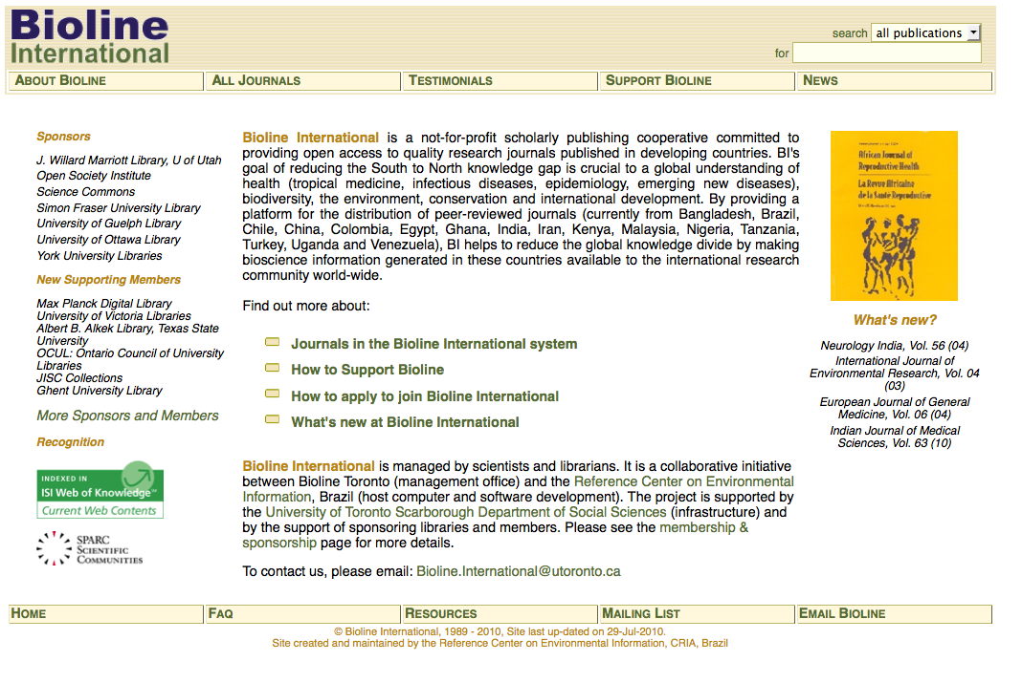
Personal Context
http://www.bioline.org.br

Slide 10
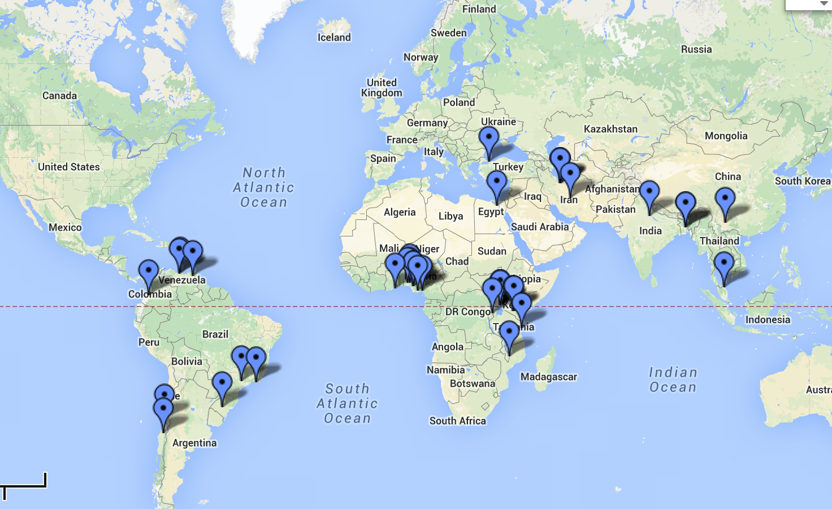
Journals on Bioline
http://goo.gl/cfR0dD

Slide 11
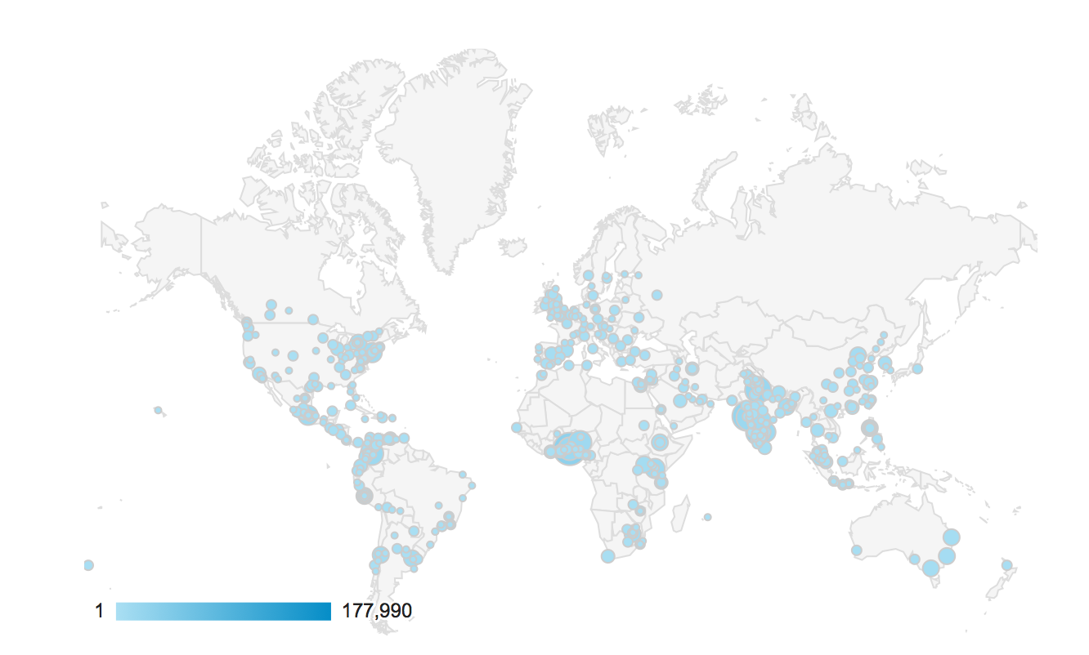
Sessions by cities: July 2013 – Aug. 2014

Slide 12
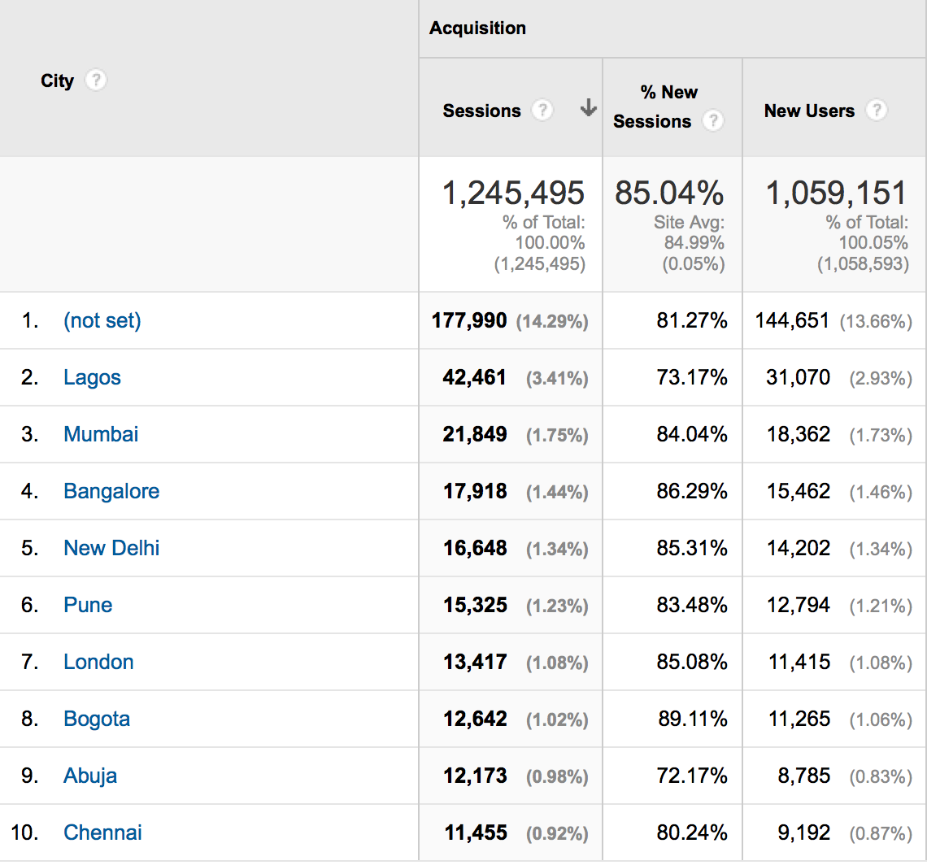

Slide 13
Will Open Access change the current power structure of global scientific production and dissemination?
OPEN ACCESS ?
Notes:
Will open access change the current power structure of global scientific production and dissemination?

Slide 14
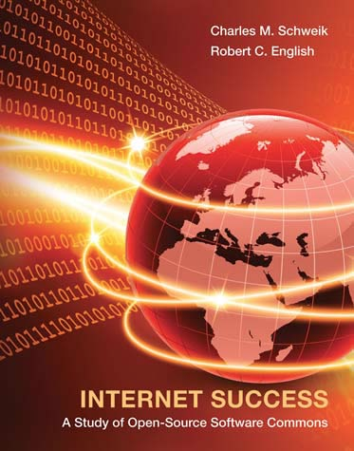
http://wealthofthecommons.org/
http://mitpress.mit.edu/books/internet-success
Notes:
“The Wealth of the Commons explains how millions of commoners have organized to defend their forests and fisheries, reinvent local food systems, organize productive online communities, reclaim public spaces, improve environmental stewardship and re-imagine the very meaning of “progress” and governance. In short: how they’ve built their commons.
In 73 timely essays by a remarkable international roster of activists, academics and project leaders, this book chronicles ongoing struggles against the private commoditization of shared resources – often known as “market enclosures” – while documenting the immense generative power of the commons. The Wealth of the Commons is about history, political change, public policy and cultural transformation on a global scale – but most of all, it’s about commoners taking charge of their lives and their endangered resources. It’s about common people doing uncommon things.”

Slide 15
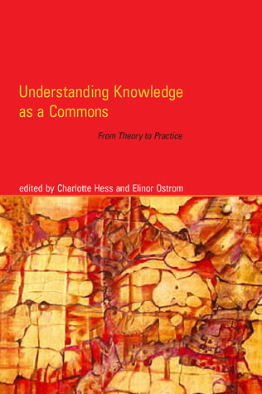
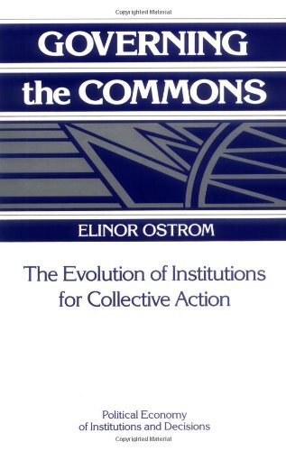

Slide 16
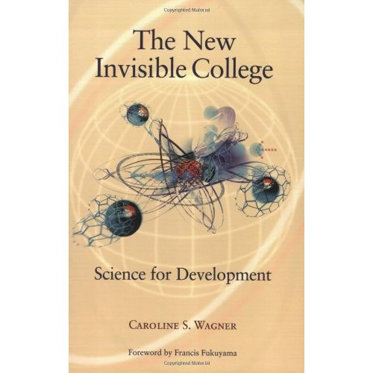
From “Big” science to Networked science
Knowledge for local problem solving
Notes:
he New Invisible College, Caroline Wagner combines quantitative data and extensive interviews to map the emergence of global science networks and trace the dynamics driving their growth. She argues that the shift from big science to global networks creates unprecedented opportunities for developing countries to tap science's potential. Rather than squander resources in vain efforts to mimic the scientific establishments of the twentieth century, developing country governments can leverage networks by creating incentives for top-notch scientists to focus on research that addresses their concerns and by finding ways to tie knowledge to local problem solving.
Movement towards more open science is an extension of a documented trend towards global networked science which some authors have already argued brings opportunities for developing countries to forge their own systems of science and innovation based on this new phenomenon and not replicate the systems in place in developed nations (Wagner, 2010). These changes are all occurring in the midst of tensions regarding the role of science in development, with a pull towards commercialisation and economic growth on one hand and the view of knowledge as a global public good to be shared on the other, which mirrors the broader development discourse introduced earlier. The extent to which open science impacts these agendas requires exploration.

Slide 17
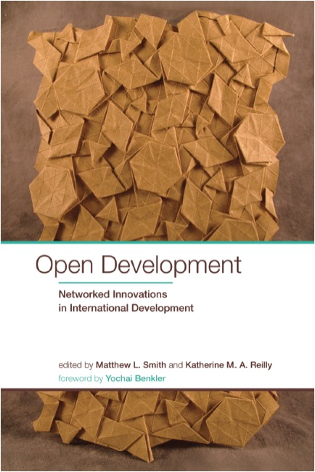
Notes:
general hypothesis - that open models and systems enabled by the Internet and pervasive technologies (such as mobile telephony), coupled with alternative Intellectual Property Rights regimes, may result in democratizing and network effects that can lead to greater access, participation, and collaboration in a number of fields and sectors – and IDRC is funding research in interrogating the quality of the effects on education, in science and knowledge production, government, and in social enterprise, part. The creative industries

Slide 19
What is the OCSDNet?
Funding:
Coordination
Notes:
IDRC funds researchers in the developing world so they can build healthier, more prosperous societies

Slide 20
Aim of the Network
To understand whether, and the conditions under which a converging set of open practices based on networked collaboration, collectively called “Open and Collaborative Science” (OCS), could lead to development outcomes in the Global South.

Slide 21
Could OCS lead to innovative models of redistribution of access to social justice, knowledge, wealth, individual freedom and well-being?

Slide 22
Open Science
“science carried out and communicated in a manner which allows others to contribute, collaborate and add to the research effort, with all kinds of data, results and protocols made freely available at different stages of the research process”
The RIN / NESTA report Open to All? Case Studies of Openness in Research
(2010)
http://www.rin.ac.uk/our-work/data-management-and-curation/open-science-case-studies

Slide 23
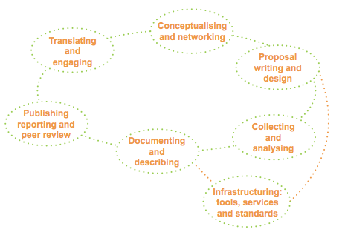
Only publications were make available in the traditional system
The RIN / NESTA report Open to All? Case Studies of Openness in Research
(2010)
http://www.rin.ac.uk/our-work/data-management-and-curation/open-science-case-studies
Notes:
The term open science describes not only accessibility to traditional research objects that people are free to use, re-use and distribute without legal, technological or social restrictions, but also describes the opening up of the entire research process from agenda setting to communication. Open science utilizes the increased prevalence of networked technologies to enable greater global research collaboration. This collaboration is not limited by the boundaries of traditional research communities but should also include the participation of citizen scientists, either in partnership with traditional research institutions, or those who participate in science in non-traditional research locations, often using open hardware and other open technologies.
OS also implies the relevance of a broad range of research outputs or artifacts – from software to curated collections to grey literature and other social artifacts

Slide 24
Social media
Public engagement
Collaborating writing
Open lab notebook
Citizen participation
Open Access
Open Peer Review
Open hardware
And software
The RIN / NESTA report Open to All? Case Studies of Openness in Research
(2010)
http://www.rin.ac.uk/our-work/data-management-and-curation/open-science-case-studies
Notes:
The term open science describes not only accessibility to traditional research objects that people are free to use, re-use and distribute without legal, technological or social restrictions, but also describes the opening up of the entire research process from agenda setting to communication. Open science utilizes the increased prevalence of networked technologies to enable greater global research collaboration. This collaboration is not limited by the boundaries of traditional research communities but should also include the participation of citizen scientists, either in partnership with traditional research institutions, or those who participate in science in non-traditional research locations, often using open hardware and other open technologies.
OS also implies the relevance of a broad range of research outputs or artifacts – from software to curated collections to grey literature and other social artifacts

Slide 25
Benefits of Open Science
Improving the efficiency of research – minimize duplication
Accelerating the pace of discovery
Enable cross-disciplinary research
Promoting scholarly rigour and reproducibility
Improving the quality and scope of scientific outputs
Enhance collaboration and greater inclusion
Promoting scientific engagement and literacy for the public
increasing the economic and social impact of research
Providing new opportunities for innovation

Slide 26
Open Science – A Typology
Knowledge as Public Goods
Access to knowledge is highly inequitable
Making scholarly knowledge freely available to everyone
Pragmatic
Open Collaboration is more efficient for knowledge creation and discovery
Citizens, Scientists, Non-government Organizations
Network infrastructure and tools are essential for open collaboration
Creating open platforms, tools and services for scientists
e-Infrastructure
Public Engagement
Science is a public enterprise and should be made publicly accessible
Scientists, policy makers, funders, citizens
Open Access, Open License, Open Data, Open Source
Opening up the process of knowledge discovery as early as possible
Scientists, tool developers
Open Data, Open Source, Crowd-sourcing, Open Access, Open License
Scientists, platform designers and providers
Defining Standards and Interoperable protocols for knowledge exchanges
Engaging citizens in design and conducting research
Social media platforms (Facebook, Twitter, blogs etc.), Crowd-sourcing
Value System
There is a need to create new metrics and incentive
Developing Alternative metrics and more inclusive system of evaluation
Scientists, Funders, Policy Makers
“Altmetrics, open peer review, openness indices
Assumption
Actions
Actors
Tools and
Strategies
Complexity of Openness
After Fecher and Friesike (2013)
Notes:
Input
Knowledge, innovation, capacity to communiate
Actors
Researchers/scientists academic publishing industry, funding bodies, government, learned societies, and higher education and other research institutions
Outcomes
Change in research culture
Accelerated discovery
Broadened benefits
New Metrics

Slide 27
Goals - Practical
Fund and support a number of diverse case studies in order to build a body of empirical data
Foster a network of OSC practitioners, thinkers, mentors, and advocates
See the call for proposals
http://ocsdnet.org/article/application

Slide 28
Goals - Theoretical
Develop a conceptual framework that serves as a comprehensive theory of change
Understanding the actors, motivations, and mechanisms that enable new kind of networked-institutions and practices
Adopt a critical approach to examining the embedded assumptions behind various models of open collaboration and theories of change.
Studying OCS is as complex socio-technological system and not simply a collection of mechanisms

Slide 29
Goals – longer term
Strengthening local infrastructure and research capacity and
Informing and enabling policy-making
Aligning incentive structures and institutional framework

Slide 30
Theoretical framework
Theory of change
Methodological Approaches
Institutional Framework and Development Analysis
Potential Outcomes
Research Questions
How does Open Science lead to new kinds of Development outcomes?
Access to outputs,
Wider participation in framing research questions
Sharing of technologies and processes
More collaborative and inclusive approaches to the conduct of research
What value framework is a prerequisite/condition) for open science?
How can non-market based peer production of knowledge improve human well-being?
How can science be made more open and inclusive?
Notes:
Multidisciplinary

Slide 31
Theory of Change

Slide 32
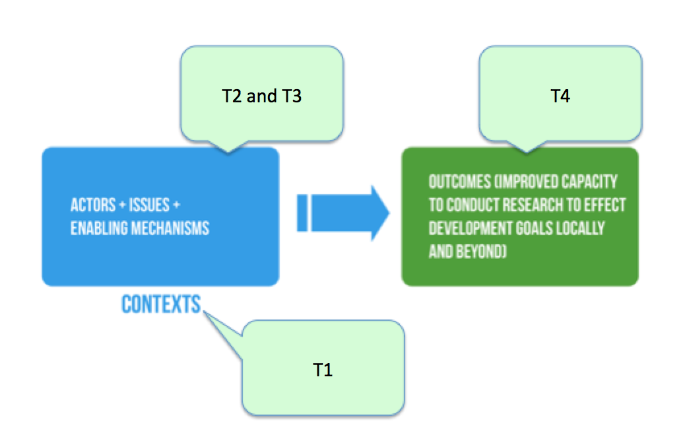
Theme 1 (T1): Motivations (Incentives and Ideologies)
Theme 2 (T2): Infrastructures & Technologies
Theme 3 (T3): Communities of practice in Open and Collaborative Science
Theme 4 (T4): Potential Impacts (Positive and Negative) of Open & collaborative science

Slide 33
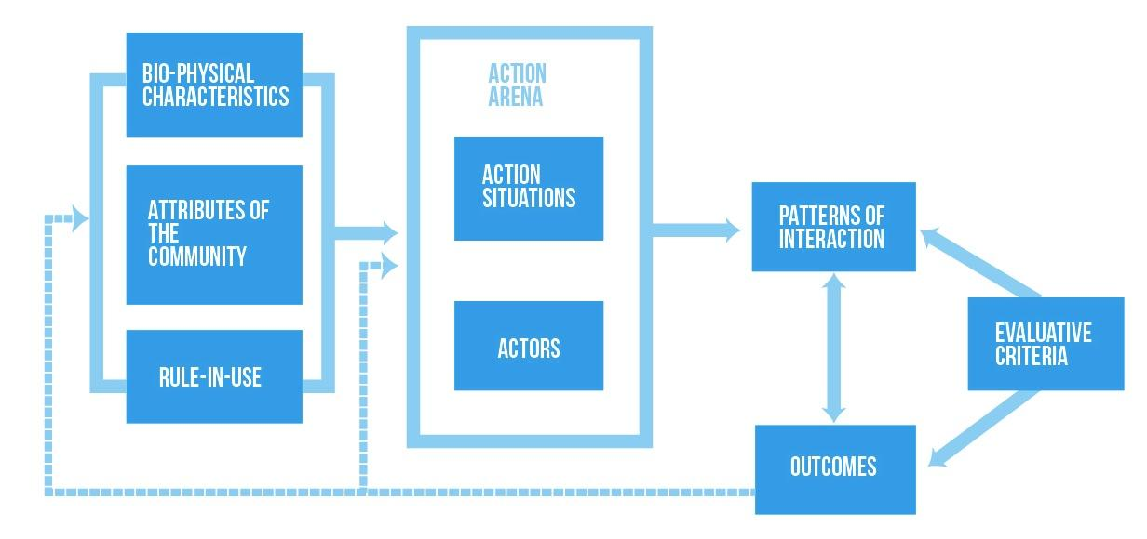
“How do fallible humans come together, create communities and organizations, and make decisions and rules in order to sustain a resource or achieve a desired outcome?” (Hess 2005: 3)
. Institutional Analysis and Development (IAD) Framework (from Ostrom, 2005)

Slide 34
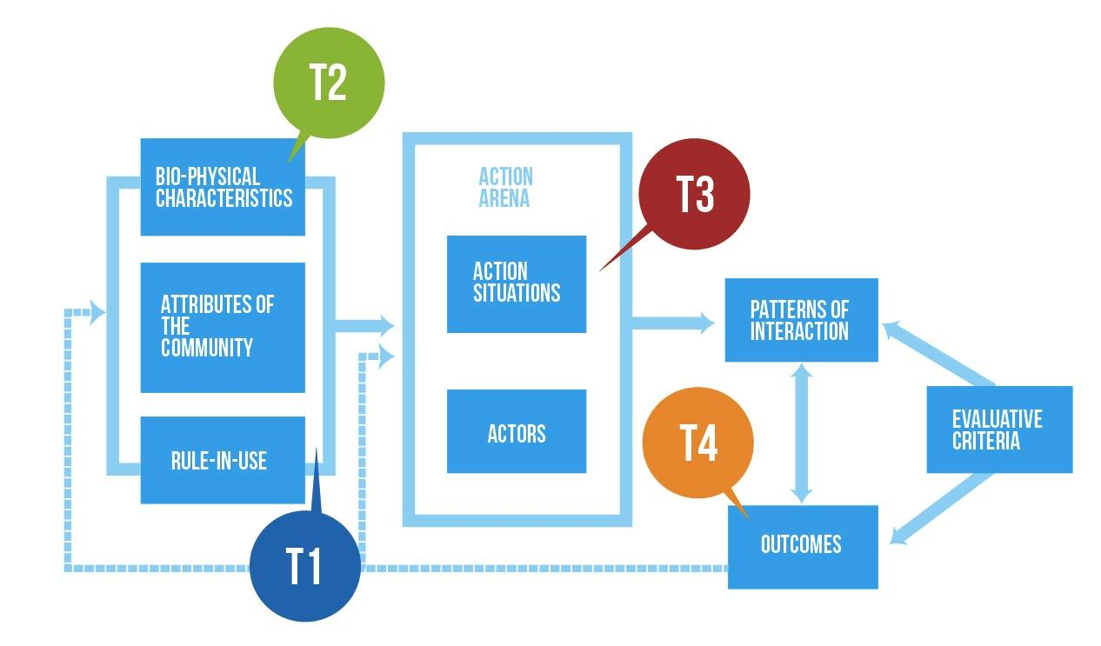

Slide 35
Questions?
http://www.ocsdnet.org
Twitter: @lesliekwchan
@ocsdnet

